Slide 1
Coast Guard Mutual Assistance
Notes:
Pre-presentation: Get to know your audience, mingle, learn names & faces, ask homes of record, seek common experiences…
Have allotment forms/campaign materials on tables
Welcome (esp Distinguished persons, audience members)
Introduce self/role
Connect with this audience:
(To connect, consider using an open-ended or polling question, commonality, anecdote, interesting fact…)
Present: Intro CGMA/centennial year (logo)
Goal of this Presentation goal: Audience will learn “The Big 4”
Who we are
Who we serve
How we help
How we are funded
_________________________
CAMPAIGN COORDINATOR ADDITIONAL LEARNING RESOURCES:
Find out more about our first CENTURY OF SERVICE here.
2022 Annual Report (Replace with 2023 Annual report when it’s available)
1924 Annual Report for historic perspective

Slide 2
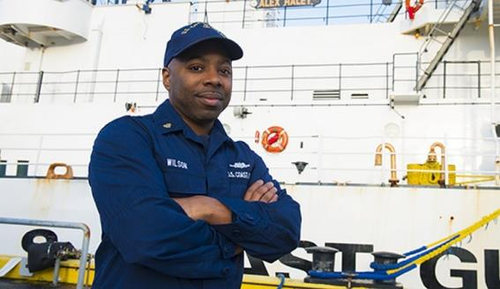
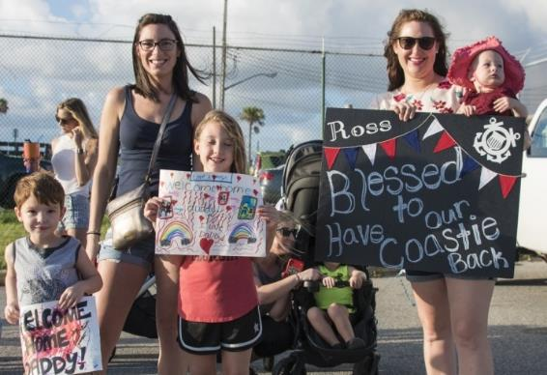
WHO IS CGMA?
The Coast Guard’s only official aid organization
A 501(c)(3) nonprofit organization
Coast Guard people helping Coast Guard people
A place to get an interest free loan or grant, even if you do not donate
A beacon of hope in times of trouble
Notes:
Key points:
CGMA is THE ONLY official Coast Guard aid organization
Private nonprofit.
Not a government entity/No government funding
4-star Charity Navigator rating
Who we serve:
Active-duty
CG Aux
Chaplains, Public Health Officers, & Civilian Employees serving the CG
CG Reservists
Retirees
Surviving spouses
_______________________
CAMPAIGN COORDINATOR ADDITIONAL LEARNING RESOURCES:
CGMA is the official relief society of the US Coast Guard. While CGMA works closely with the Coast Guard, it is an independent nonprofit charitable organization. It is established and operated by Coast Guard people for Coast Guard people.
MISSION: To support the financial resilience of the Coast Guard community.
VISION: Always Ready through our steadfast commitment to responsible financial management, equipped with adaptable, innovative, and inclusive solutions to help our own navigate dynamic financial challenges.
GUIDING PRINCIPLES: All actions of Coast Guard Mutual Assistance Board of Directors members, Representatives and staff members are governed by the following principles:
To help members of the Coast Guard family achieve autonomous financial well-being.
To foster self-respect and self-worth.
To assure applications for financial assistance are treated confidentially.
To treat all members of the Coast Guard community in an honorable and respectful manner.
To provide assistance in a timely manner.
To consistently apply our guidelines and principles fairly and equitably to all.
To make decisions based on the merits of individual cases.
Almost everyone associated with the U.S. Coast Guard is eligible to request assistance. Many programs can be used for spouses and children of the member.
For reference and clarity, the Coast Guard Foundation (CGF) is NOT connected to CGMA at all. It is an entirely different organization, with a different mission, history, & focus. They are not congressionally established.

Slide 3
Coalition of Relief: Serving 2.5 million
Over 600 CGMA representatives
at 127 shore units and
53 cutters in 39 states & territories
across 19 time zones
Notes:
Key Points:
Describe our Coalition.
Give example in your own words: “PCSing across the country… car breaks down near Ft Leavenworth, KS… get help from Army base…”
Help is available to your and your co-workers 24/7.
What we do NOT do:
No Credit checks
Does not affect your security clearance or credit score
Does not limit the number of times you receive CGMA assistance during your career
_______________________
CAMPAIGN COORDINATOR ADDITIONAL LEARNING RESOURCES:
CGMA has agreements with the American Red Cross, the Air Force Aid Society, the Army Emergency Relief, and the Navy-Marine Corps Relief Society.
Coast Guard military members may receive emergency assistance from these organizations when CGMA is not available, and CGMA will provide assistance to their members when their aid society is not available.
In all cases, the aid society for the member’s branch must approve the assistance.

Slide 4
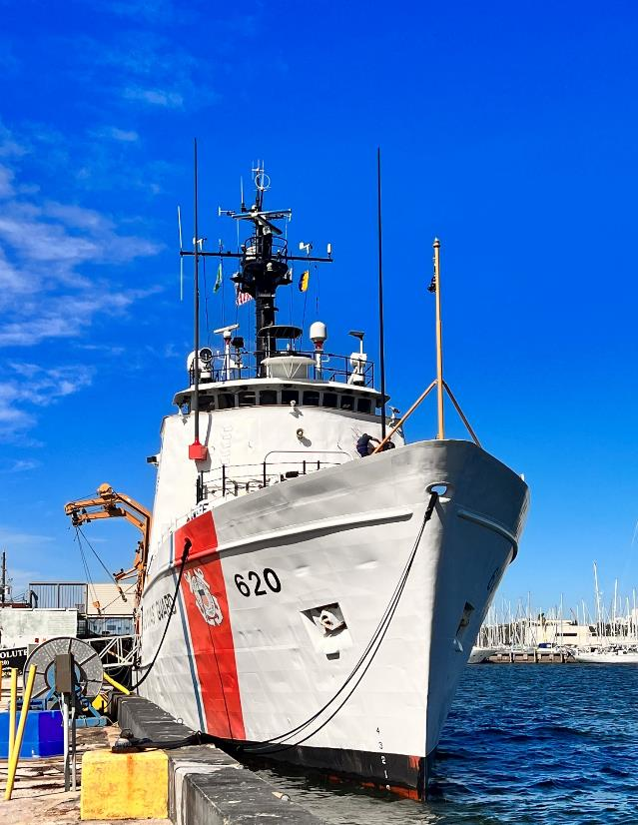
Our mission is to enable financial resiliency within the Coast Guard Community.
Disaster & Emergency Relief
Day-to-Day Support
Education Assistance
GRANTS AND ZERO PERCENT LOANS ensuring short-term financial challenges don’t become long-term financial problems
Notes:
How we help
Highlight the “3 buckets of financial assistance” (Disaster relief, Day-to-day Support, Education Assistance)
Key points:
Mission: Financial resiliency
Grants (free, no need to payback)
0% interest loans (repay over time)
Key Phrase: CGMA works to ensure that short-term financial challenges don’t become long-term financial problems
_______________________
CAMPAIGN COORDINATOR ADDITIONAL LEARNING RESOURCES:
CGMA provides a way to extend compassion to one another in times of need. It serves as a vital financial safety net, promoting financial stability and general wellbeing, fostering high morale, and encouraging a sense of loyalty to the Coast Guard.
We provide interest-free loans, grants, counseling, referrals, and other help. Our assistance programs focus on situations requiring immediate attention for essentials and solving temporary problems.
Explore this link to find out more about:
CHILDREN, DAY-TO-DAY,DISASTERS, EDUCATION, EMERGENCIES, FAMILY, FAMILY BUILDING, FINANCIAL, HEALTH AND SAFETY, HOUSING, MILITARY LIFE/PCS, SPOUSES

Slide 5
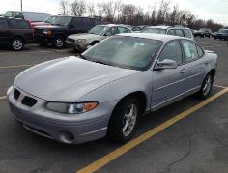
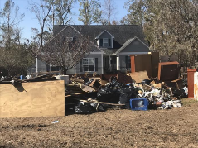
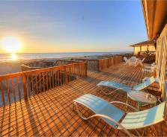
CGMA ASSISTANCE
helps fund
does not fund
Life’s essentials
Immediate needs
Temporary problems
Non-essentials, wants
living beyond your means
Long-term support
Notes:
Highlight green checks and red x’s
“Each of CGMA’s grant and interest-free loan programs are purposefully designed to ensure that short term financial challenges do not become chronic financial problems.”
“We recognize that life is unpredictable, and it is impossible to account for every possible situation. So if there is a short term financial need that doesn’t fit into one of these standard programs, please reach out to your local Rep. We will do all we can to help.”
CGMA is CG people helping CG people. This requires EFFECTIVE STEWARDSHIP of donated funds.
_______________________
CAMPAIGN COORDINATOR ADDITIONAL LEARNING RESOURCES:
CGMA IS FOR:
Life (food, water, shelter, transportation), utilities, disaster, education, unexpected budget biggies...
CGMA assistance is NOT normally authorized for:
Long-term, continuing, or frequent assistance
Legal fees
Personal credit card balances
Taxes
Gambling debts
Business ventures
Marriage or divorce costs
Vacations
Non-emergency furnishings or cars
Disciplinary costs
Any costs related to a second home or rental property
Personal, unspecified loans

Slide 6
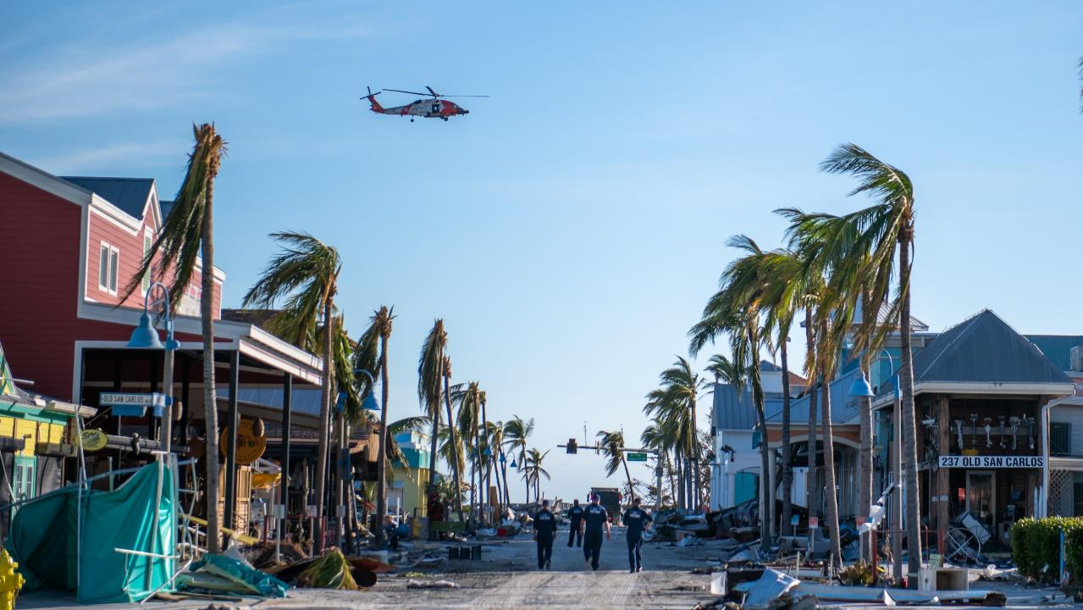
Disaster & Emergency Relief
Notes:
Disaster Assistance
Our “1st bucket of funding assistance” - Generally, this is our deepest financial bucket.
Audience engagement question: Can anyone tell me where this picture might be from? (Hurricane Ian, 2022)
On Sept. 28, 2022, Category 4 Hurricane Ian made landfall near Cayo Costa in Lee County, Florida as one of the most powerful storms in U.S. history. Ian brought death and destruction to Fort Myers Beach and Lee County's other barrier islands as deadly storm surge as high as 15 feet was pushed onto land.
The CG was there. So were Coast Guard families…
But CGMA was there, too.
Re-tell MST2 Benson’s story in your own words.
_______________________
CAMPAIGN COORDINATOR ADDITIONAL LEARNING RESOURCES:
(MST2 Benson story located in 2022 Annual Report, Pg 12)

Slide 7
Disaster & Emergency Relief
Basic Living Expenses
Car and Home Repairs
Emergency Travel Expenses
Evacuation Assistance
Funeral Expenses
Loss of Funds
Medical & Dental Costs
Spoiled Food Replacement
Temporary Living Expenses
Notes:
Audience engagement:
Tell… the audience to look this list over. (Give them a moment.)
Ask… them “Which ones would you like to hear more about?” Or “Which ones are most likely to affect you and your co-workers?”
Highlight… a few of these. (Be prepared to knowledgeably share about any/all of these)
_______________________
CAMPAIGN COORDINATOR ADDITIONAL LEARNING RESOURCES:
Who helps the helpers? We do. In major disasters such as hurricanes and typhoons and personal disasters like fires, the Coast Guard community can count on CGMA as a trusted and reliable resource. CGMA has loans and grants for a range of needs from evacuation, to replacing essentials and starting repairs.
https://mycgma.org/programs/disaster-assistance/
https://mycgma.org/programs/?cat_id=14

Slide 8
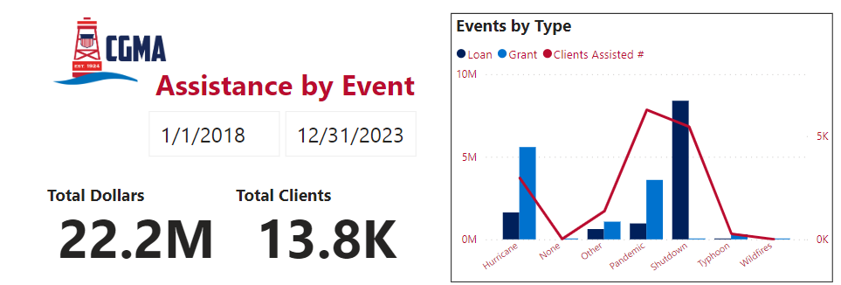
Disaster & Emergency Relief
Notes:
Shutdown - $8.5M in just 35 days
Pandemic - $3.5 M in grants, $4.4 total COVID assistance
Hurricanes - $5.4M
Typhoon Mawar - $308,312
Other – Texas winter storm, PR power outage, D14 Water issue, Various pay issues

Slide 9
Day-to-Day Support
Notes:
Day-to-Day Support
Our 2nd bucket of funding assistance - our most diverse bucket
Lots of niche categories: Includes Housing, Transportation, Family, Special Needs, Pets
_______________________
CAMPAIGN COORDINATOR ADDITIONAL LEARNING RESOURCES:
https://mycgma.org/programs/?cat_id=15

Slide 10
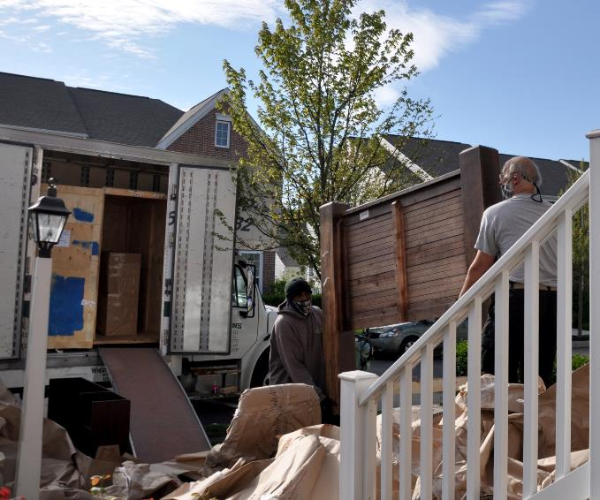
Housing Assistance
Rental Assistance Loan
Closing Costs Loan
Household Furnishings Loan
Utility Startup Loan
DLA Supplemental Grant
PCS Incidentals Loan
Notes:
Highlight a couple of these programs designed to help establish a new residence.
Rental assistance loan for first and last month’s rent/security deposit.
Both the rental assistance and closing cost loan were increased from $6,000 to $9,000.
DLA Supplemental Grant - $1,000 if required to move outside of a PCS due to no fault of the member
_______________________
CAMPAIGN COORDINATOR ADDITIONAL LEARNING RESOURCES:
https://mycgma.org/programs/?cat_id=25

Slide 11
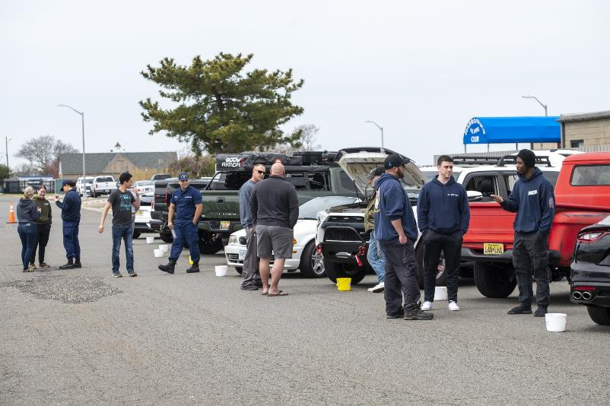
Transportation Assistance
OCONUS Car Rental Loan
Vehicle Shipment Loan
Vehicle Repair
Notes:
(Keep an eye on elapsed time. 1/2 way thru slides)
Regarding Vehicle repair 0% interest loan - CGMA can help with:
Major, unexpected repairs to primary vehicle.
Major, unexpected repairs to secondary vehicle if necessary for family needs.
Pending insurance settlement.
Parts- if member is performing their own repairs.
_______________________
CAMPAIGN COORDINATOR ADDITIONAL LEARNING RESOURCES:
https://mycgma.org/programs/?cat_id=21

Slide 12
Family Support
PCS Childcare Grant
Childcare Loans
Special Needs Grant
Breast Milk Shipment Reimbursement (Grant)
Pet/Quarantine Expense Loan
Adoption Assistance - Grant and Loan
Assisted Reproductive Services Loan
Baby Supplies (Layette)
Funeral Expenses
Elder Care Loans
Notes:
Highlight the ones you think might be relevant to your audience.
Remind them that time in the presentation is limited, but that you will be available to discuss details of these programs and deeper questions after the presentation.
_______________________
CAMPAIGN COORDINATOR ADDITIONAL LEARNING RESOURCES:
https://mycgma.org/programs/?cat_id=28

Slide 13
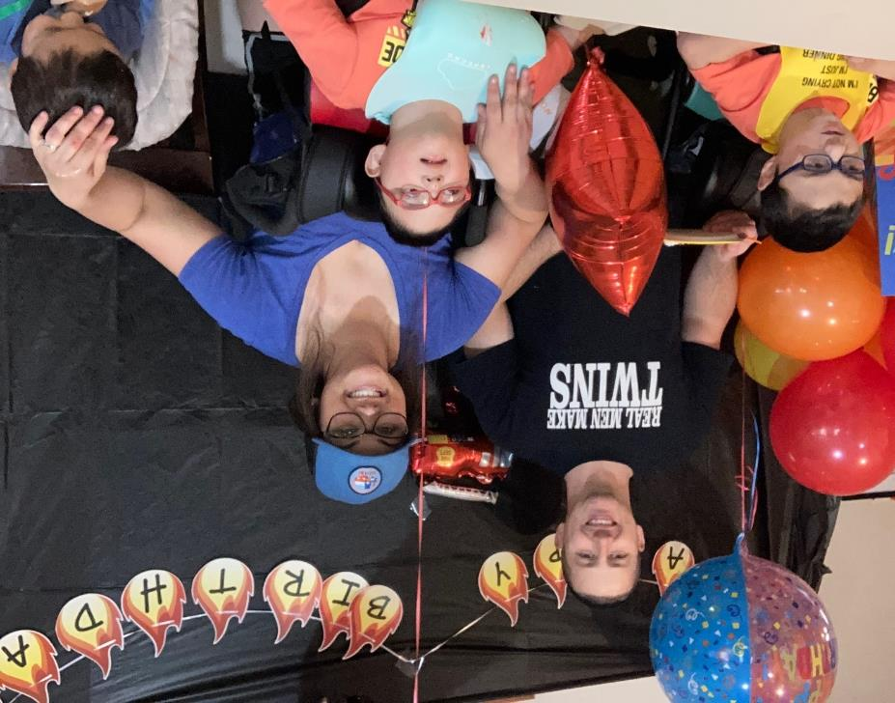
“We are very grateful that we are going to be able to PCS with the support of childcare assistance, a cooling vest, and more. We know this will help alleviate our worries as we travel with our medically fragile boys. Thank you so much for your support!”
— AETC Theodore &
Elizabeth Trout
Notes:
(Consider updating: When 2023 Annual Report is released, consider replacing with a more recent story.)
Introduce the Trout Family
Tell this story in your own words.
_______________________
CAMPAIGN COORDINATOR ADDITIONAL LEARNING RESOURCES:
(Full story found in 2022 Annual Report, pg 9)

Slide 14
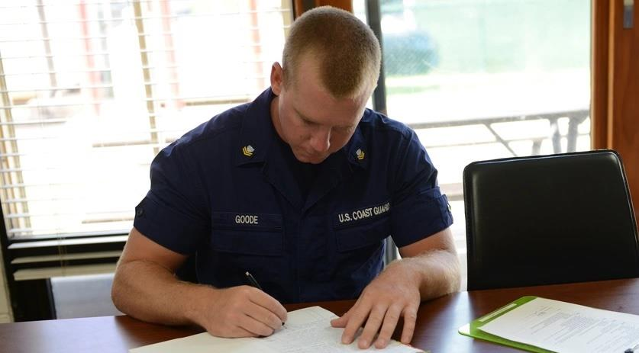
Education Assistance
Notes:
Our 3rd bucket of money - and “The most popular” bucket. (Meaning it serves the most people)
This one has potential to change YOUR future and your family’s legacy

Slide 15
Education Loan Program
GRANTS
Supplemental Education Grant
Education Advocate Grant
Stafford/Plus Loan Fee Grant
Financial Counseling Grant
Financial Education Childcare Grant
LOANS
Education Loan
CG COOL Loan
Spouse Professional Rqmts Loan
Debt Mgmt Loan
Notes:
Audience engagement: Have audience take their phones out and take a picture of this slide to look at or share with someone later.
Update on SEG: $750 annually. Computer reimbursement every 3 years.
Highlight a couple other programs that might be of particular interest to this audience.
Transition statement:
“Now you know who we are, who we serve, and how we help… so how are we funded? I’m glad you asked!”
_______________________
CAMPAIGN COORDINATOR ADDITIONAL LEARNING RESOURCES:
https://mycgma.org/programs/?cat_id=16

Slide 16
How is CGMA funded?
Coast Guard people helping Coast Guard people!
Notes:
CGMA IS FUNDED BY YOU!
YOU make all of this happen!
CGMA (YOU!) helped 1 in 7 active duty service members in 2023.
Consider beginning or updating your allotment today. Forms are on the tables or you can start allotment online.
$5/mo or $200/mo… it all makes a difference in the lives of Coasties
Coast Guard people helping Coast Guard people!
_______________________
CAMPAIGN COORDINATOR ADDITIONAL LEARNING RESOURCES:
https://mycgma.org/give-help/
Since 1924, CGMA has proudly served the Coast Guard community. We invite you to join us in Helping Our Own with a donation that is meaningful to you. With your support, Mutual Assistance will provide direct financial assistance to help ease the burdens and relieve the financial strain for Coast Guard members in need. CGMA does not receive any government funding. We rely on your contributions, along with loan repayments and investment income. Thank you for giving as generously as you can!
Website has info on all these giving tools:
ALLOTMENT / PAYROLL DEDUCTION
GIVE ONLINE
LEGACY GIFT / PLANNED GIVING
DONATE STOCK
MEMORIAL OR TRIBUTE GIFT
VOLUNTEER

Slide 17
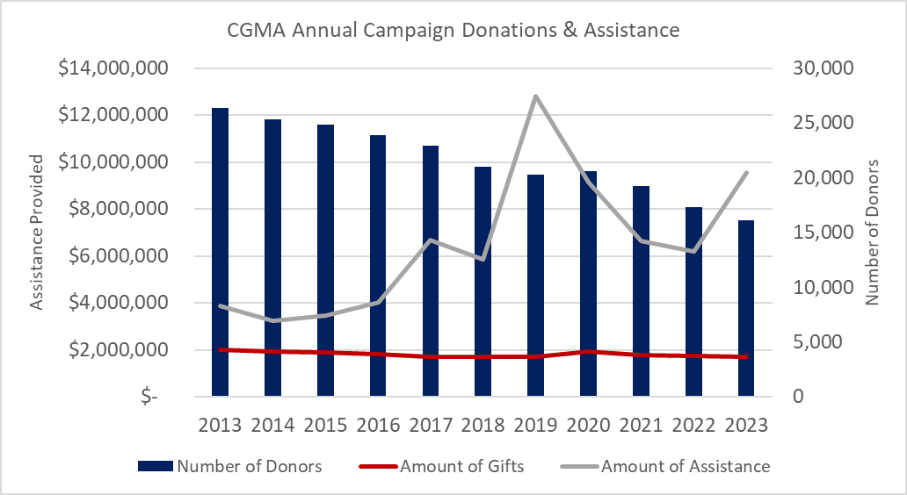
How is CGMA funded?
Individual contributions
Return on investments
Corporate gifts
CGMA receives no government funding.
Notes:
Despite all the assistance that has been delivered in the last century, and more specifically since the 2019 lapse in appropriations, pandemic and busy weather seasons, active duty donors and donations have continued to fall.
The Annual CGMA Fundraising Campaign is held each year to generate revenue needed for CGMA programs. Without an annual infusion of funds, CGMA would deplete its resources and be unable to provide assistance. This is true of most charitable organizations.
This year, in recognition of these 100 years of extraordinary support of the Coast Guard community, we’re challenging everyone to give back. 100 for 100.
Our goal this year is 100% unit participation. Starting an allotment of just $1.00 a month has the power to make a lasting impact in the life of a struggling shipmate.
For every dollar donated in 2023, CGMA provided $2.28 in assistance. Your donation goes further with CGMA.
Donation forms are available today or you can set up an allotment online today.

Slide 18
THANK YOU!
MyCGMA.org | 800-881-2462 | CGMA@MyCGMA.org
Notes:
Wrap up:
Three buckets of assistance…
Audience engagement: Trivia question/giveaways… “Can anyone name the 3 buckets” (Disaster, Day-to-day, Education) Give frisbee, coins, etc…
Consider supporting your fellow Coasties. Remember: Celebrate 100 for 100! (100% participation for our 100 years of service.)
Note web address, phone, and email. Suggest audience take another picture.
Remain for Q&A
Thank everyone.

