Slide 1
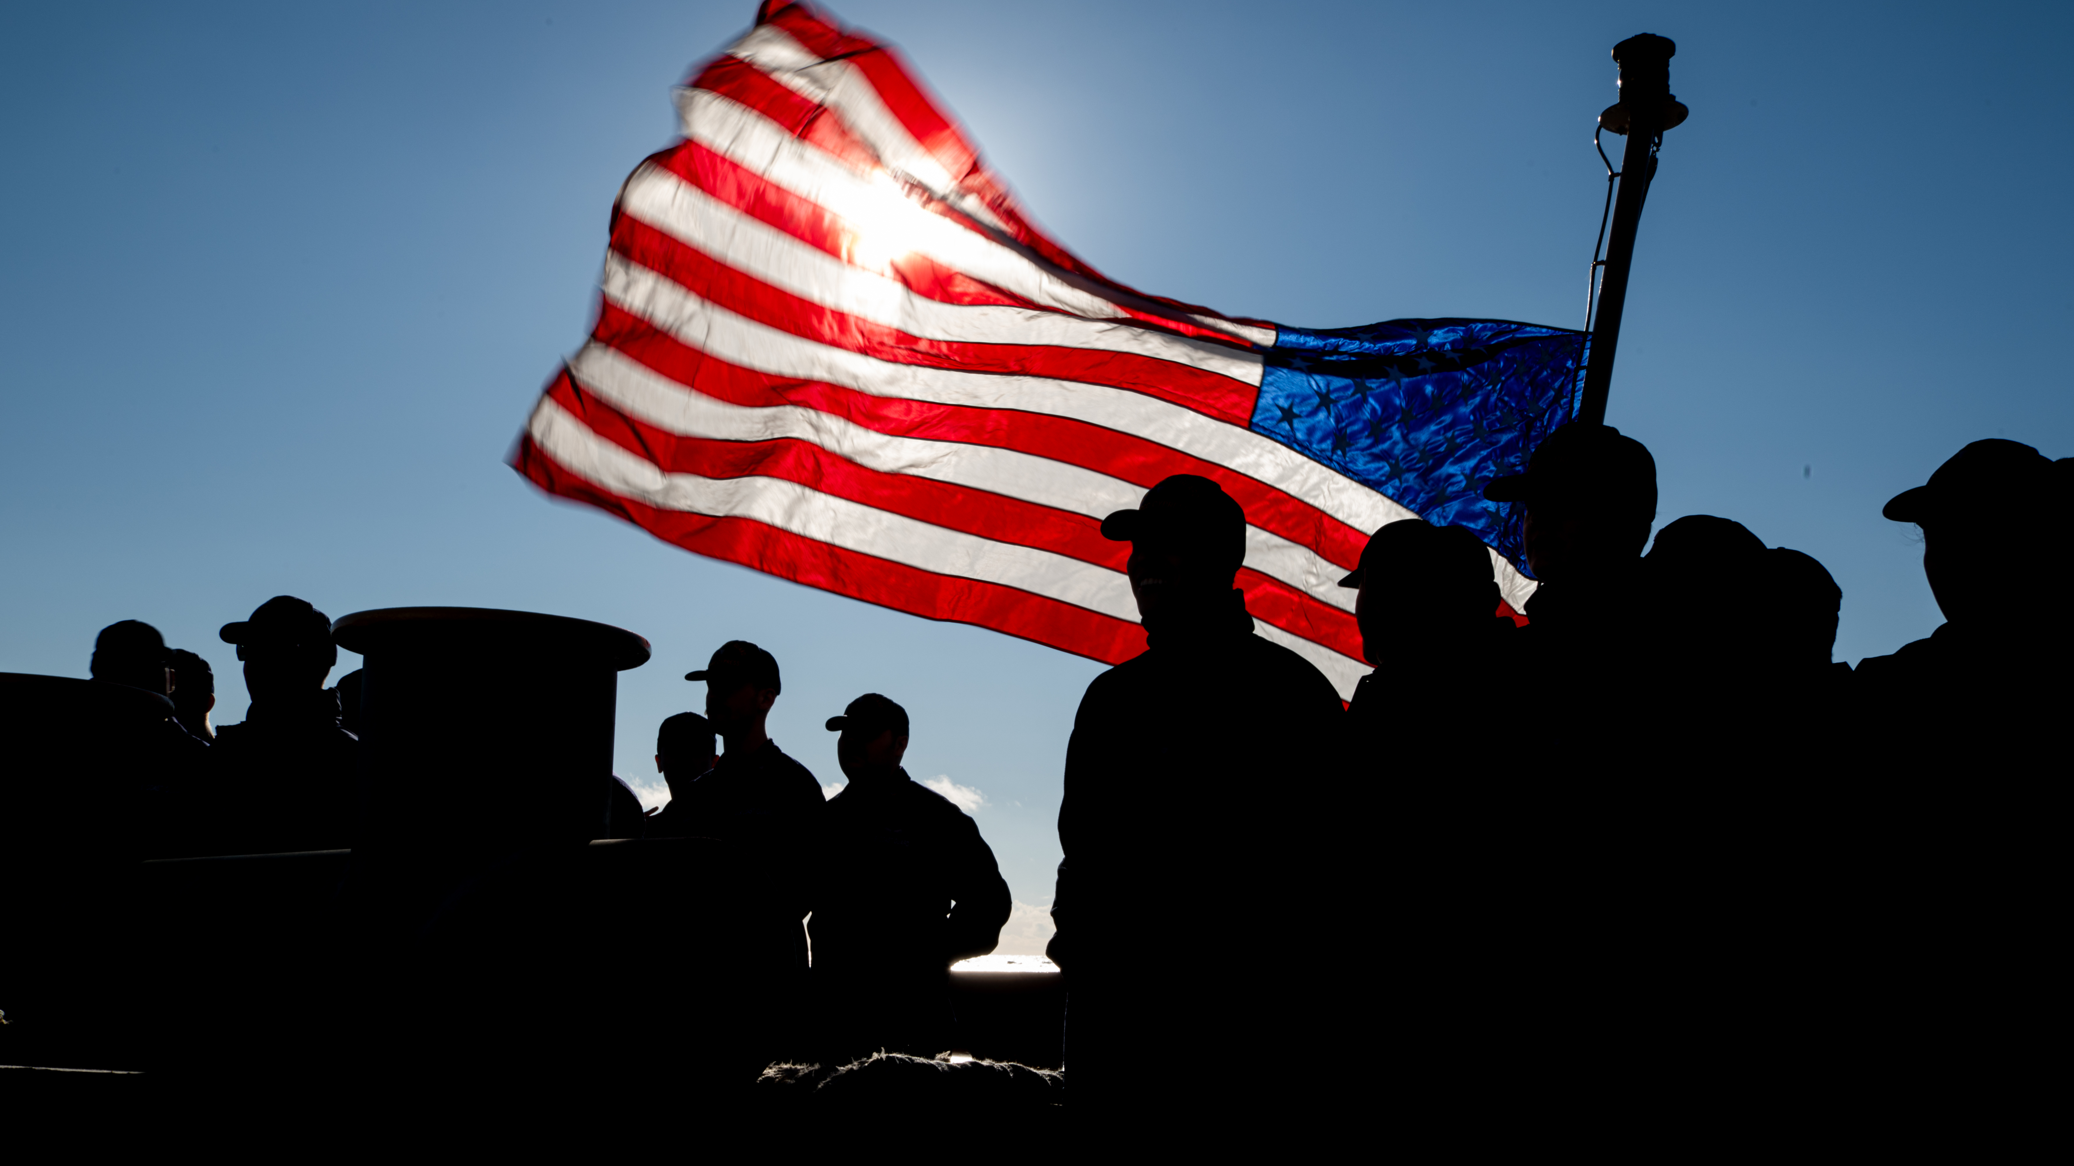
THE POWER OF US
2025 ANNUAL FUNDRAISING CAMPAIGN
April, 2005
Notes:
PLAY VIDEO TO START THE MEETING IF POSSIBLE
Thank you all for joining us today. My name is, [insert rank/name] and I'm the Campaign Coordinator for this year's CGMA Fundraising Campaign. This campaign is about taking care of our own - we all serve side by side, and part of that service means looking out for each other - not just in our daily mission, but in times of personal need. Support of CGMA helps us help our own.

Slide 2
Notes:
Link to video: https://www.youtube.com/watch?v=49Z7xfNw7f8

Slide 3
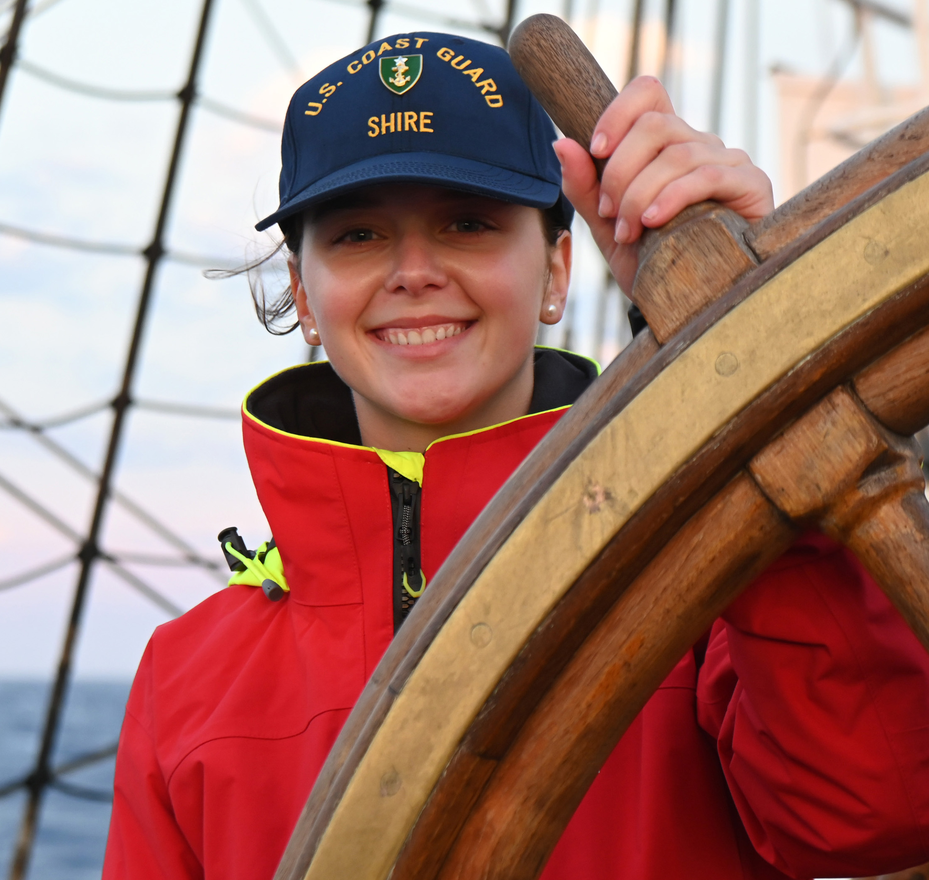
AGENDA
Who is CGMA
CGMA assistance
Why Give
Unit Goals
Ways to give
Local Fundraising Events, if applicable
Q&A
Notes:
Some of you may be aware of who CGMA is and what they do - I'm going to talk about all of the programs they provide and how you can help CGMA continue to offer support to your fellow Coasties.
I'll cover, Who CGMA is - what assistance they offer, why you should give and how to give. I'm also going to cover our unit goals and share some upcoming fundraising events we're planning and then I'll open it up to Q&A.

Slide 4
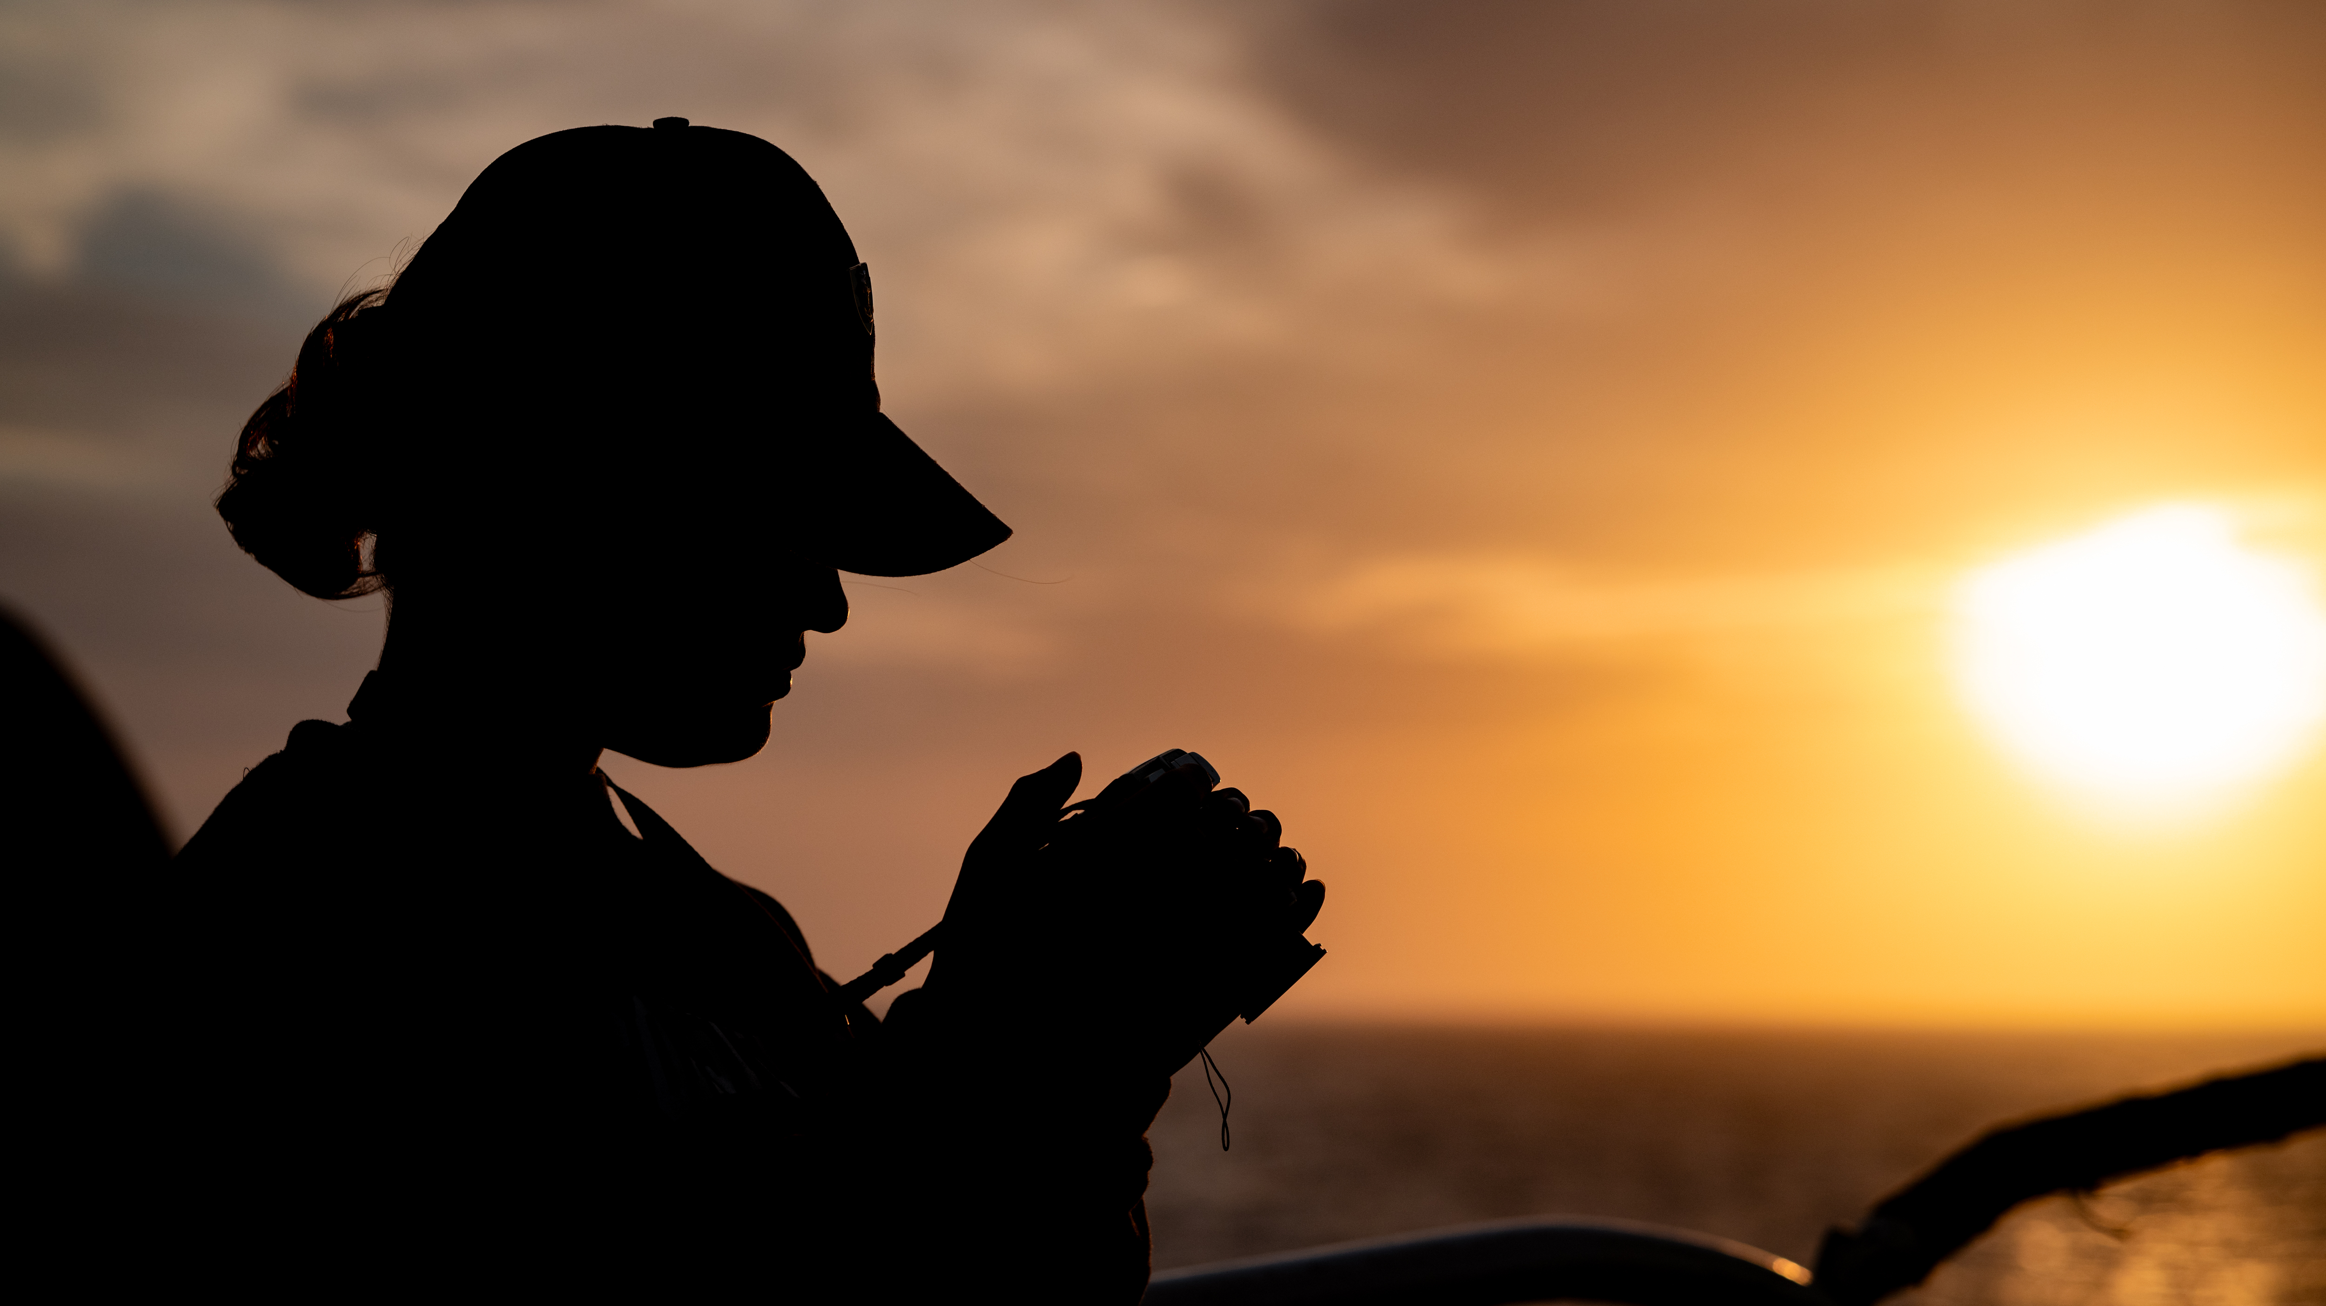
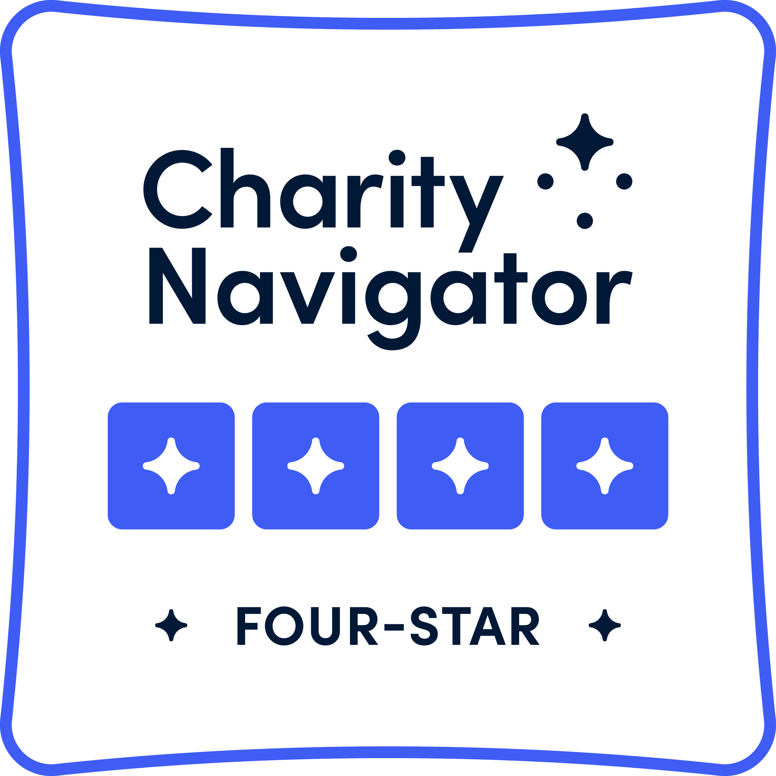
Notes:
CGMA is a 501.c.3 non-profit and the official military aid society for the U.S. Coast Guard.
We are a highly regarded charitable organization, earning a 4-star ranking with Charity Navigator.

Slide 5
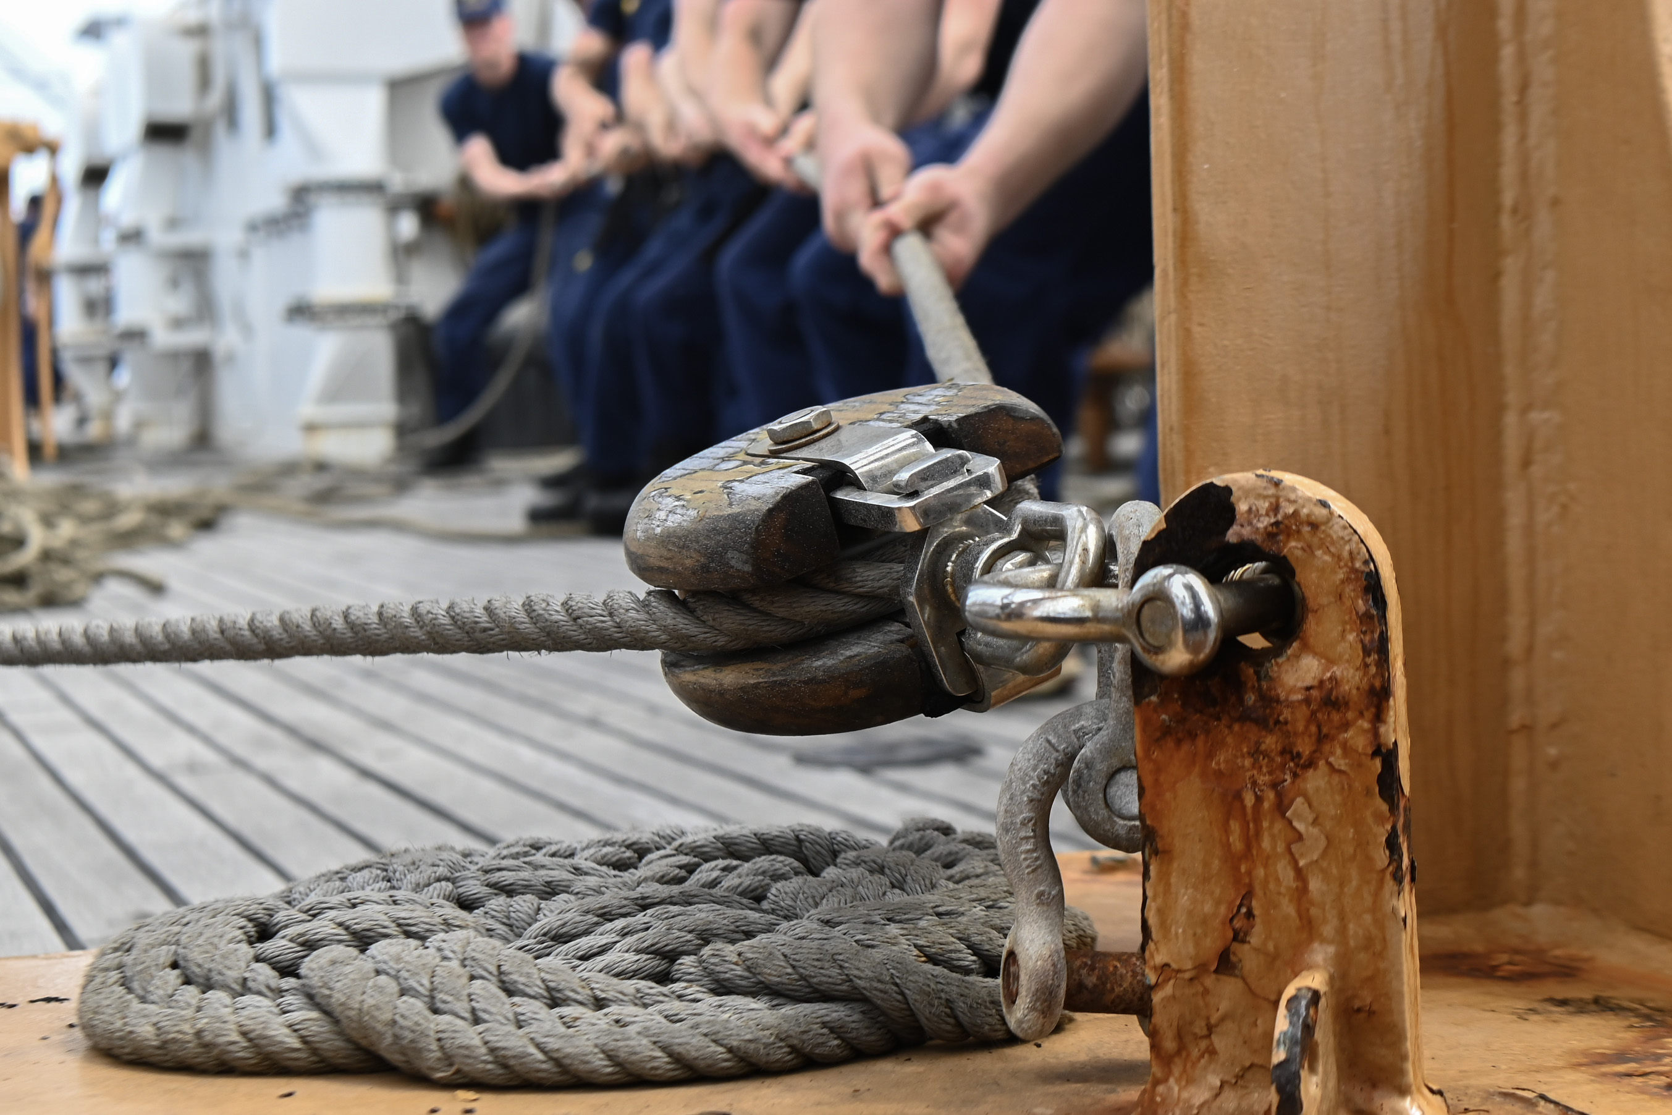
CGMA BOARD OF DIRECTORS
CGMA's Board only includes Directors who represent our Community:
Chair: Commandant
President: Asst Commandant of Personnel, CG-1
MCPOCG & MCPOCG-D
Commissioned Officer (Senior and Junior)
Chief Warrant Officer
Enlisted Leaders (Senior and Junior)
Civilian Employee
Reservist
Auxiliarist
Retiree
Spouse (Officer & Enlisted)
At Large
Notes:
Unlike other CG-related non-profits…
CGMA is governed by a Board of Directors who represent the CG Community.
CGMA is By Coasties, For Coasties
This is because CGMA is the Official Relief Society for the USCG; every Service has just one.
This relationship is like a bloodline—CGMA has direct access to .mil and our workforce; CG Leaders have direct access to CGMA.
CG calls CGMA when they anticipate large groups of members will need support. For example, CGMA bridges the gap w/ Payroll issues.
The Board of Directors advises CGMA of needs for new programs, like the Housing Assistance Program or PCS Incidentals program.

Slide 6
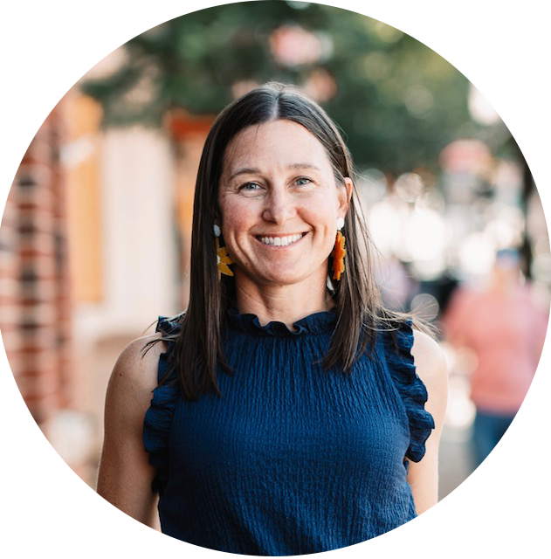
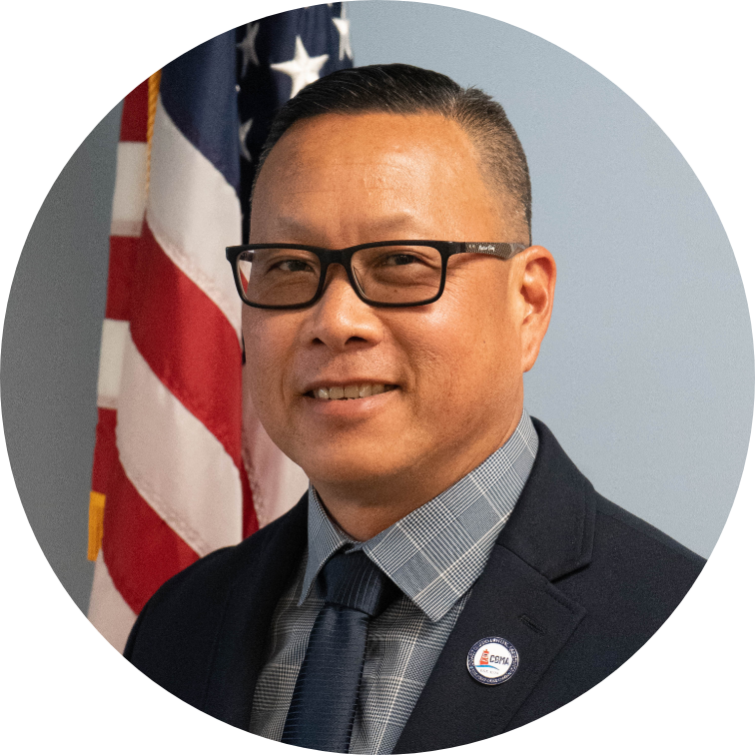
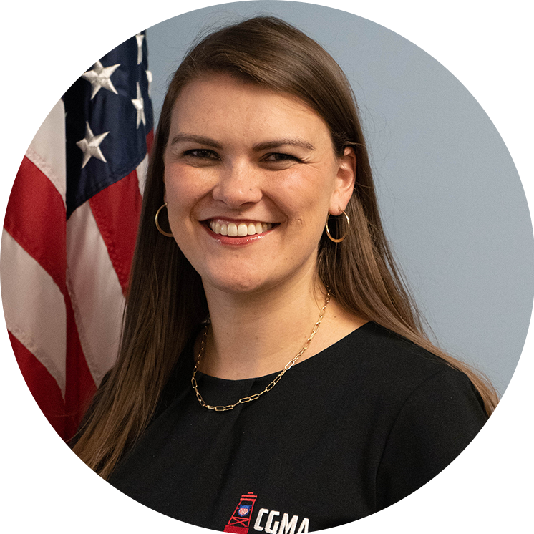
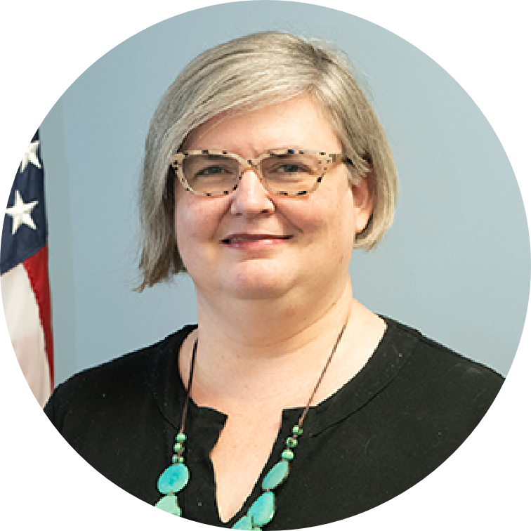
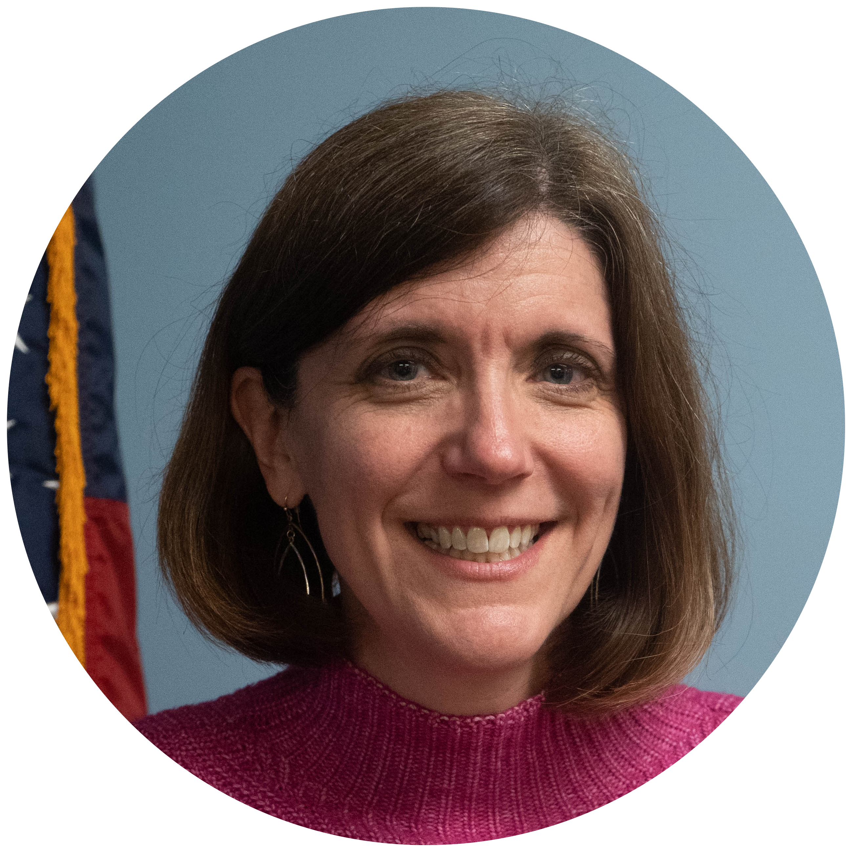
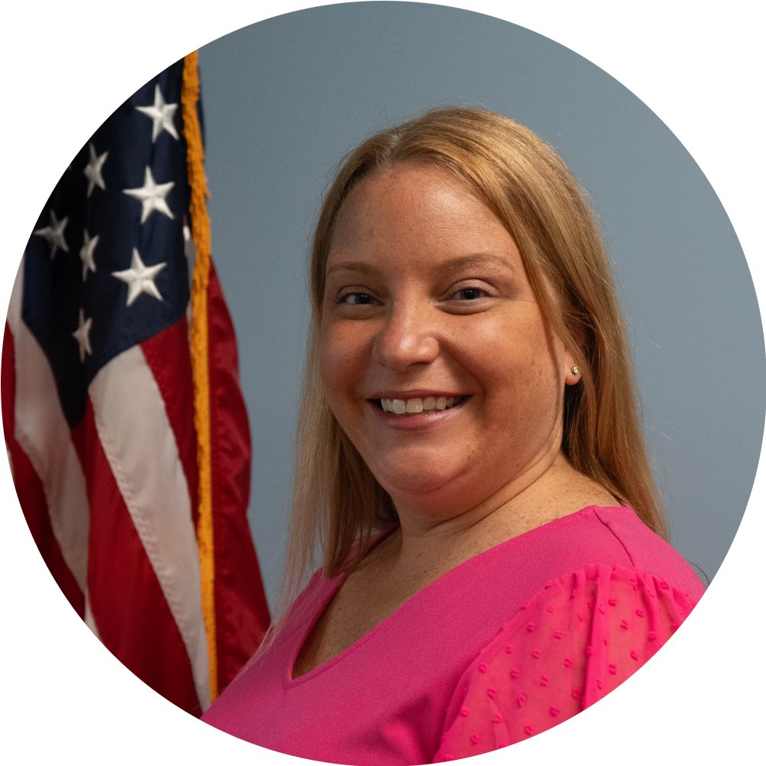
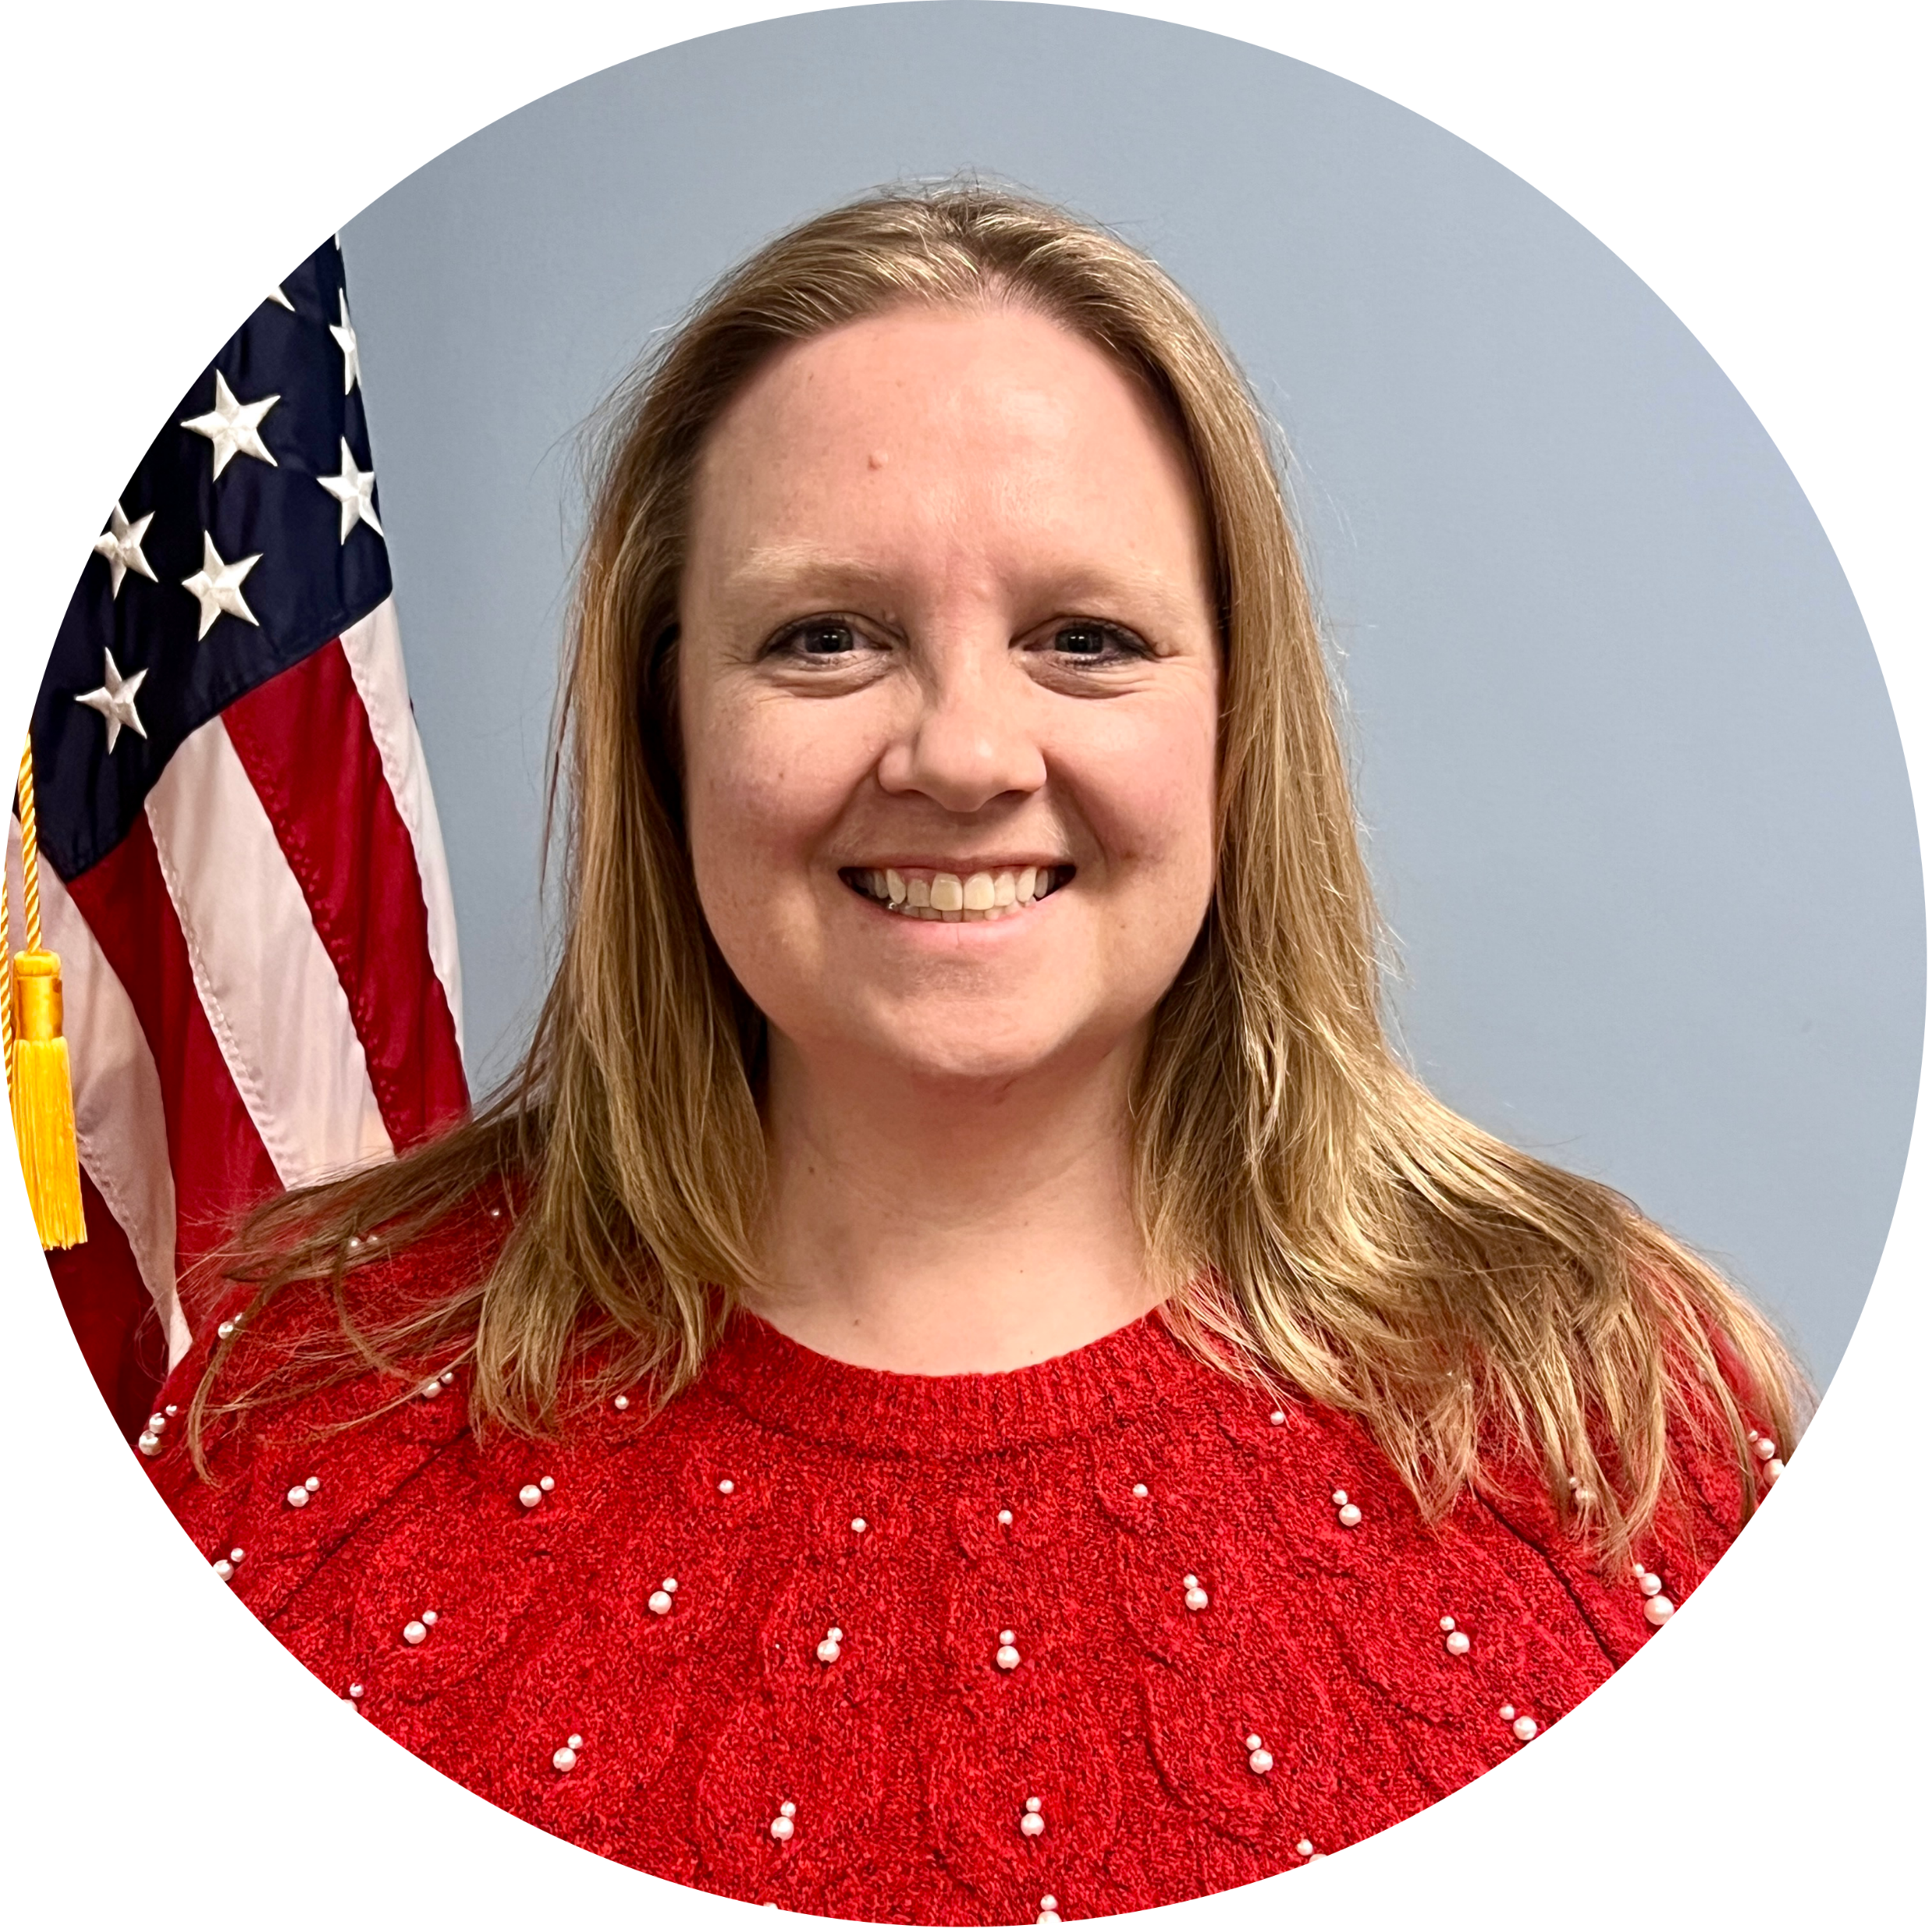
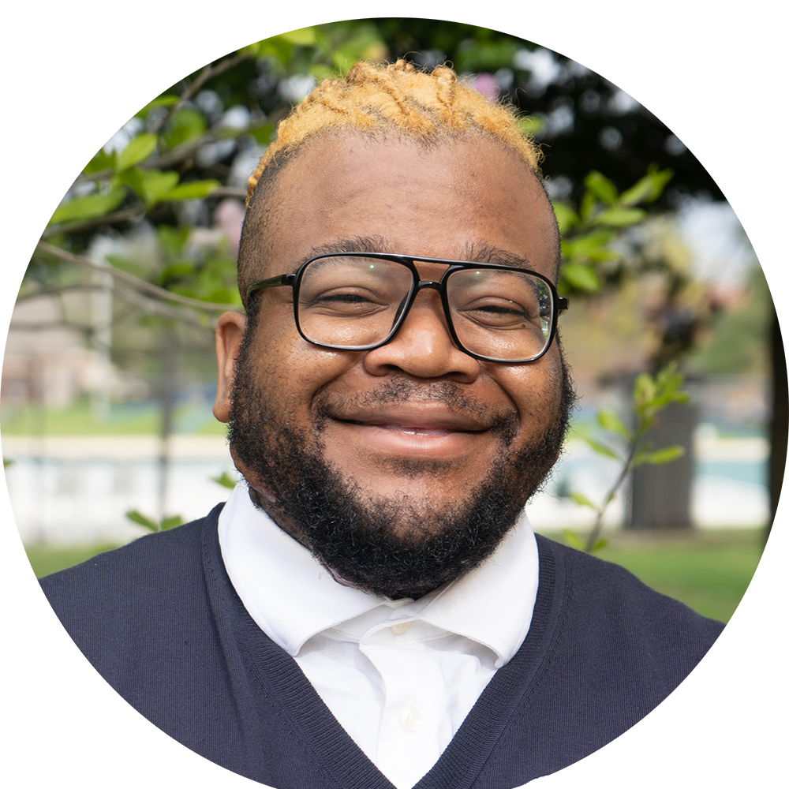
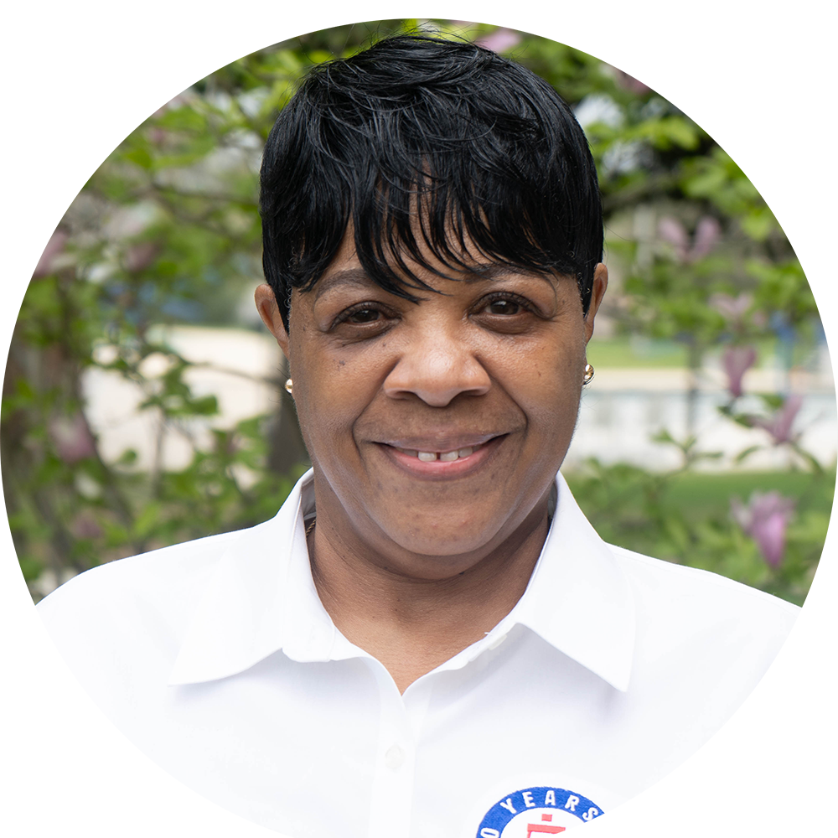
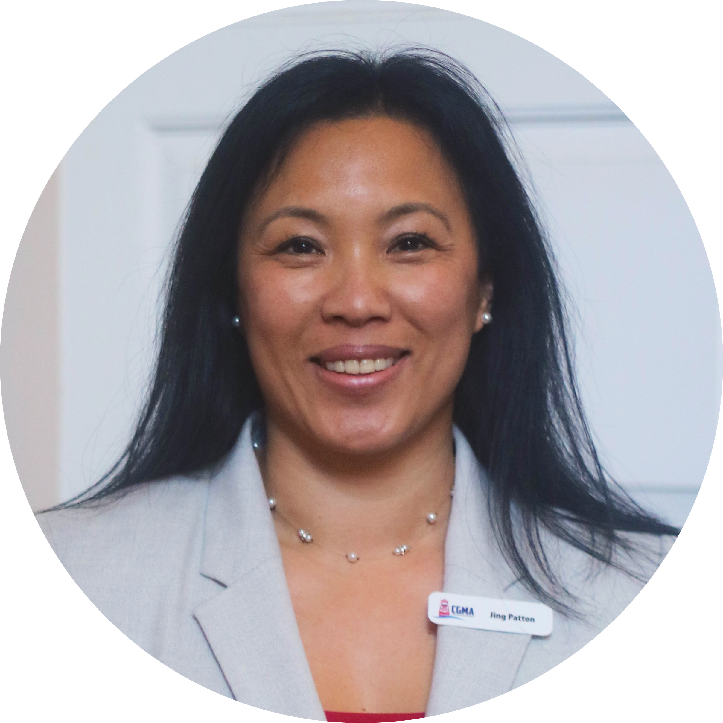
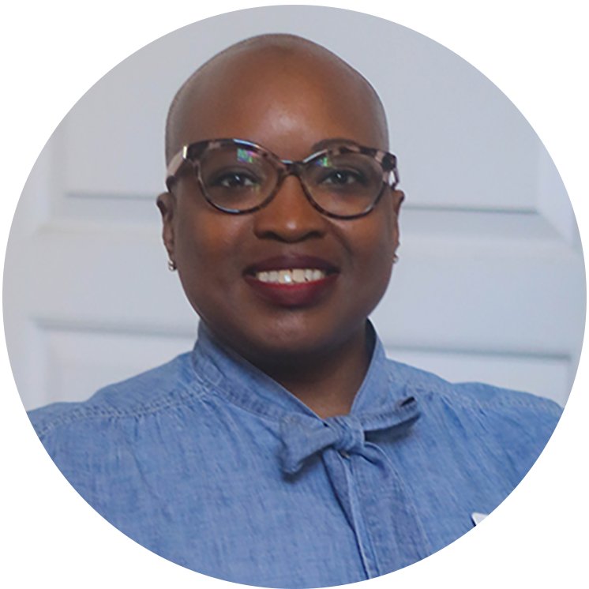
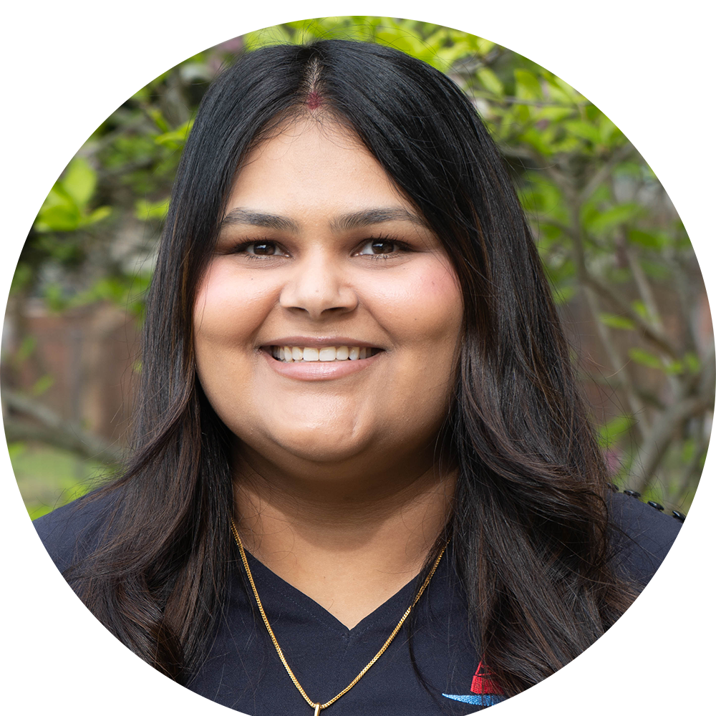
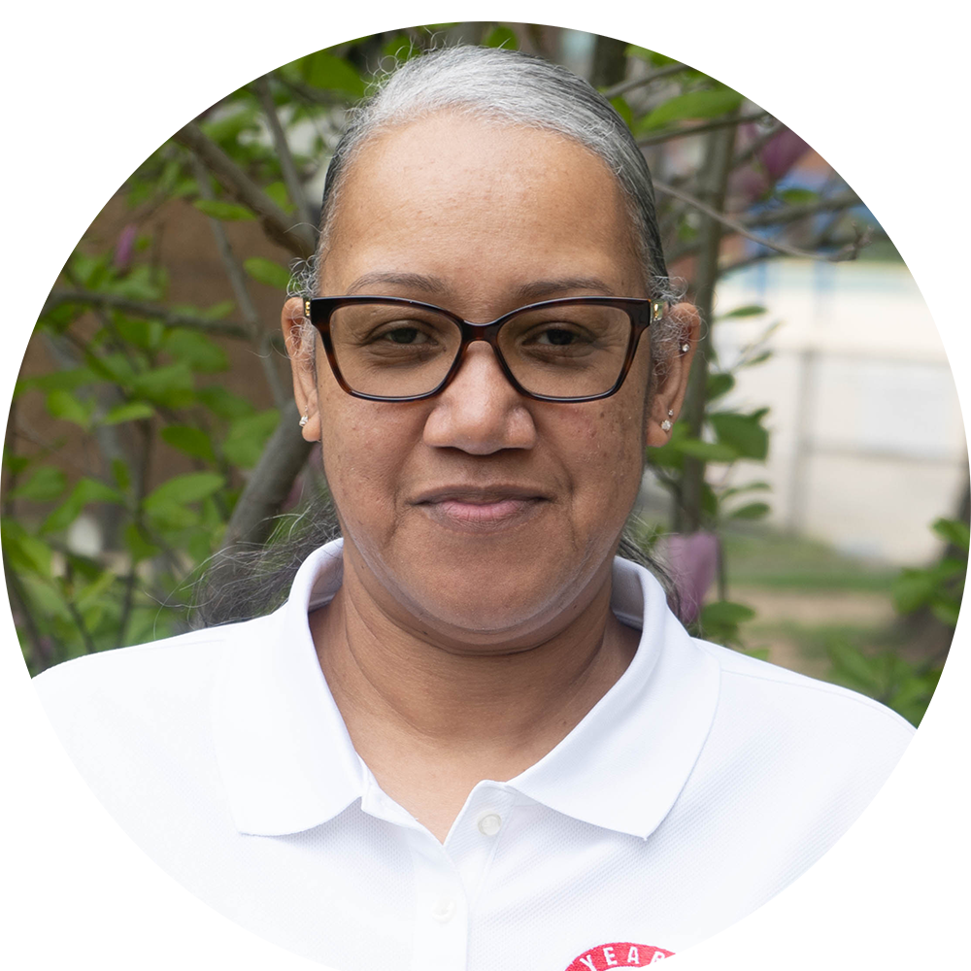
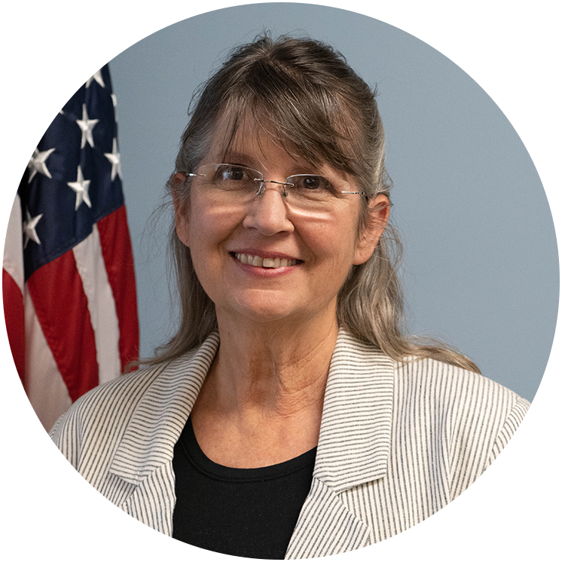
CGMA STAFF
Brooke Milard
CEO
Jason Wong
COO
Alena Howard
Chief Development and Comms Officer
Sara Martin
CIO
Mellissa Bell
CFO
Andrea Cacciola
Operations
Erica Chapman
Fundraising Manager
Gosnel McDermott
Media Assistant
Gwendolyn Fouch
Office Manager
Jessica Manfre
Safe Harbor
Jing Patton
Operations
Sabrina Merritt
Accounts Payable
Shilpy Vohra
IT Support
Tanya Mathis
Collections
Valerie Stanley
Volunteer Assistant
CONTACT US AT CGMA@MYCGMA.ORG OR BY PHONE AT: 703-875-0404

Slide 7
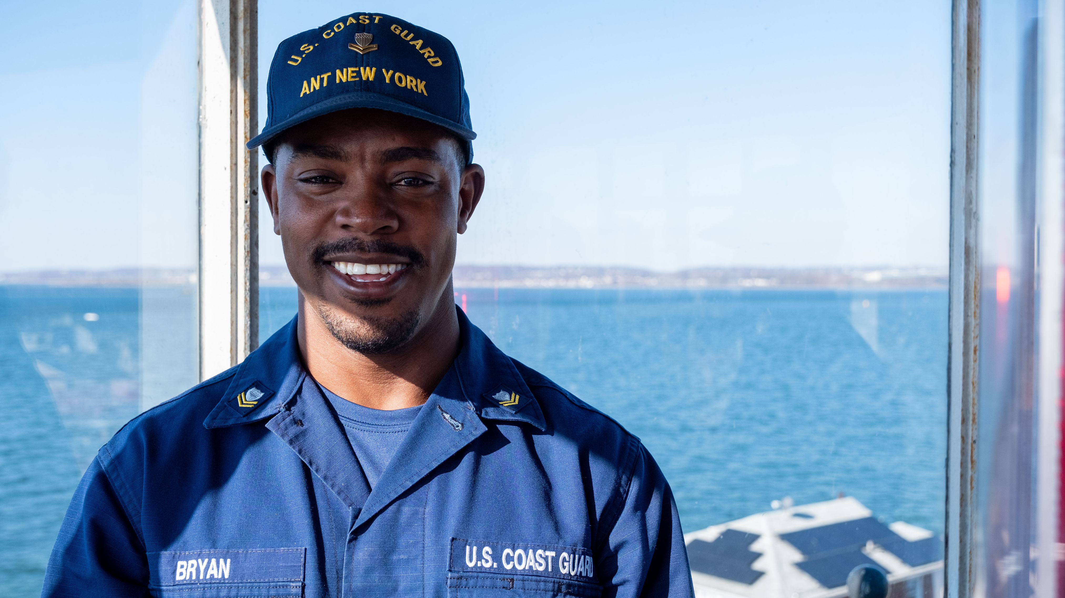
OUR MISSION
To Help Our Own
OUR VISION
A Coast Guard Community
empowered by a trusted network and shared resources to eliminate financial worry.
Disaster and Emergency Relief
Day-to-Day Support
Education Assistance
Grants and interest-free loans ensure short-term financial challenges don't become long-term financial problems
Notes:
For 100 years, Coast Guard Mutual Assistance has been helping Coast Guardsmen.
From caring for Coast Guard widows and members returning from the First World War to serving those impacted by the 2019 Government Shutdown, the COVID-19 pandemic, and more recent events like Hurricane Helene and the California wildfires — CGMA has proved a sure and steady resource
CGMA's Mission is “to help our own."
Since our founding, CGMA has provided more than $250 million in direct support to Coast Guard members in need.
We do this through grants and interest-free loans ensuring short-term financial challenges don’t become long-term financial problems
These grants and loans help people with day-to-day essentials and immediate needs that crop up, and help see them through temporary challenges
It’s important to note that CGMA grants and loans are not meant to provide long-term support or funding for non-essential needs
This year the campaign is all about - The Power of Us. You might not realize it, but someone in your unit - in this meeting, has benefitted from a grant or interest-free loan from CGMA. The power of us is coming together to make contributions so CGMA can provide disaster and emergency relief, day-to-day support and education assistance. This campaign is about making sure that no one in our Coast Guard community has to navigate financial challenges alone.
The assistance CGMA provides fits into 3 main "Buckets" Disaster & Emergency Relief, Day to Day Support, and Education Assistance

Slide 8
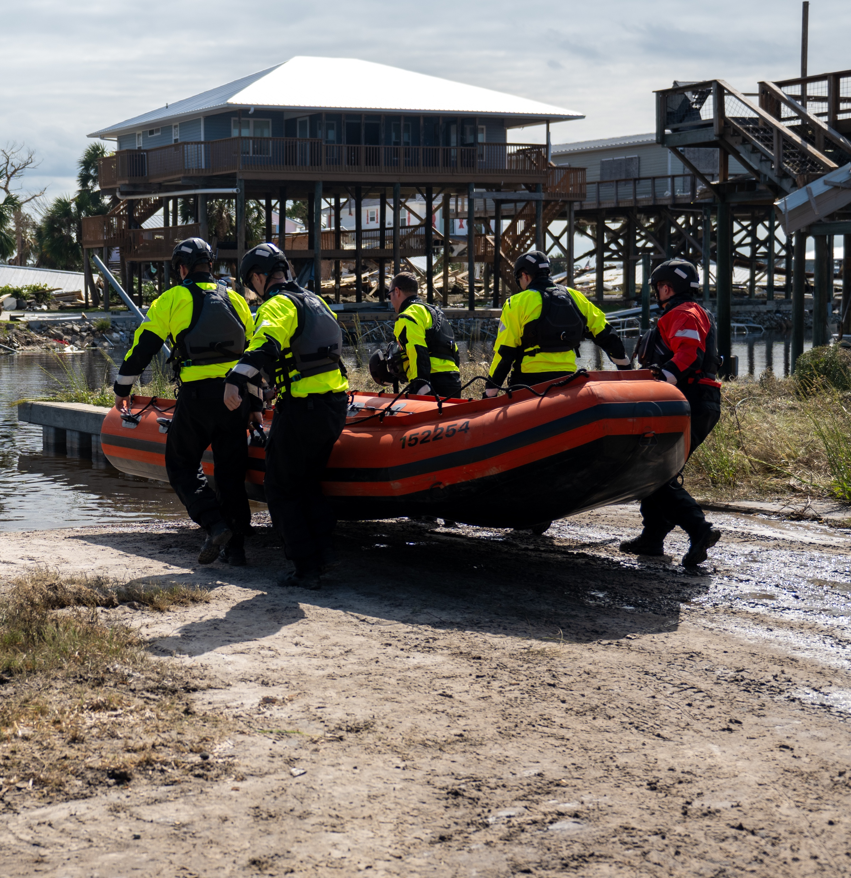
DISASTER AND
EMERGENCY RELIEF
Basic Living Expenses
Car and Home Repairs
Travel Expenses
Evacuation Expenses
Funeral Expenses
Loss of Funds
Medical and Dental Costs
Spoiled Food Replacement
Temporary Living Expenses
Notes:
Disaster and Emergency Relief is just what the name suggests – assistance we provide when disaster strikes, whether on an individual level, or widespread.
During Hurricanes, several CGMA reps receive TDY orders from PSC to augment the Personnel Support Team, or FAST team, ensuring those affected get help quickly.

Slide 9
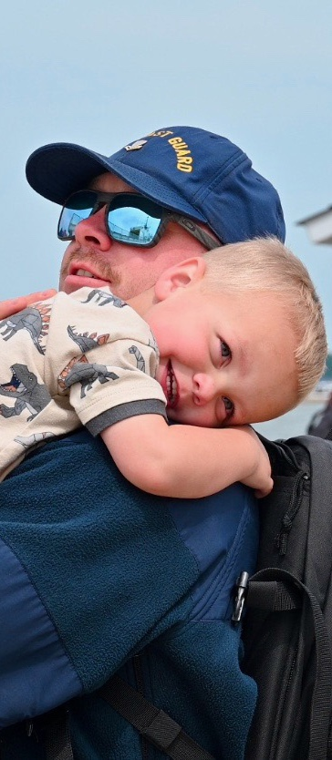
DAY-TO-DAY SUPPORT
Family Support
PCS Childcare Grant
Childcare Loans
Special Needs Grant
Adoption Assistance – Grant and Loan
Assisted Reproductive Services Loan
Baby Supplies (Layette)
Non-Rate Uniform Loan (A-School orders)
Pet/Quarantine Expense Loan
Funeral Expenses
Elder Care Loans
Housing Assistance
Rental Assistance Loan
Closing Costs Loan
Household Furnishings Loan
Utility Startup Loan
DLA Supplemental Grant
PCS Incidentals Loan
Transportation Assistance
OCONUS Car Rental Loan
Vehicle Shipment Loan
Vehicle Repair
Notes:
Day-to-day support includes newborn baby supplies, uniforms for A-school, housing assistance, and family building support for procedures like IVF, surrogacy or adoption.
There are so many programs available to help people start families, purchase homes, take care of loved ones and so much more.
Did you know that CGMA provides non-rates with orders to A-School an interest-free loan to buy new uniforms so they show up to TRACENs looking sharp!
Detailed information on all of CGMA's programs, can be found on their website at mycgma.org.

Slide 10
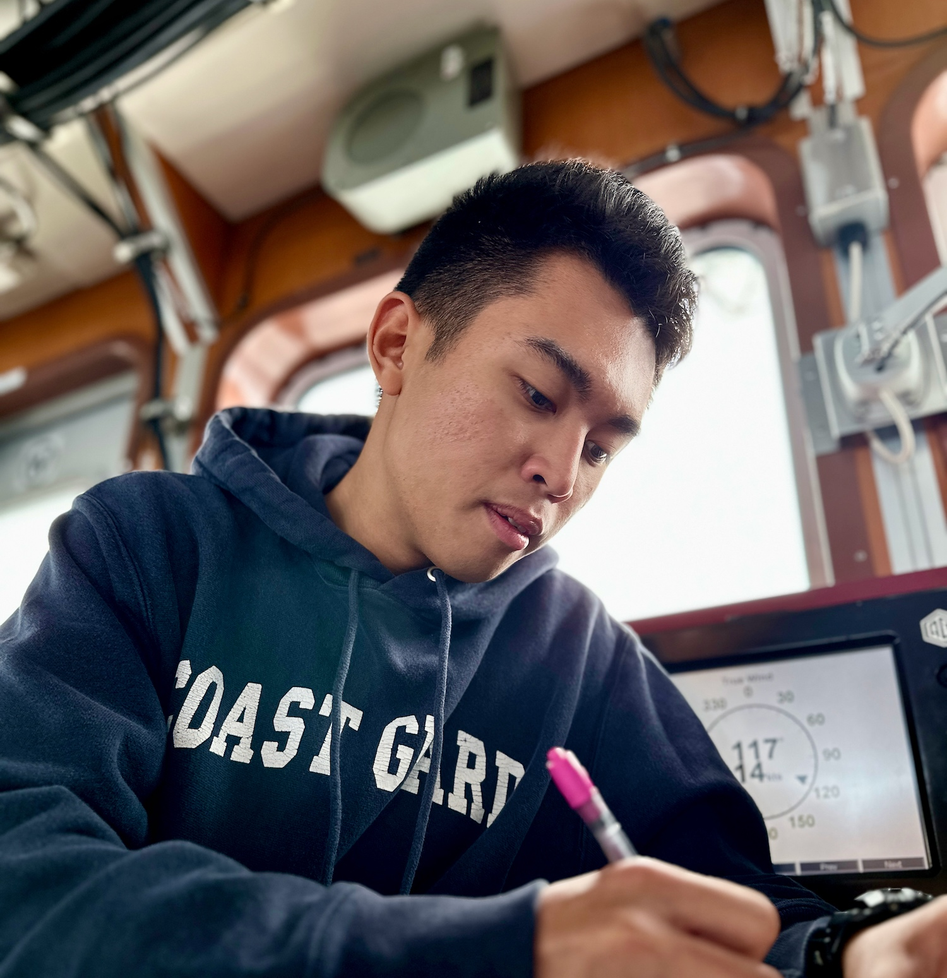
EDUCATION ASSISTANCE
Grants
Supplemental Education Grant
Education Advocate Grant
Stafford/Plus Loan Fee Grant
Financial Counseling Grant
Financial Education Childcare Grant
Loans
Education Loan
CG Cool Loan
Spouse Professional Requirement Loan
Debt Management Loan
Notes:
Education Programs are a major initiative for CGMA. By supporting higher education, these programs foster long-term financial stability.
CGMA provides grants and zero-percent loans to help Coasties access educational opportunities without the burden of high-interest debt.
Our SEG grant may be the most popular program we offer.
Our Education Assistance can be used for any number of costs associated with education from tuition to the cost of a laptop.

Slide 11
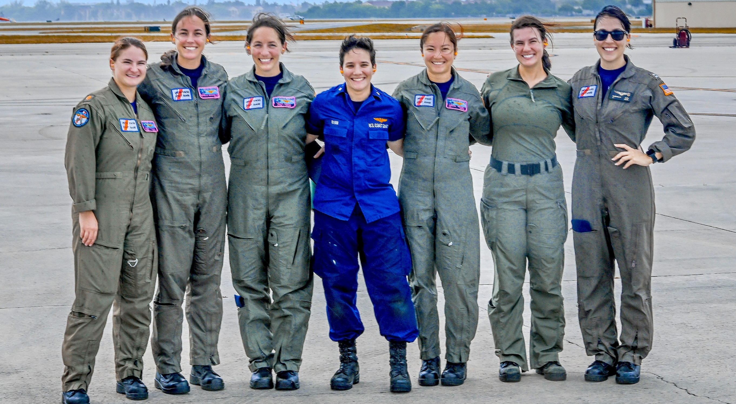
IN ANY GIVEN YEAR CGMA PROVIDES SUPPORT TO 1 IN 7 ACTIVE DUTY MEMBERS.
THAT’S THE POWER OF US
Notes:
CGMA has countless good-news stories like that of BM2 Tucker.
Any given year 1 in 7 Active Duty Members use CGMA...
In 2024, CGMA delivered nearly $8.5 Million to members in need... $3 Million of that was in grants.
CGMA is largely funded by COASTIES and is for COASTIES. THAT's the POWER of US!!

Slide 12
2024 GIVING BREAKDOWN
In 2024, CGMA Representatives processed 6,302 cases
2024 Support
Highest Grant Amount
$24,000
Total Grants
$2.9 Million
$8.5 million in total support; over $2.9 million in grants
ACTIVE DUTY
5,207 CLIENTS
$6,684,055 IN ASSISTANCE
RESERVE MEMBERS
319 CLIENTS
$422,825 IN ASSISTANCE
DISASTER AND EMERGENCY RELIEF
$4,039,040
AUXILIARY MEMBERS
61 CLIENTS
$173,441 IN ASSISTANCE
RETIRED MEMBERS
282 CLIENTS
$505,176 IN ASSISTANCE
EDUCATION ASSISTANCE
$1,783,866
CIVILIAN MEMBERS
388 CLIENTS
$682,136 IN ASSISTANCE
OTHER
45 CLIENTS
$96,860 IN ASSISTANCE
DAY-TO-DAY SUPPORT
$2,741,587
On an average day, CGMA provides $27,123 in assistance.
More than 590 CGMA Representatives at 132 shore units and 54 cutters
in 39 states and territories across 19 time zones
Notes:
In 2024 CMGA helped more than 6,300 Coast Guard members and provided $8.5 million in assistance.
And on an average day, we provided $27,123 in assistance over the last year.
We support active duty, reservists, auxiliarists, retirees and civilians - and their families
More than 590 Representatives across the Coast Guard help educate members on our programs and walk them through the process of applying for assistance.

Slide 13
The CGMA Difference: A Tale of 2 Piers
PIER 1
E5 stationed on CGC cutter had a baby who needed to spend 2 weeks in NICU, a 3-hr drive away
Command Tried
TDY orders to area …did not come with housing
Grant from CPOA … <$1000
Wounded Warriors …could not support
Outcome: Member drove 6 hours roundtrip to the hospital each day
PIER 2
E5 stationed on CGC cutter had a baby who needed to spend 2 weeks in NICU, a 3-hr drive away
Member received a CGMA Emergency Travel Grant + Loan and stayed 2 weeks in hotel near the hospital
CGMA let us focus on ensuring our baby would be getting the care she needed and deserved rather than trying to drive up and down the Keys daily and paying for hotels out of pocket.
– BM2 John Tucker
Notes:
It's important that ALL HANDS know about available CGMA resources. Here's why:
In this tale of two piers—where two E5s had similar experiences which kept them away from homebase for a few weeks- one command/ crew knew of CGMA, while the other did not.
On Pier 1, a Cutter Command tried many strategies to help pay for the E-5's lodging near the Miami hospital, but they didn't call CGMA. The member ended up driving the 6-hr roundtrip route each day to see his baby.
On Pier 2 across the waterfront, BM2 John Tucker's baby Aurora was born in Key West, FL but she needed open heart surgery at just 5 days old.
She was diagnosed with transposition of the great artery. This was a life-or-death situation.
She was medi-vac'd to Nicklaus Children Hospital in Miami FL just 3 hours after her birth.
John and his wife found a hotel near the hospital so they could be near their newborn daughter.
His Chief, BMC Snovell, worked with LT Alger, their local CGMA rep, to get secure CGMA funds to help pay for local lodging, food, and fuel, for 2 weeks.
Now, Aurora is one year old. She's a healthy and happy baby.

Slide 14
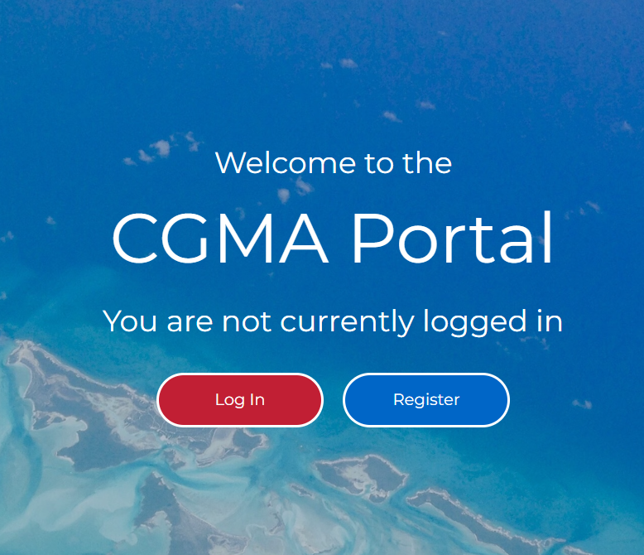
Notes:
You can get more information about CGMA's programs and how to apply for assistance by speaking with your CGMA Representative or by visiting the website at mycgma.org
If you’re not sure who your CGMA Rep is, you find that out on our website, as well via the "Find My Rep" button in the top right corner.
The online application portal is NEW (as of Dec 2024) and everyone eligible can start an application for assistance without a CGMA Rep's initial help.

Slide 15
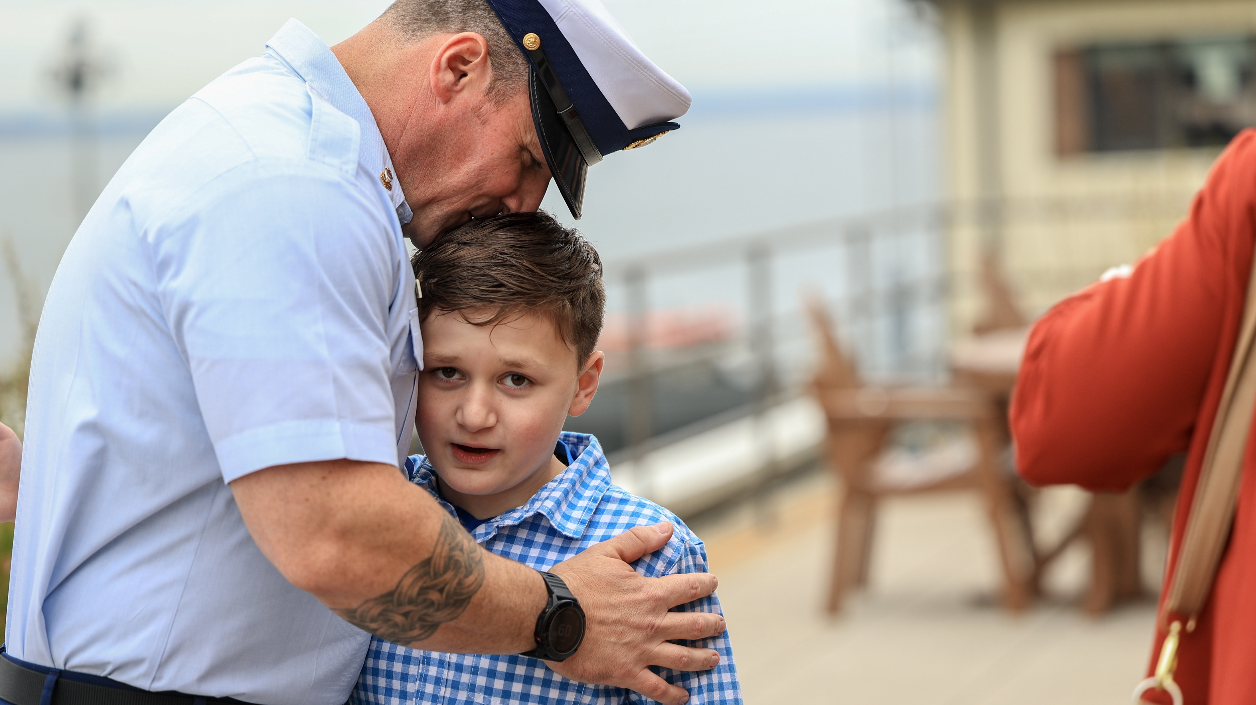
CGMA IS 100% FUNDED THROUGH DONATIONS
Notes:
In order to provide this support, CGMA relies on contributions from the Coast Guard community.
As I said, we are the Coast Guard’s only official aid organization. CGMA does NOT receive any government funding.
CGMA is 100% funded through donations, primarily from the Coast Guard community.

Slide 16
WHY GIVE
CGMA is 100% funded by donations, and your support helps support the Coast Guard community
The need for financial support remains steady, but donations and allotments have decreased dramatically over the last decade.
If this trend continues, we will not be able to sustain our current level of support.
We are losing an average of 877 allotments annually (net)
Notes:
Over the last several slides, we've talked about the support that CGMA provides.
Your contributions directly fund grants and loans that change lives—ensuring individuals receive critical services, and our Coast Guard community thrives.
Needs are increasing, but funding is shrinking. The demand for services is rising at an unprecedented rate. Without increased donations, CGMA won’t be able to sustain the current level of support they provide or keep up with the growing need.
Giving through an allotment provides steady, reliable funding that allows CGMA to sustain its giving and support those in need. Allotments are automatic, recurring and are deducted directly from your paycheck.
Over the last few decades, allotments among Active Duty Coast Guard members – which is the most important method of donation – has steadily declined at a pace of 877 allotments each year. This translates to a loss of about $43,000 per year. Over the last decade, the cumulative impact of this has been a nearly 50% reduction in allotments.
Allotments were once the backbone of sustained giving— and they are dropping rapidly. Even small payroll contributions, when pooled together, make a powerful impact.
This is why your support matters now more than ever. By giving, you ensure that resources remain available for those who need them most.
Our goal as a unit is to double Active Duty allotments - Please consider starting or increasing your allotment today.

Slide 17
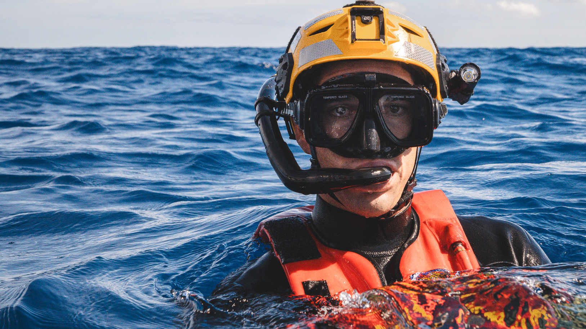
2025 ANNUAL FUNDRAISING CAMPAIGN
THE POWER OF US
APRIL 1 – MAY 31
Notes:
This year’s campaign will run from April 1 through May 31
Our campaign theme is The Power of Us
This truly embodies CGMA – we are Coasties Helping Coasties. CGMA is able to provide Coast Guard community members the help they need when they need it thanks to the generosity of all its members.

Slide 18
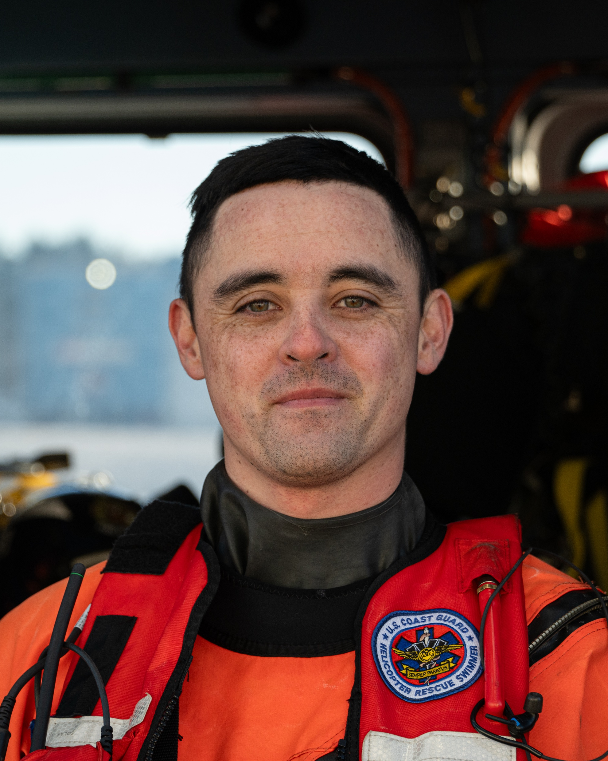
CAMPAIGN GOAL
To raise funds needed to provide grants to Coast Guard members in need.
In 2024, CGMA provided $2.5 million in grants alone to Active Duty members.
Today, there are about 42,000 Active Duty members of the U.S. Coast Guard.
$2.5M / 42,000 = $59 / year =
$5 / month
Notes:
Our unit has been challenged by MCPOCG Heath Jones to double Active Duty allotments and increase overall giving—not just to meet a number, but to make a meaningful difference in the lives of our fellow Coast Guard members and their families.
But meeting that challenge depends on us - our efforts, our conversations, and our ability to rally our unit.
Starting or increasing an allotment ensures consistent, reliable funding for emergency grants, interest-free loans, and essential programs
Every contribution – large or small – strengthens the safety net for our Coast Guard community.
We are also tasked with raising the funds needed to provide grants and loans for Coast Guard members in need.
The funds we raise help ensure grants are available for those experiencing financial hardship, facing unexpected crises or seeking educational support.

Slide 19
Include current duty station and 5-digit OPFAC number when donating
PAYROLL ALLOTMENT | CREDIT CARD | CHECK
Notes:
There are several ways to give - you can give in the way that works best for you - choose from allotment or biweekly payroll deduction, credit card or check.
As I said before, giving through an allotment is one of the most important ways to help - recurring donations provide steady, reliable funding that allows CGMA to sustain its giving.
Allotments are automatic deductions and make giving easy.
A small amount per paycheck adds up over time, providing sustainable support
Even an increase of $5 or $10 per month can make a significant difference
We are focusing our efforts on allotments because you can set it and forget it, and 100% of the funds go directly to CGMA.
You can set up or increase your payroll allotment or donate by credit card online
Just scan this QR code with your phone to go directly to the allotment page to start or increase a payroll allotment.
You can also visit the campaign landing page - at mycgma.org/campaign (UPDATE THIS URL) to set up or increase your allotment or make a one-time donation.
OR you can fill out the pledge form I'm handing out.
If you do not choose to set up an allotment, you can donate through a check or credit card. Please keep in mind a credit card donation will incur a 4% fee.
When donating, it’s important that you include our unit/current duty station name [insert here] and our 5-digit OPFAC number – which is [insert OPFAC number].

Slide 20
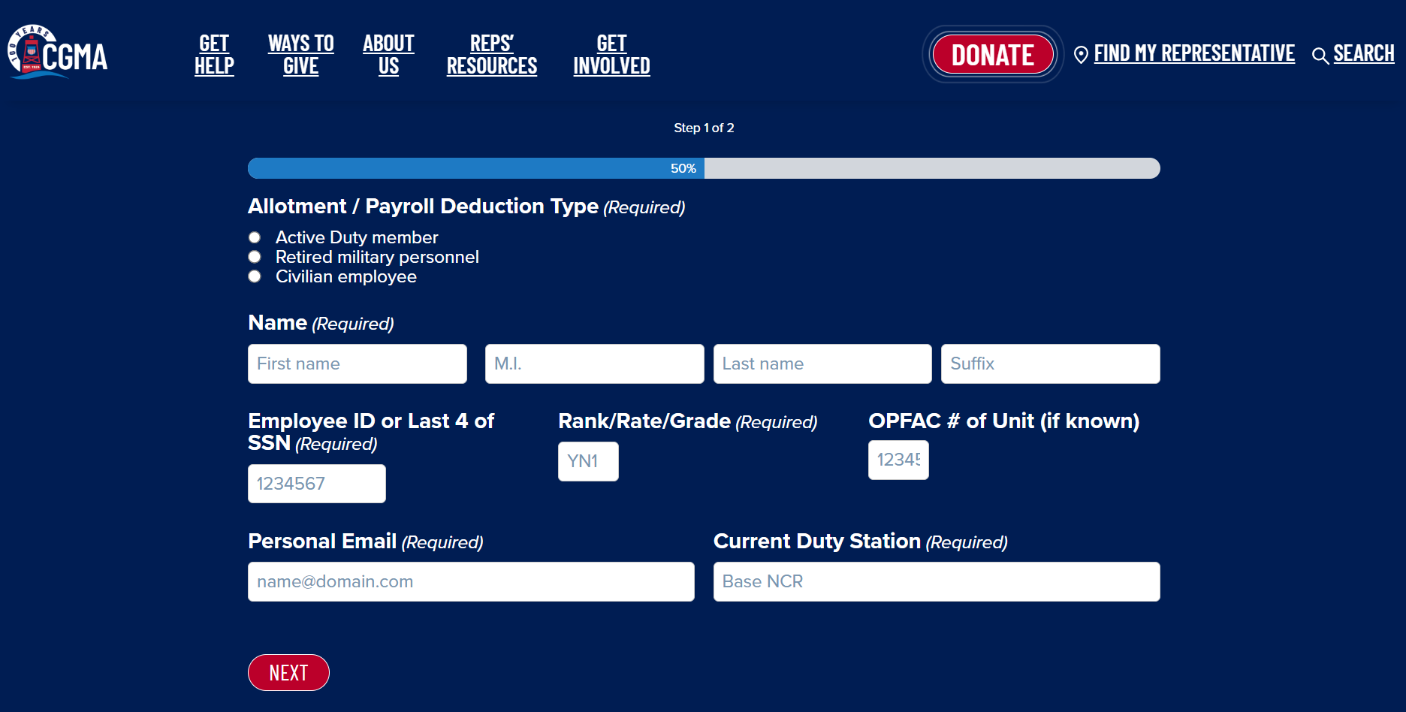
Notes:
Here's how you sign up for or increase your allotment:
Step 1 is to fill out your personal information, including employee ID or SSN, Rank/Rate/Grade and OPFAC# of our unit.

Slide 21
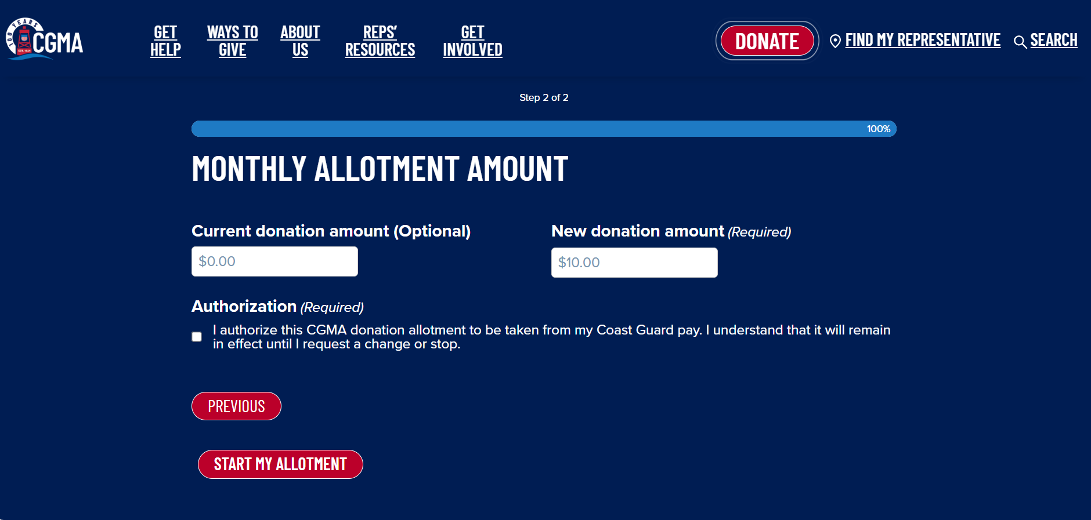
Notes:
Step 2: Complete this information & then "Start My Allotment" -- CGMA's staff will take it from there.
THAT's It- Just 2 Clicks!!

Slide 22
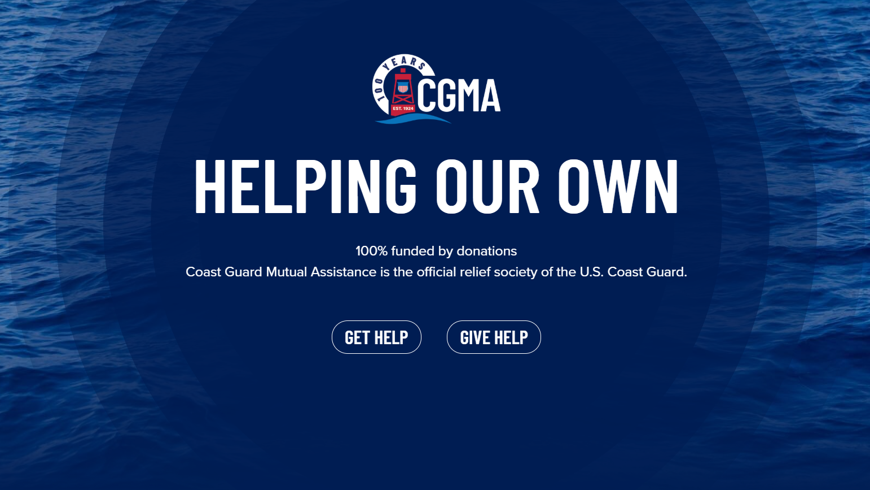
THANK YOU FOR YOUR SUPPORT!!
WWW.MYCGMA.ORG/GETHELP
WWW.MYCGMA.ORG/GIVE-HELP/ALLOTMENT-PAYROLL-DEDUCTION/

Slide 23
Q&A

Slide 24
FREQUENTLY ASKED QUESTIONS
What's the difference between CGMA and Coast Guard Foundation?
CGMA focuses squarely on supporting the financial resilience of the individual Coast Guard member.
Coast Guard Foundation primarily supports the broader needs of BIG Coast Guard and units.
What's the difference between CGMA and CG TLEA?
Typically, CGTLEA provides the DSF community about $90k/year, however their 990 IRS form for 2023 is not public.
To compare, in 2024, CGMA provided the DSF community with more than $350k in support.
WWW.MYCGMA.ORG/GETHELP
WWW.MYCGMA.ORG/GIVE-HELP/ALLOTMENT-PAYROLL-DEDUCTION/
Notes:
What's the difference between CGMA and Coast Guard Foundation?
CGMA focuses squarely on supporting the financial resilience of the individual Coast Guard member. It provides grants and loans to ensure today's financial challenge does not become tomorrow's problem.
Coast Guard Foundation primarily supports the broader needs of BIG Coast Guard and units. For example, it executes the Shipmate fund that a unit might tap into to replace gym equipment; it supports the Coast Guard museum and the Coast Guard Academy athletics program too.
In the last few years, the Foundation has also provided disaster relief grants at $3,000 per person, max. There is no maximum grant amount CGMA can provide, depending on need. In fact, CGMA gave an E5 a $24,000 disaster relief grant post Hurricane Helene.
Collectively, in any given year, CGMA provides nearly 5X the amount of money in disaster relief grants to the Coast Guard community than the Foundation.
Both the Foundation and CGMA support members' educational goals. That funding for education is about equal between the two organizations.
The big difference between CGMA and the Coast Guard Foundation is that CGMA is the Coast Guard’s official relief society. As the official relief society, Sentinels are encouraged to participate in CGMA activities-- serve as representatives, campaign coordinators, raise funds, and endorse CGMA publicly—all while in uniform and on Federal property.
What's the difference between CGMA and CG TLEA?
CGTLEA is a membership-based organization run by, and exclusively for, members of the DSF community/tactical coxswains.
CGTLEA provides an annual scholarship, as well as financial support to DSF members in need.
Typically, CGTLEA provides the DSF community about $90k/year, however their 990 IRS form for 2023 is not public.
To compare, in 2024, CGMA provided the DSF community with more than $350k in support.

Slide 25
CGMA 2024
Contributions* Support
Air Stations | 66,348 | 679,041 10x
Bases | 72,985 | 1,023,696 14x
Sectors | 115,921 | 1,316,225 11x
DSF | 28,368 | 368,289 13x
Cutters | 118,847 | 871,397 7x
Training Centers | 66,886 | 404,309 6x
Total Active Duty and Civilian Employee Coast Guard Support to CGMA
$888,081
Total CGMA Support to Coast Guard Active Duty and Civilian Employees
$7,366,191 8x
Each OPFAC has distinct information
There is no overlap of information except for HITRON, which is placed under AirSta and DSF, and SMTC, which is placed under DSF and Training Centers
Not included in this slide deck CG Stations, CG ANTs, MSUs, ESDs, CGHQ, Districts, Recruiting Cmds, CG Cyber, etc.
*AD + Civilian Employee donations
WWW.MYCGMA.ORG/GETHELP
WWW.MYCGMA.ORG/GIVE-HELP/ALLOTMENT-PAYROLL-DEDUCTION/

Slide 26
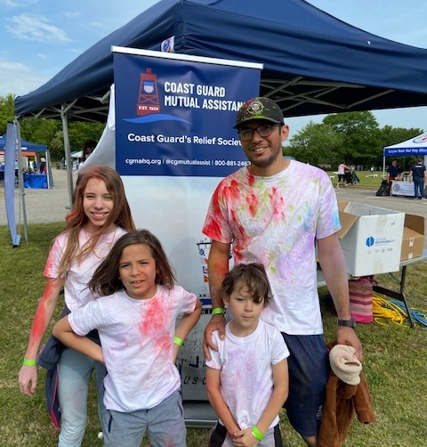
LOCAL FUNDRAISING EVENTS
Plank for Donations
April X
1 pm
Basketball Tournament
April X
1 pm
Pie-in-the-Face
May X
1 pm
These are examples. Replace these with your own Fundraising events and activities.
Notes:
Coordinators, use this page to set the stage for upcoming local fundraising events. Refer to the 2025 Fundraising Guide for ideas and inspiration.

