Slide 1
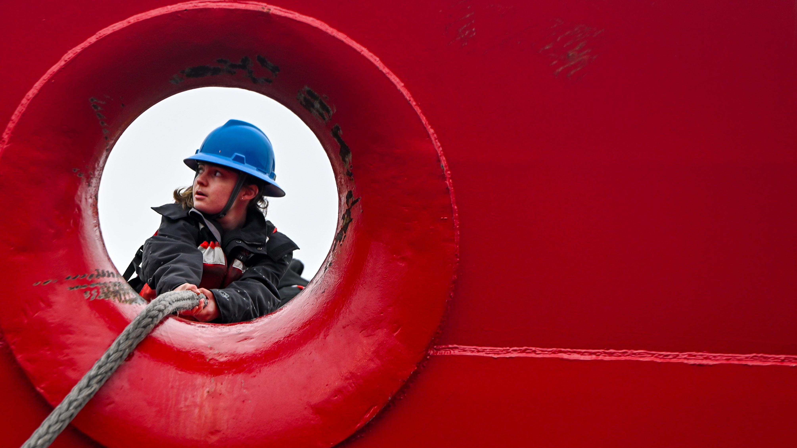
THE POWER
OF US
2025 ANNUAL FUNDRAISING CAMPAIGN COORDINATOR TRAINING
Notes:
Thank you all for joining us today. And thank you for serving as this year’s Campaign Coordinators.
Your role is essential to our campaign’s success and to raising the funds needed to keep CGMA supporting the Coast Guard community.

Slide 2
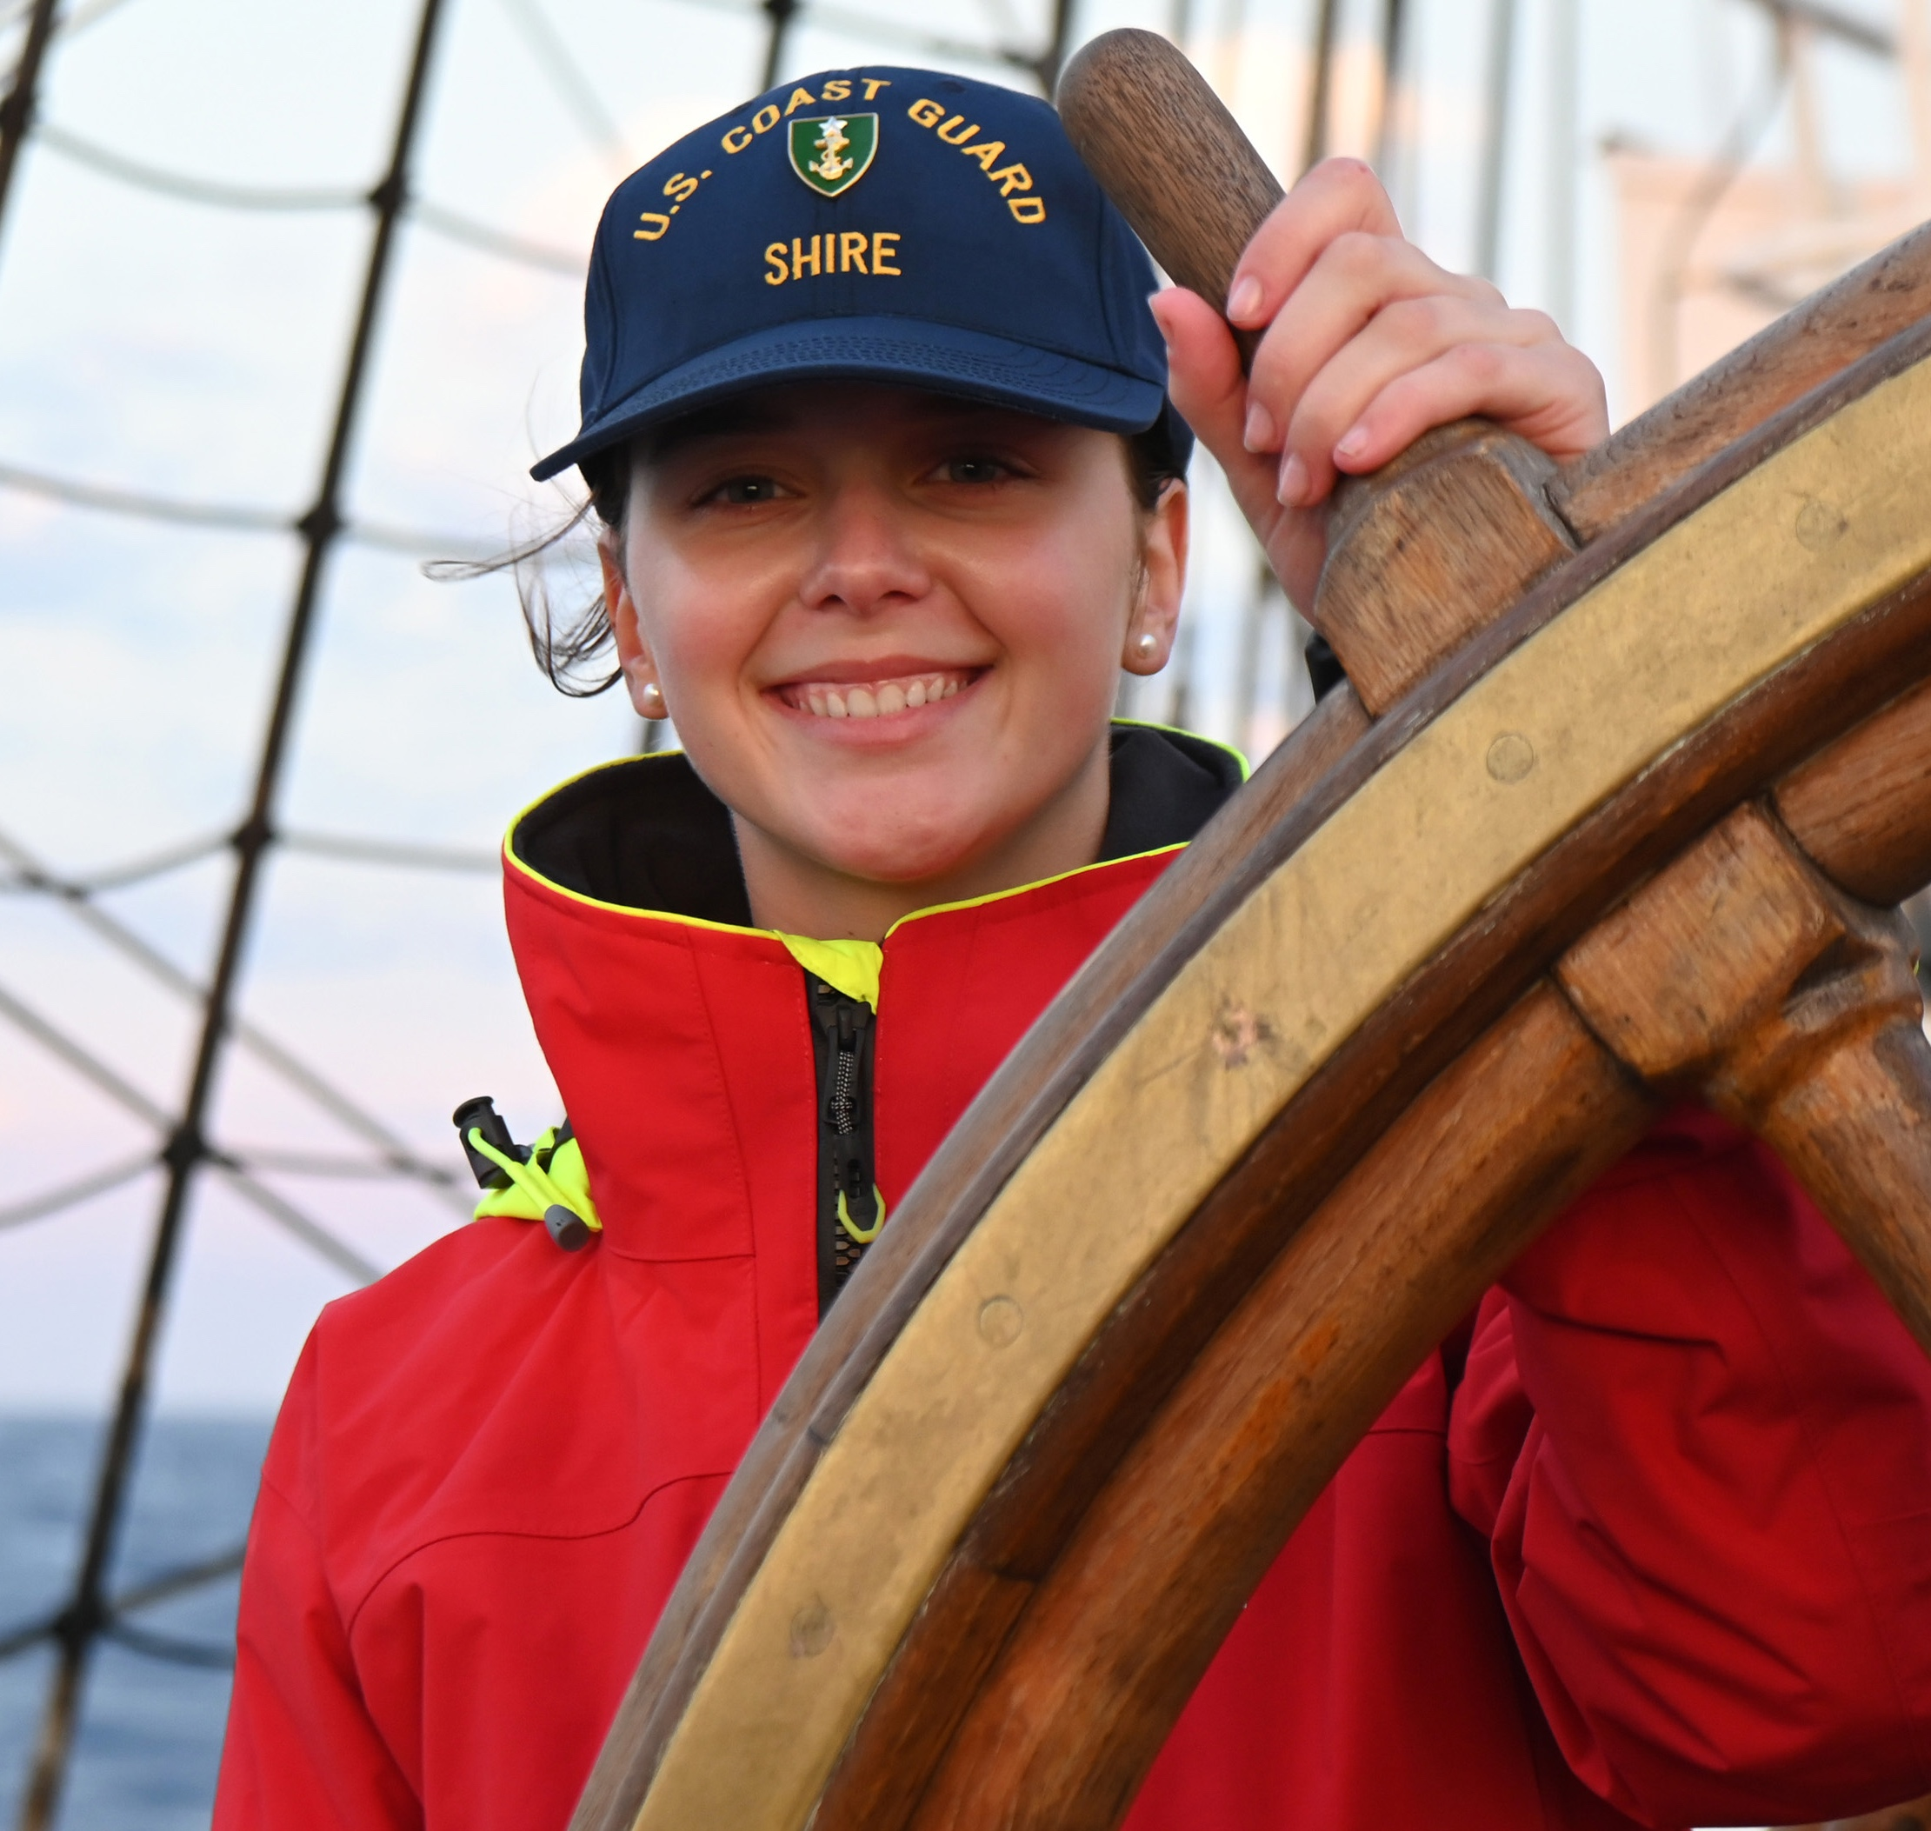
AGENDA
Who is CGMA
CGMA assistance
Why give
Campaign overview
Your role
Ways to give
Coordinator resources
Campaign materials
Timeline
Notes:
Today we’re going to review a number of items to prepare you for your role as Campaign Coordinator for this year.
I know most or all of you are aware of CGMA, but we’ll run through a quick overview of the programs and resources we provide
The bulk of today’s presentation will be an overview of this year’s campaign – The Power of Us – your role as Campaign Coordinator, and the materials and resources you’ll be provided to make sure you’re set up for success.

Slide 3
Notes:
CGMA is a 501.c.3 non-profit and the official military aid society for the U.S. Coast Guard.
We are a highly regarded charitable organization, earning a 4-star ranking with Charity Navigator.

Slide 4
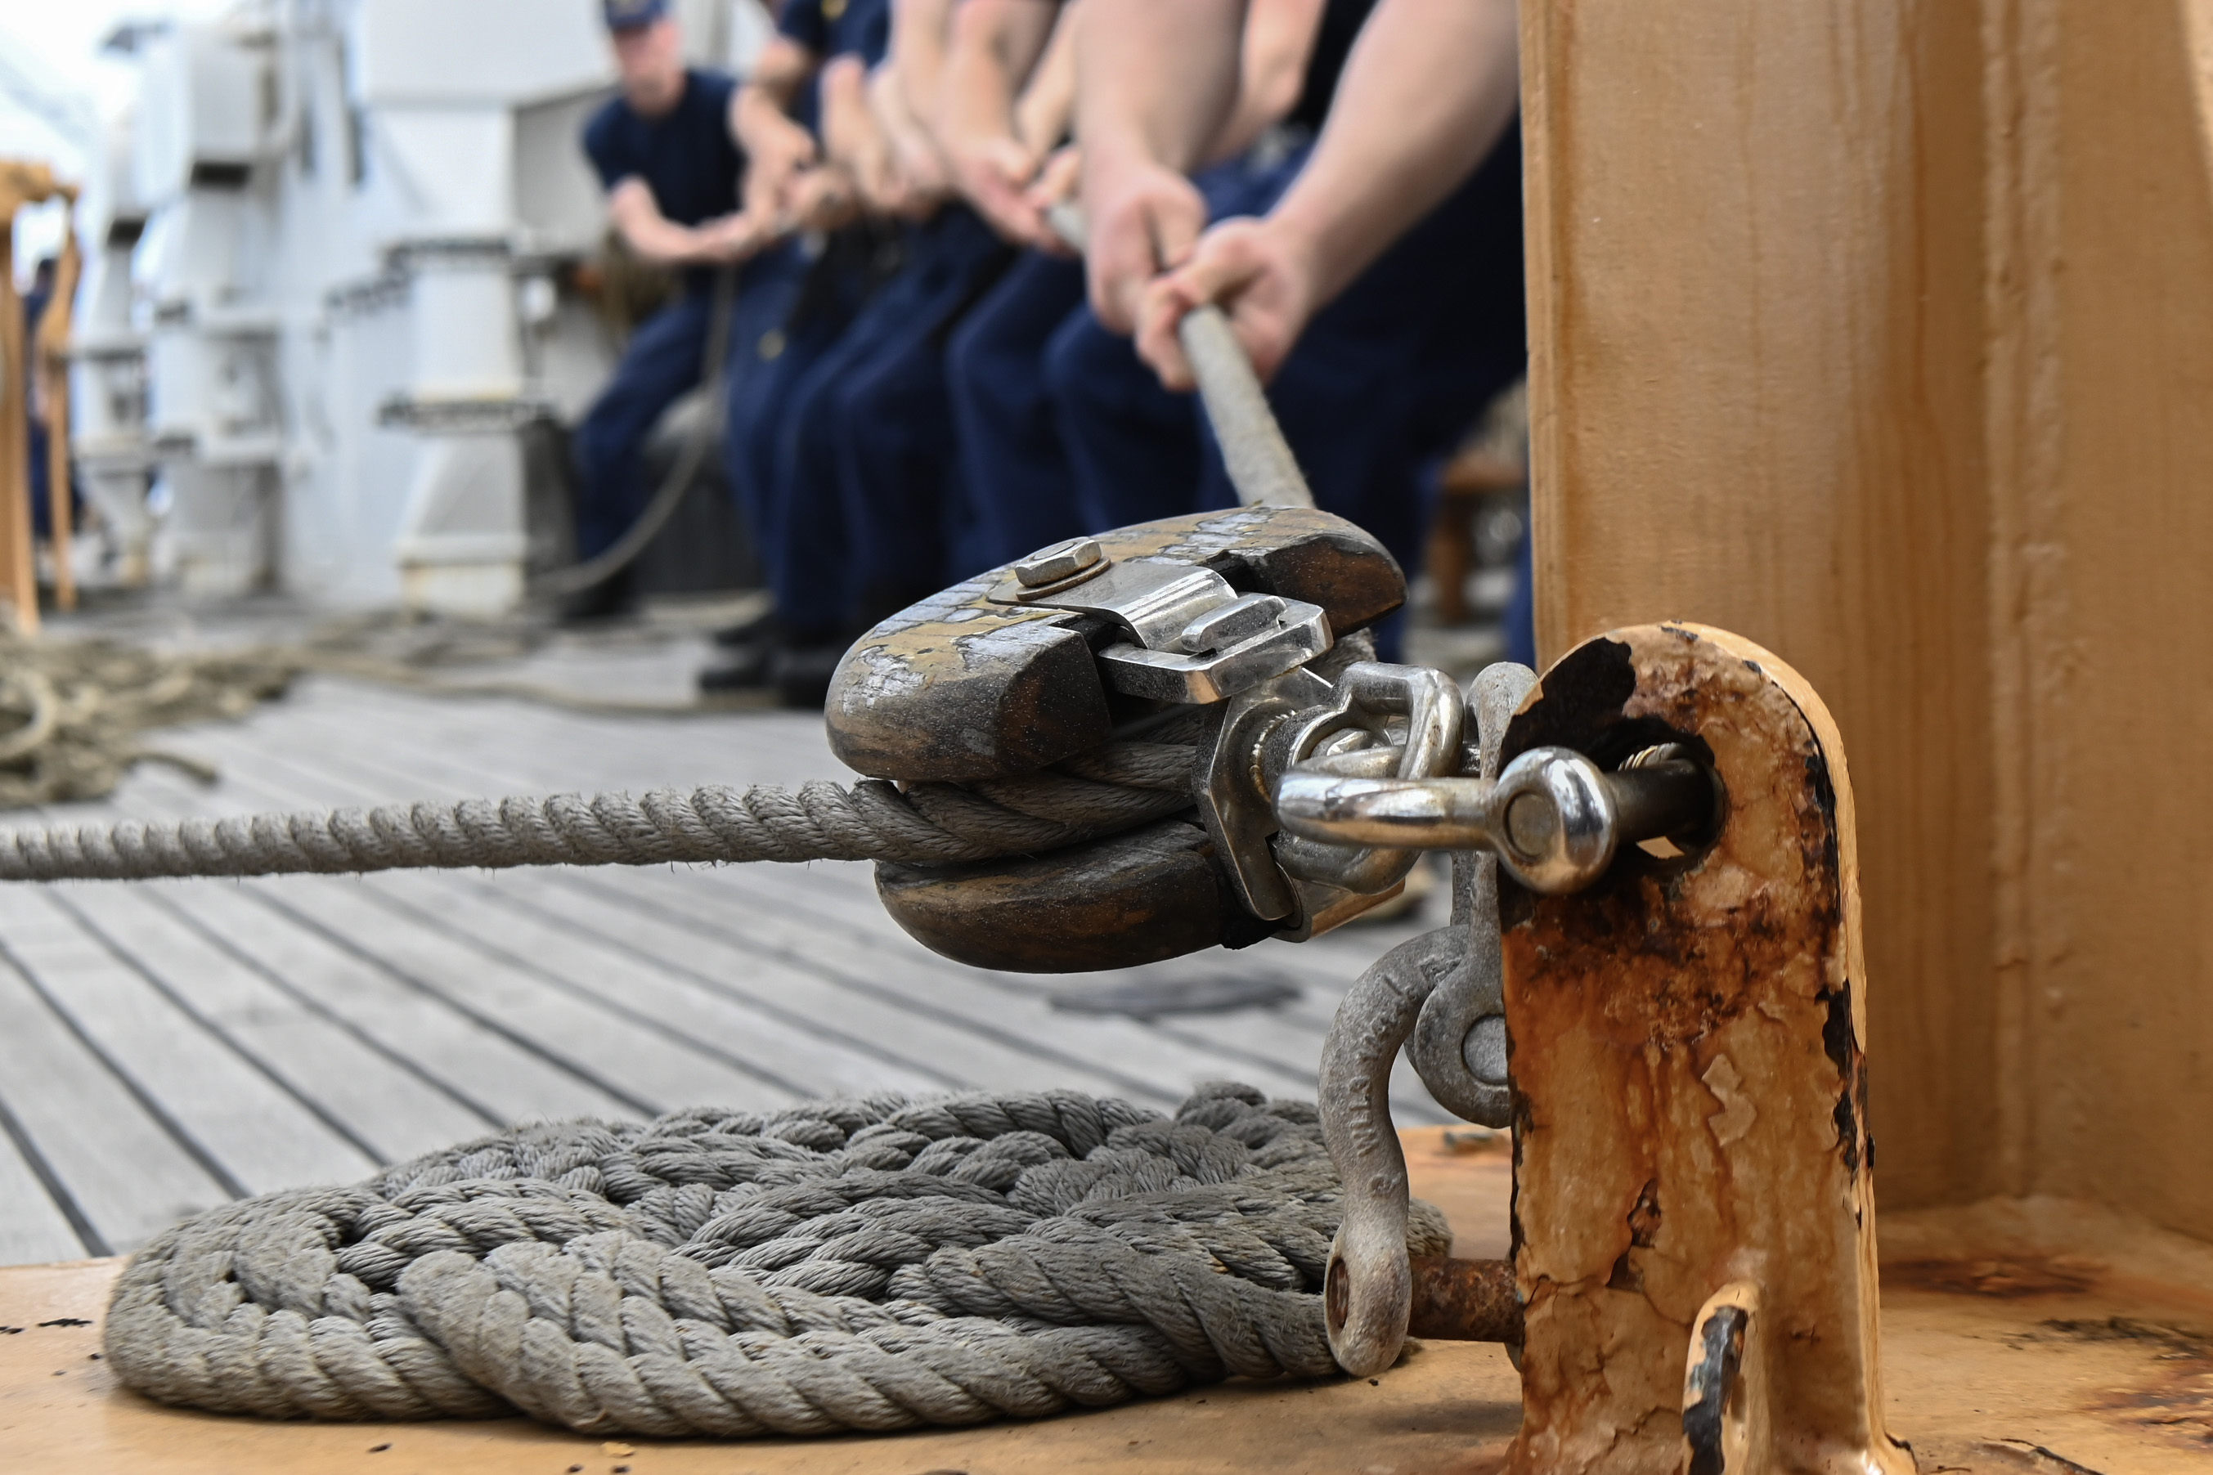
CGMA BOARD OF DIRECTORS
CGMA's Board only includes Directors who represent our Community:
Chair: Commandant
President: Asst Commandant of Personnel, CG-1
MCPOCG & MCPOCG-D
Commissioned Officer (Senior and Junior)
Chief Warrant Officer
Enlisted Leaders (Senior and Junior)
Civilian Employee
Reservist
Auxiliarist
Retiree
Spouse (Officer & Enlisted)
At Large
Notes:
Unlike other CG-related non-profits…
CGMA is governed by a Board of Directors who represent the CG Community, including:
Commandant
CG-1, Assistant Commandant of Personnel
MCPOCG
MCPOCG-D
Commissioned Officer (Senior & Junior)
Chief Warrant Officer
Enlisted Leaders (Senior & Junior)
Civilian Employee
Reservist
Auxiliarist
Retiree
Officer & Enlisted Spouse

Slide 5
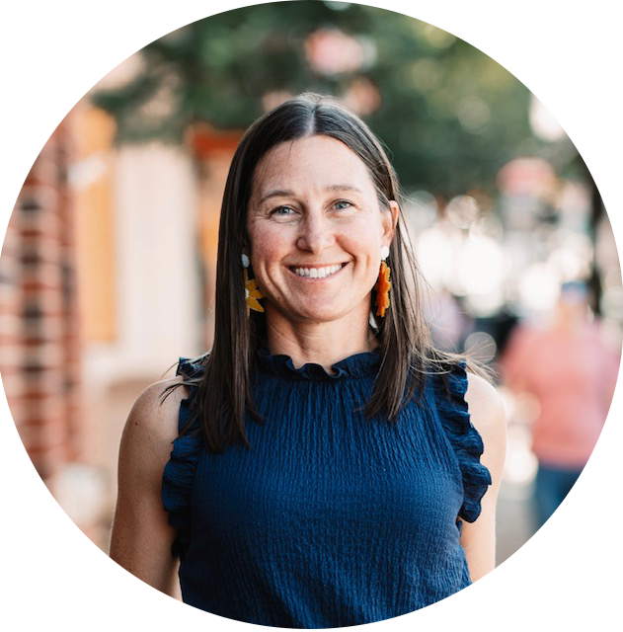
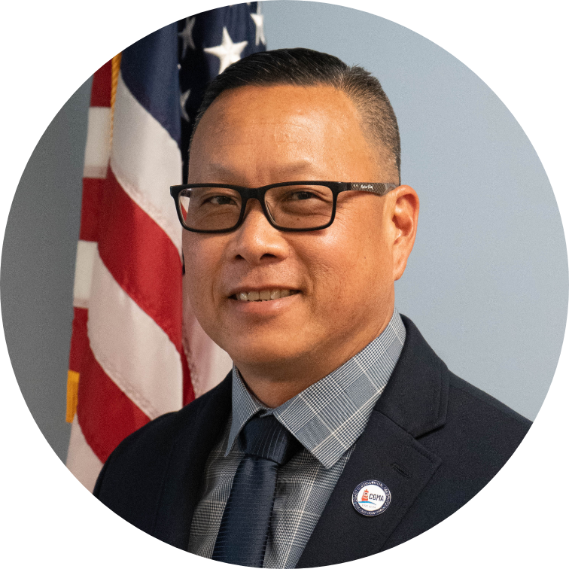
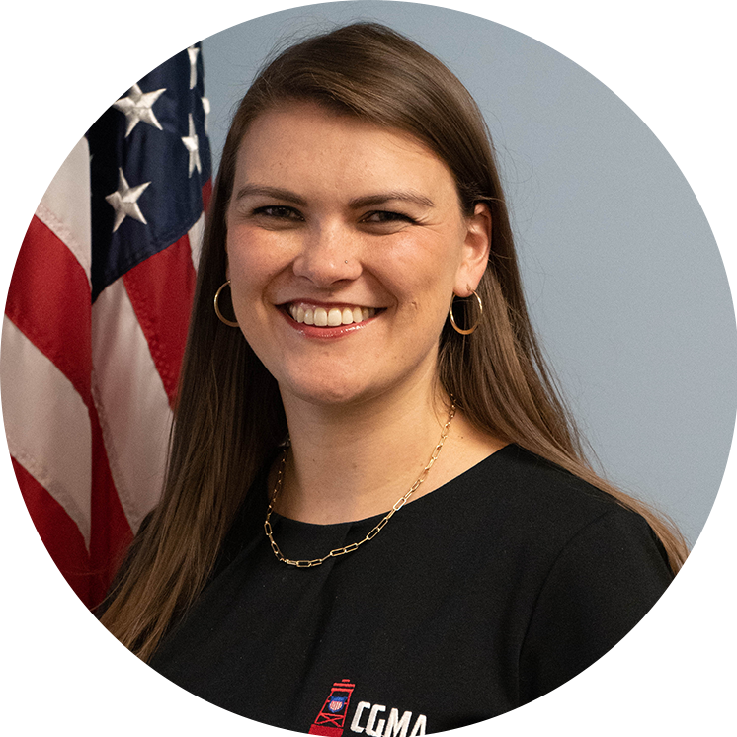
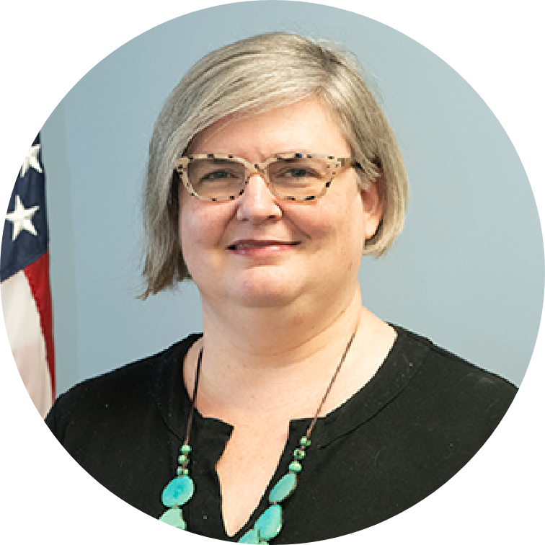
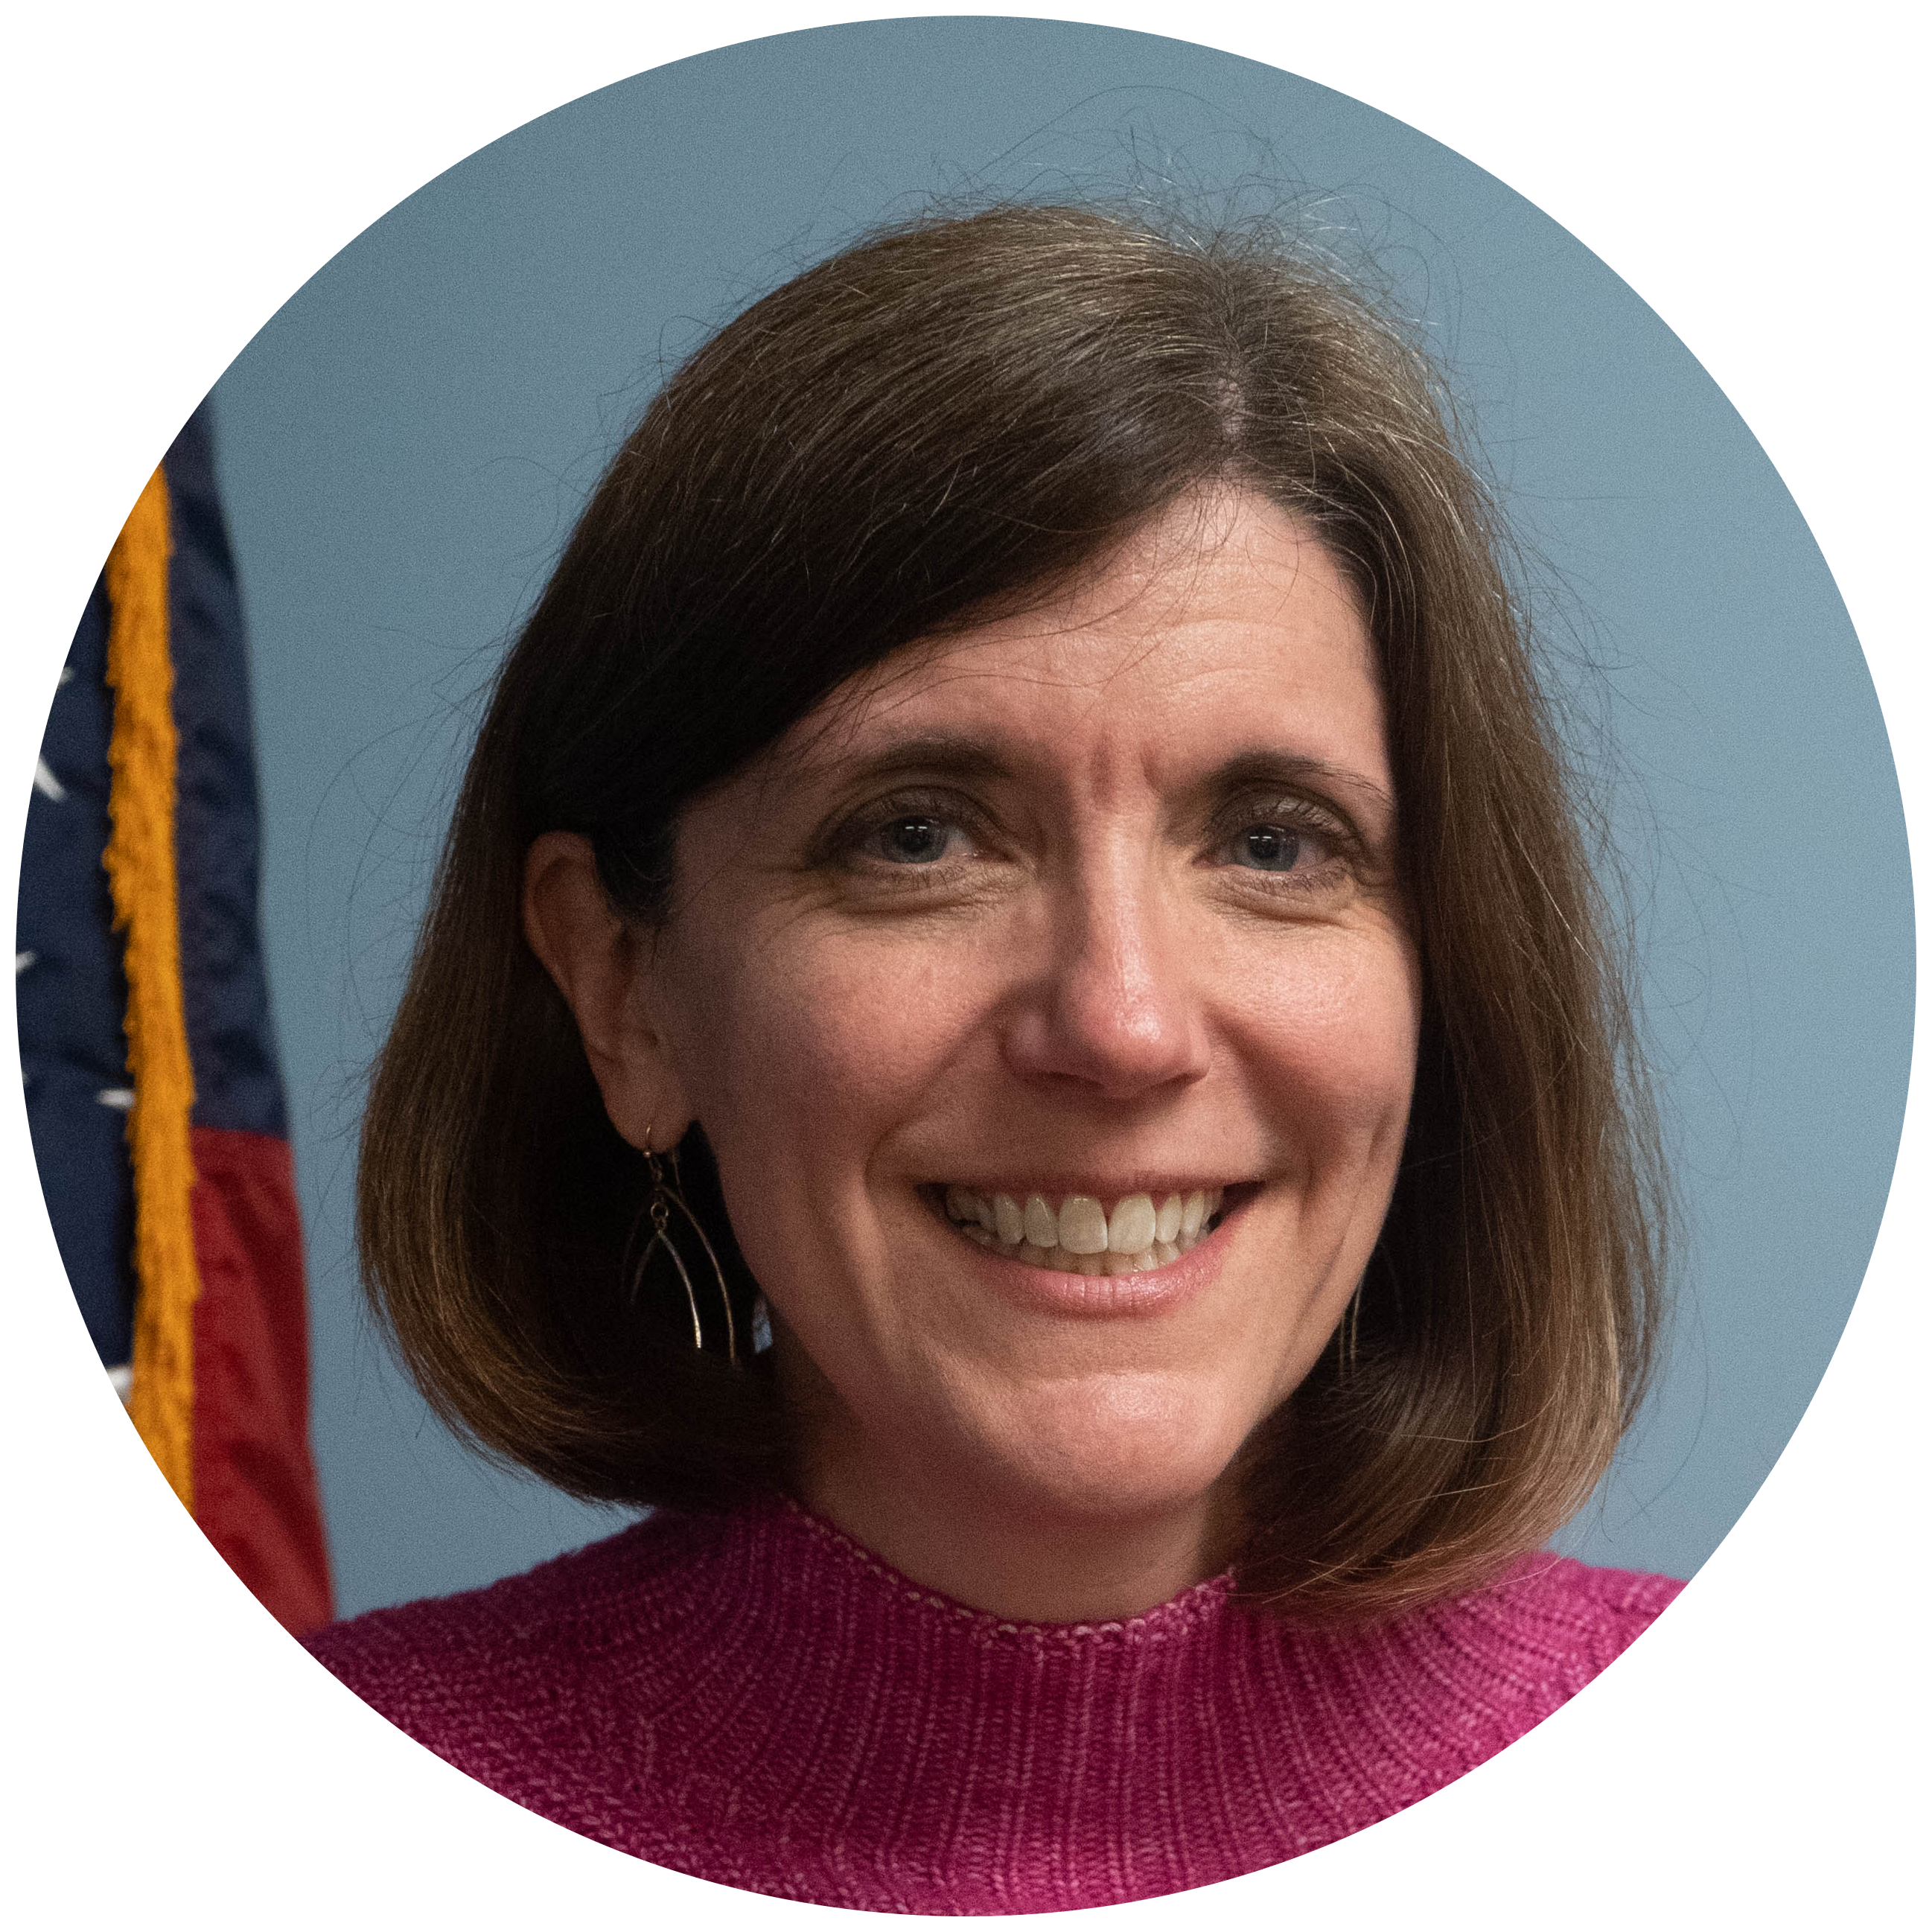
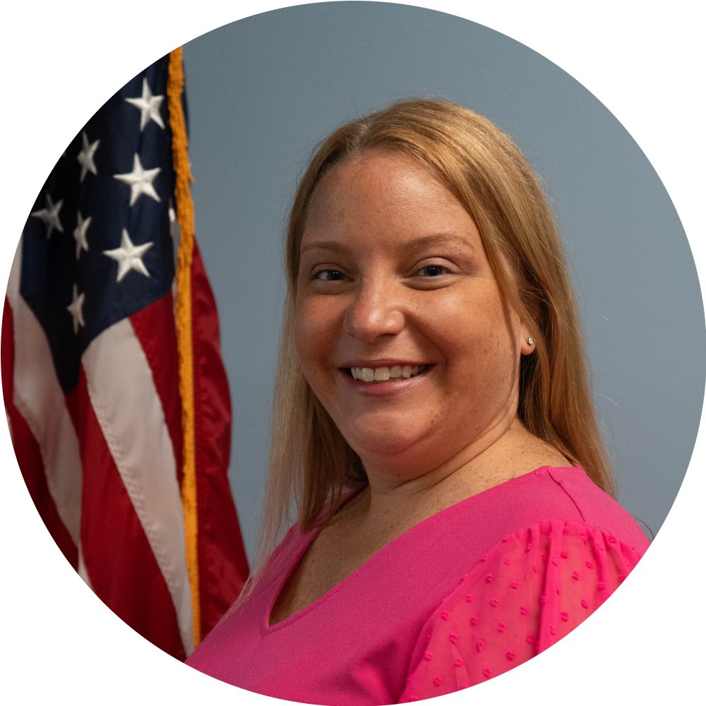
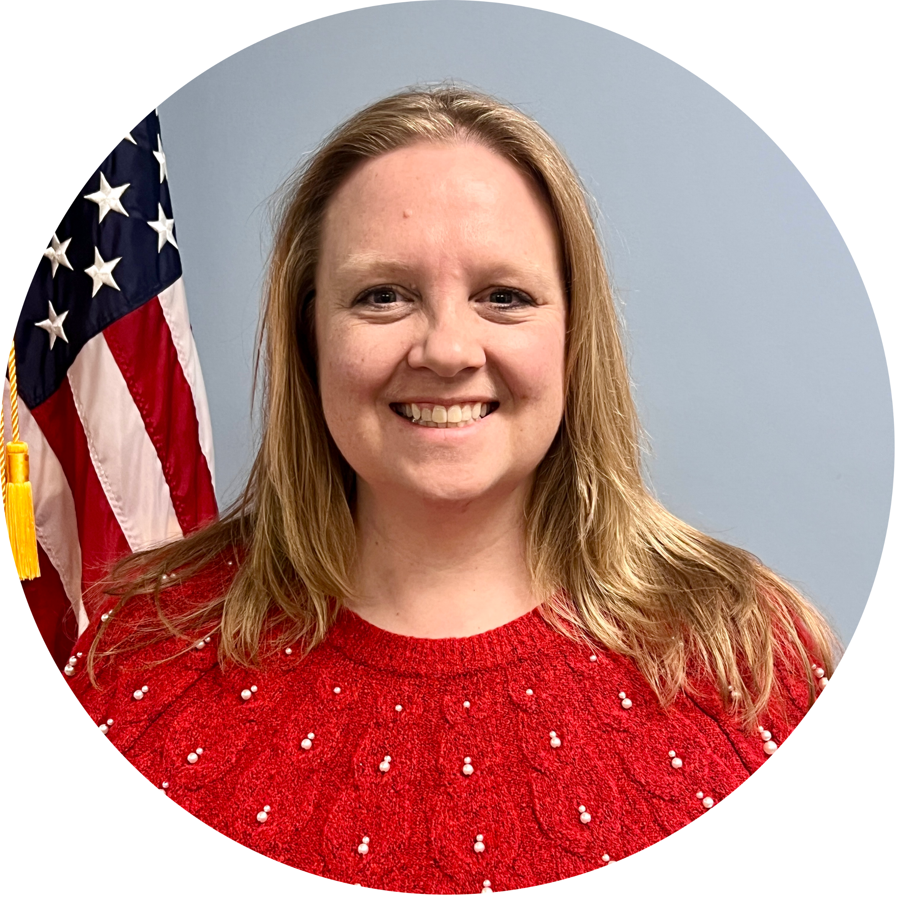
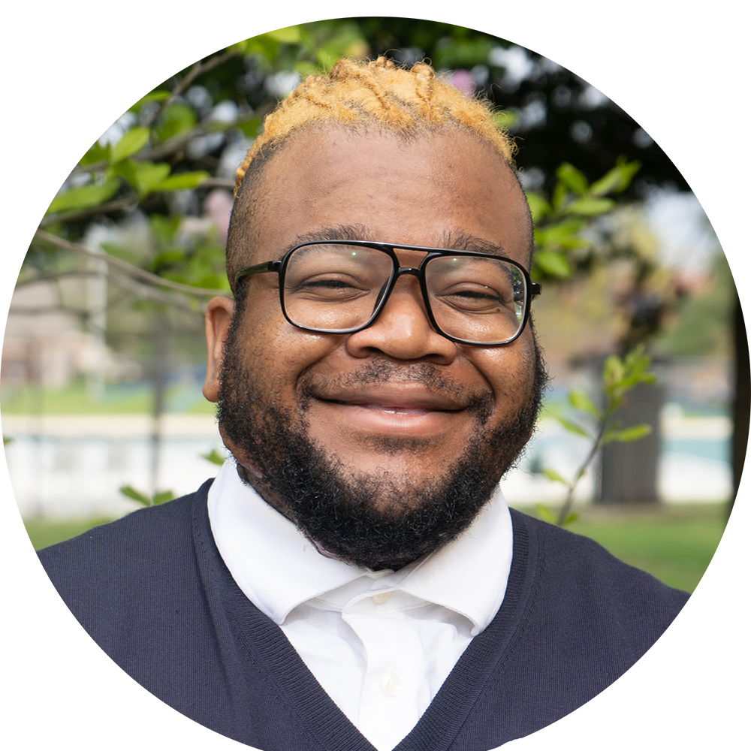
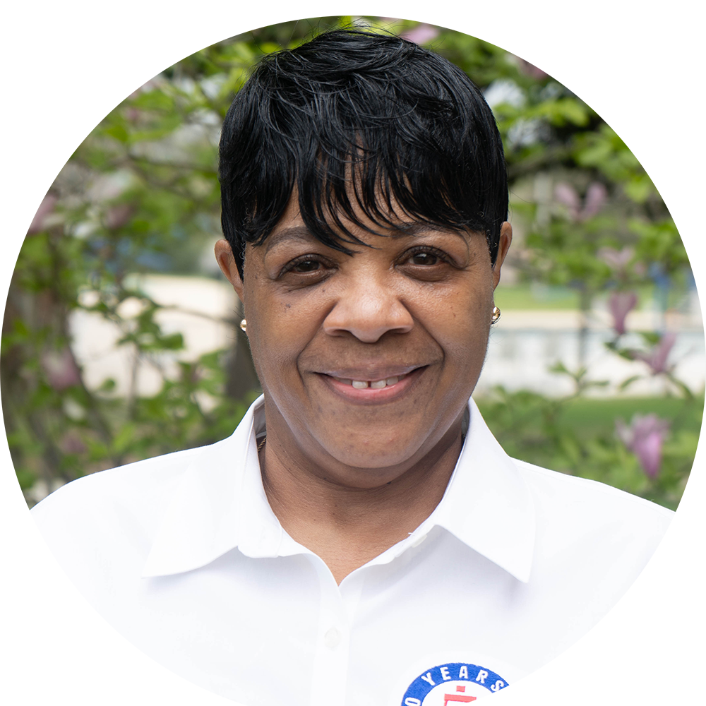
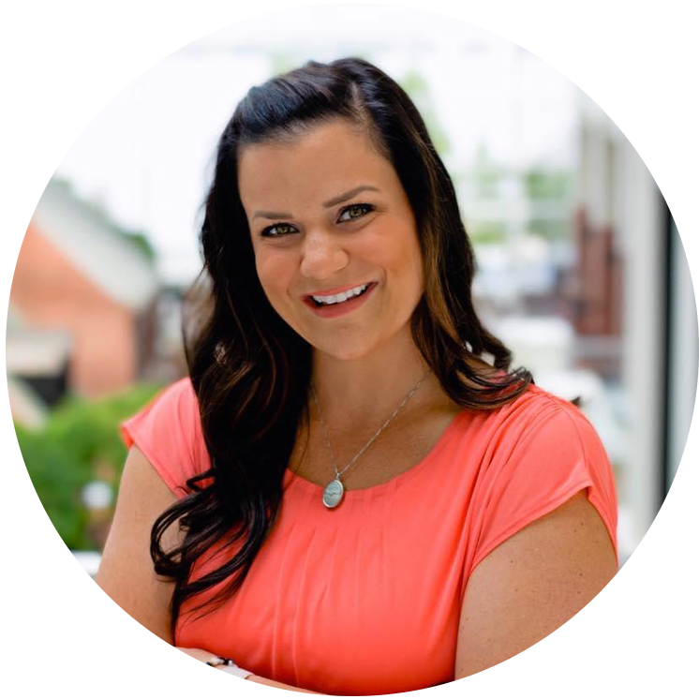
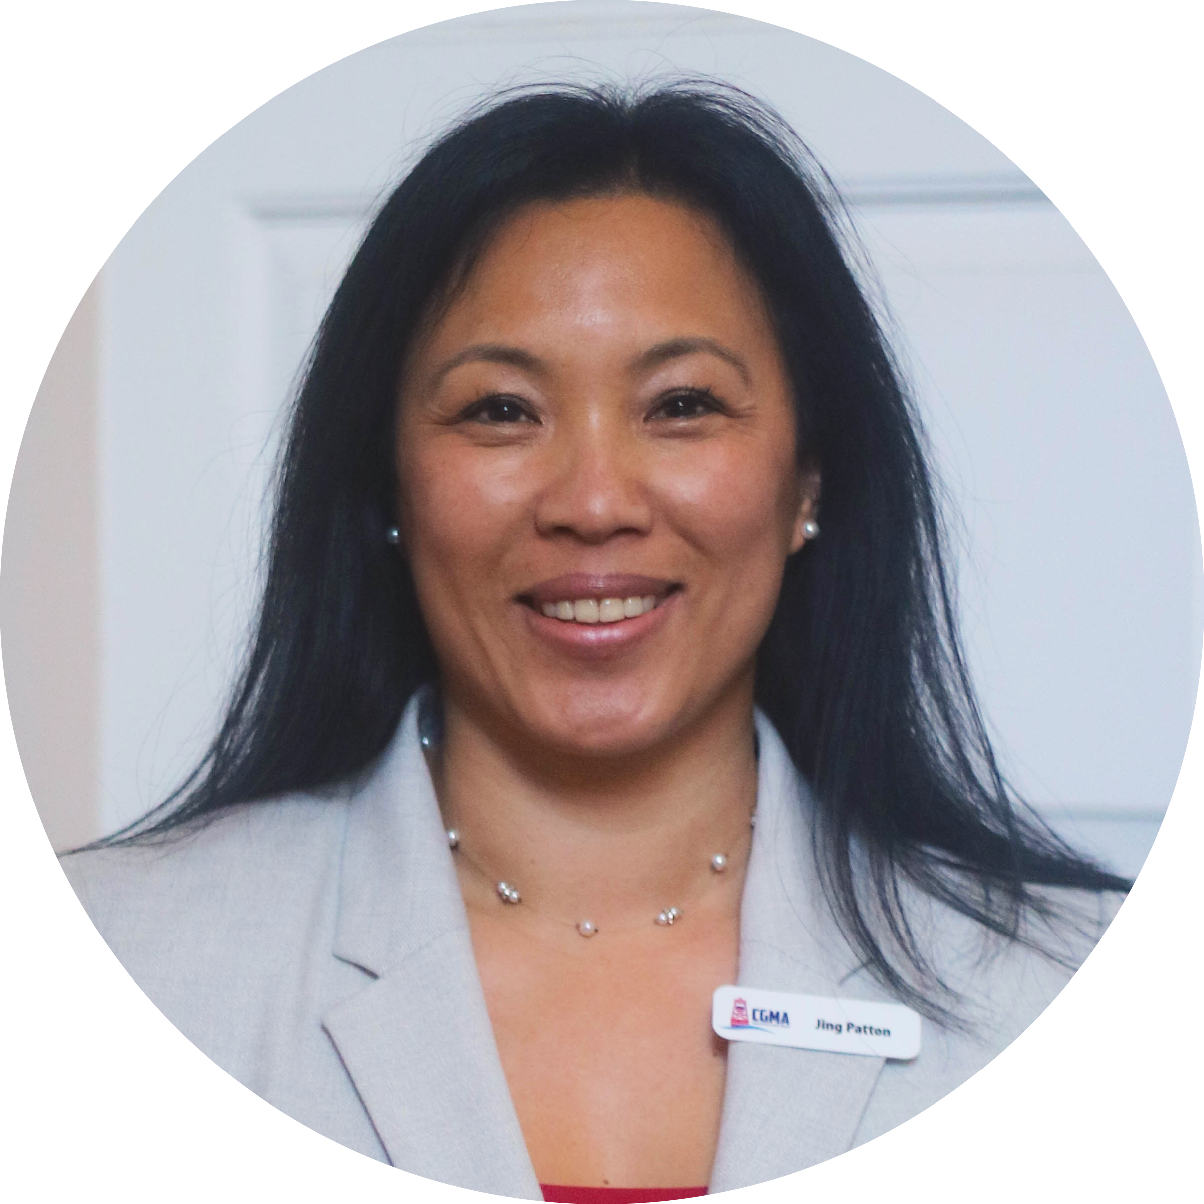
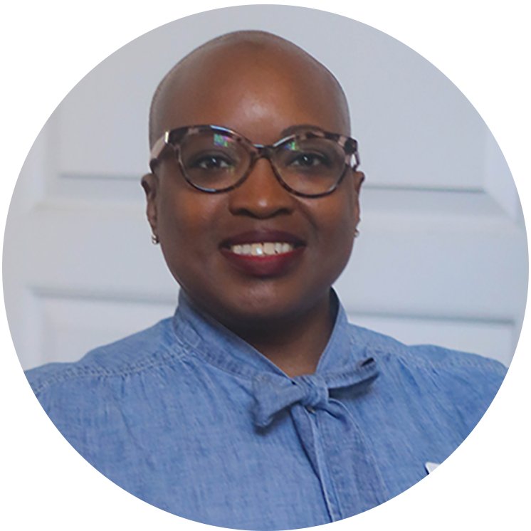
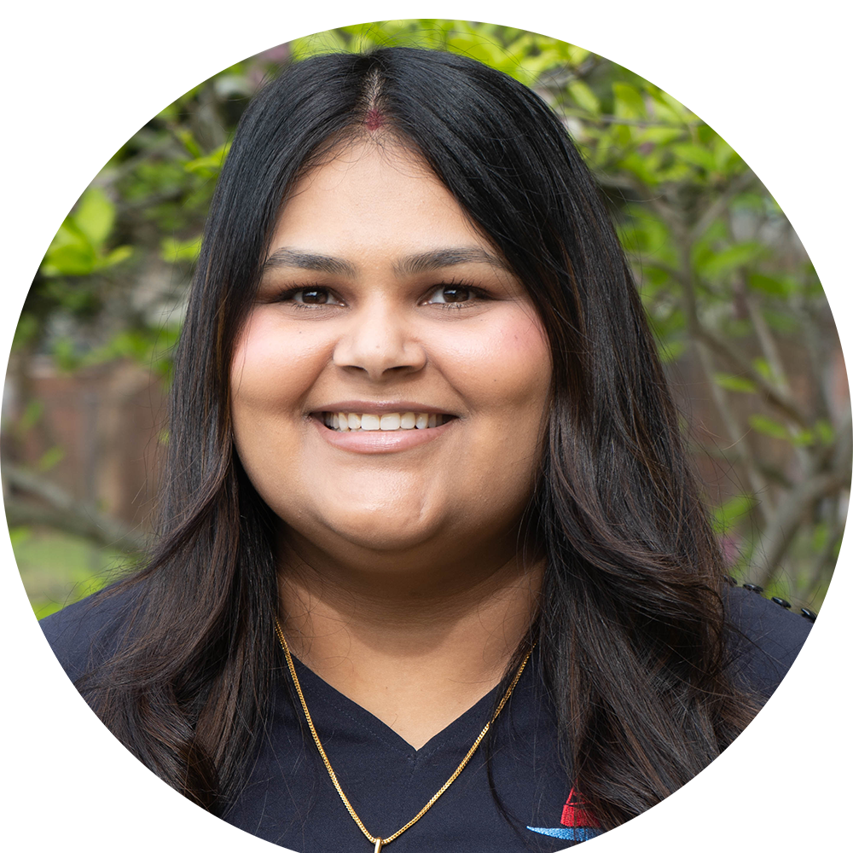
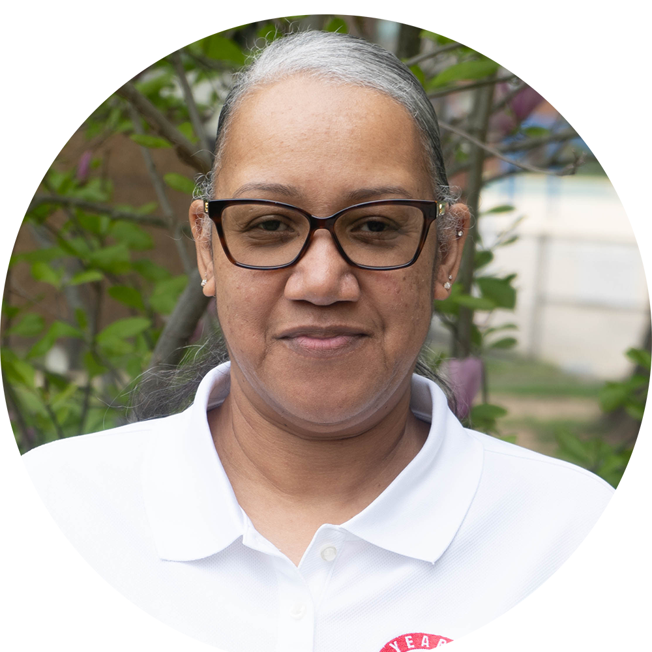
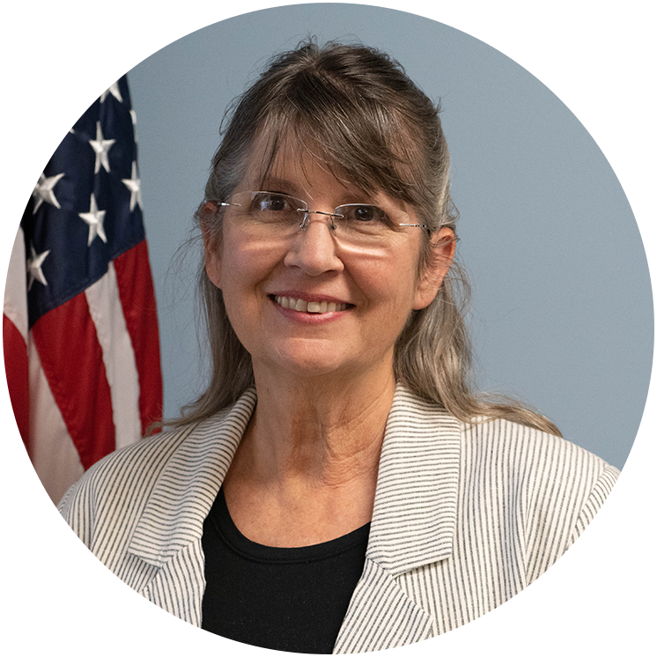
CGMA STAFF
Brooke Millard
CEO
Jason Wong
COO
Alena Howard
CDO & CCO
Sara Martin
CIO
Mellissa Bell
CFO
Andrea Cacciola
Operations
Erica Chapman
Fundraising Manager
Gosnel McDermott
Media Assistant
Gwendolyn Fouch
Office Manager
Jessica Manfre
Safe Harbor
Jing Patton
Operations
Sabrina Merritt
Accounts Payable
Shilpy Vohra
IT Support
Tanya Mathis
Collections
Valerie Stanley
Volunteer Assistant
CONTACT US AT CGMA@MYCGMA.ORG OR BY PHONE AT: 703-875-0404

Slide 6
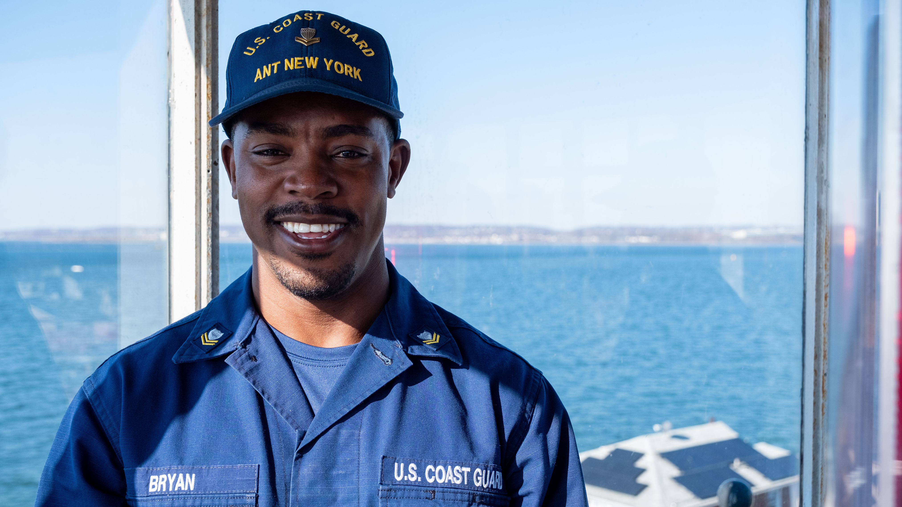
OUR MISSION
To Help Our Own
OUR VISION
A Coast Guard Community
empowered by a trusted network and shared resources to eliminate financial worry.
Disaster and Emergency Relief
Day-to-Day Support
Education Assistance
Grants and zero interest loans ensure short-term financial challenges don't become long-term financial problems
Notes:
For 100 years, Coast Guard Mutual Assistance has been helping Coast Guardsmen.
From caring for Coast Guard widows and members returning from the First World War to serving those impacted by the 2019 Government Shutdown, the COVID-19 pandemic, and more recent events like Hurricane Helene and the California wildfires — CGMA has proved a sure and steady resource
CGMA's Mission is "To help our own."
Since our founding, we have provided more than $240 million in direct support to Coast Guard members in need.
We do this through grants and zero percent loans ensuring short-term financial challenges don’t become long-term financial problems
These grants and loans help people with day-to-day essentials and immediate needs that crop up, and help see them through temporary challenges
It’s important to note that CGMA grants and loans are not meant to provide long-term support or funding for non-essential needs
This year the campaign is all about - The Power of Us. You might not realize it, but someone in your unit - on this call, could be benefiting from a grant or zero interest loan from CGMA. The power of us is coming together to make contributions so CGMA can provide disaster and emergency relief, day-to-day support and education assistance. This campaign is about making sure that no one in our Coast Guard community has to navigate financial challenges alone.

Slide 7
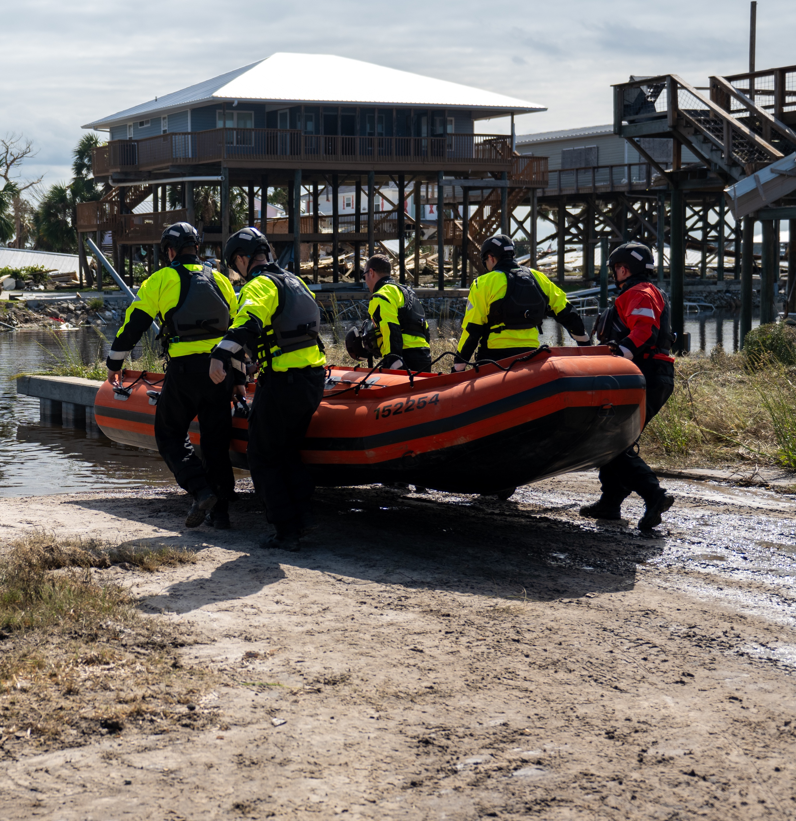
DISASTER AND
EMERGENCY RELIEF
Basic Living Expenses
Car and Home Repairs
Travel Expenses
Evacuation Expenses
Funeral Expenses
Loss of Funds
Medical and Dental Costs
Spoiled Food Replacement
Temporary Living Expenses
Notes:
Disaster and Emergency Relief is just what the name suggests – assistance we provide when disaster strikes, whether on an individual level, or widespread.

Slide 8
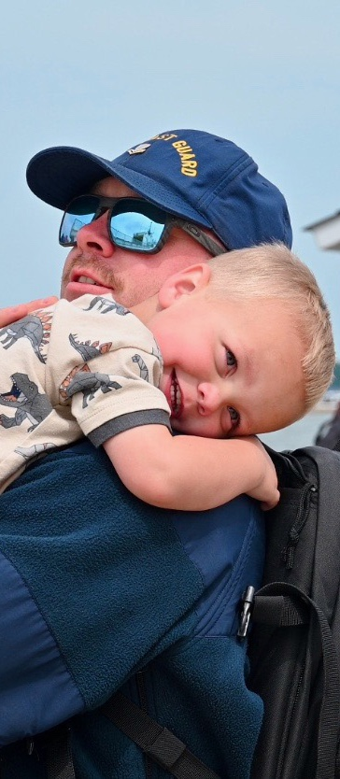
DAY-TO-DAY SUPPORT
Family Support
PCS Childcare Grant
Childcare Loans
Special Needs Grant
Adoption Assistance – Grant and Loan
Assisted Reproductive Services Loan
Baby Supplies (Layette)
Breast Milk Shipment Reimbursement(Grant)
Pet/Quarantine Expense Loan
Funeral Expenses
Elder Care Loans
Housing Assistance
Rental Assistance Loan
Closing Costs Loan
Household Furnishings Loan
Utility Startup Loan
DLA Supplemental Grant
PCS Incidentals Loan
Transportation Assistance
OCONUS Car Rental Loan
Vehicle Shipment Loan
Vehicle Repair
Notes:
Day-to-day support includes newborn baby supplies, uniforms for A-school, housing assistance, and family building support for procedures like IVF, surrogacy or adoption.
There are so many programs available to help people start families, purchase homes, take care of loved ones and so much more.
Detailed information on all of our programs, can be found on our website at mycgma.org.

Slide 9
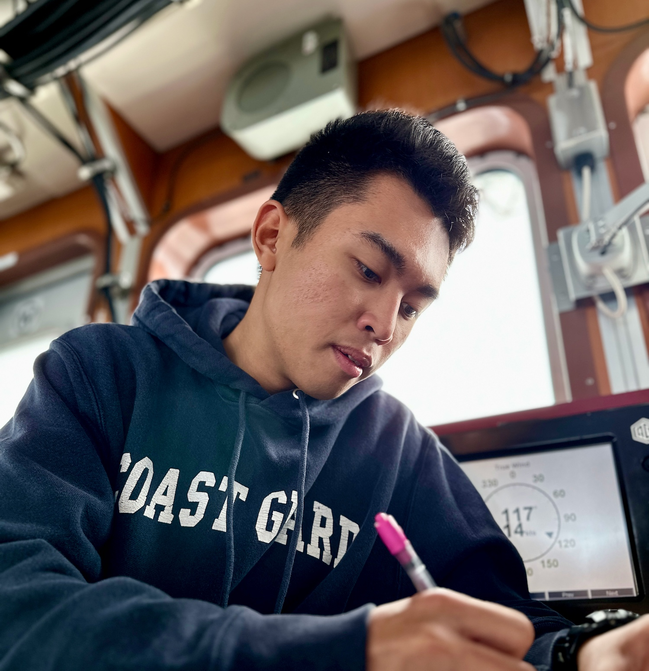
EDUCATION ASSISTANCE
Grants
Supplemental Education Grant
Education Advocate Grant
Stafford/Plus Loan Fee Grant
Financial Counseling Grant
Financial Education Childcare Grant
Loans
Education Loan
CG Cool Loan
Spouse Professional Requirement Loan
Debt Management Loan
Notes:
Education Programs are a major initiative for CGMA. By supporting higher education, these programs foster long-term financial stability.
CGMA provides grants and zero-percent loans to help Coasties access educational opportunities without the burden of high-interest debt.
Our SEG grant may be the most popular program we offer.
Our Education Assistance can be used for any number of costs associated with education from tuition to the cost of a laptop.

Slide 10
IN ANY GIVEN YEAR CGMA PROVIDES SUPPORT TO 1 IN 7 ACTIVE DUTY MEMBERS.
THAT’S THE POWER OF US

Slide 11
2024 GIVING BREAKDOWN
In 2024, CGMA Representatives processed 6,302 cases
2024 Support
Highest Grant Amount
$24,000
Total Grants
$2.9 Million
$8.5 million in total support; nearly $3 Million in grants
ACTIVE DUTY
5,207 CLIENTS
$6,684,055 IN ASSISTANCE
RESERVE MEMBERS
319 CLIENTS
$422,825 IN ASSISTANCE
DISASTER AND EMERGENCY RELIEF
$4,039,040
AUXILIARY MEMBERS
61 CLIENTS
$173,441 IN ASSISTANCE
RETIRED MEMBERS
282 CLIENTS
$505,176 IN ASSISTANCE
EDUCATION ASSISTANCE
$1,783,866
CIVILIAN MEMBERS
388 CLIENTS
$682,136 IN ASSISTANCE
OTHER
45 CLIENTS
$96,860 IN ASSISTANCE
DAY-TO-DAY SUPPORT
$2,741,587
On an average day, CGMA provides $27,123 in assistance.
More than 590 CGMA Representatives at 132 shore units and 54 cutters
in 39 states and territories across 19 time zones
Notes:
In 2024 CMGA helped more than 6,300 Coast Guard members and provided $8.5 million in assistance.
And on an average day, we provided $27,123 in assistance over the last year.
We support active duty, reservists, auxiliarists, retirees and civilians - and their families
More than 590 Representatives across the Coast Guard help educate members on our programs and walk them through the process of applying for assistance.
They can also serve as your partners in your campaign efforts, but we’ll talk more about that later in this presentation.

Slide 12
The CGMA Difference: A Tale of 2 Piers
PIER 1
E5 stationed on CGC cutter had a baby who needed to spend two weeks in NICU, a 3-hr drive away
Command Tried
TDY orders to area …did not come with housing
Grant from CPOA …<$1000
Wounded Warriors …could not support
Outcome: Member drove 6 hours roundtrip to the hospital each day
PIER 1
E5 stationed on CGC cutter had a baby who needed to spend two weeks in NICU, a 3-hr drive away
Member received a CGMA Emergency Travel Grant & Loan and stayed 2 weeks in hotel near the hospital
CGMA let us focus on ensuring our baby would be getting the care she needed and deserved rather than trying to drive up and down the Keys daily and paying for hotels out of pocket.
– BM2 John Tucker
Notes:
Baby Aurora was born to BM2 John Tucker on Cutter Skipjack in Key West, FL but needed open heart surgery at just 5 days old.
She was diagnosed with transposition of the great artery. This was a life-or-death situation.
She was medi-vac'd to Nicklaus Children Hospital in Miami FL just 3 hours after her birth.
John and his wife found a hotel near the hospital so they could be near their newborn daughter.
His Chief, BMC Snovell, worked with LT Alger, their local CGMA rep, to get secure CGMA funds to help pay for local lodging, food, and fuel, for 2 weeks.
Now, Aurora is one year old. She's a healthy and happy baby.

Slide 13
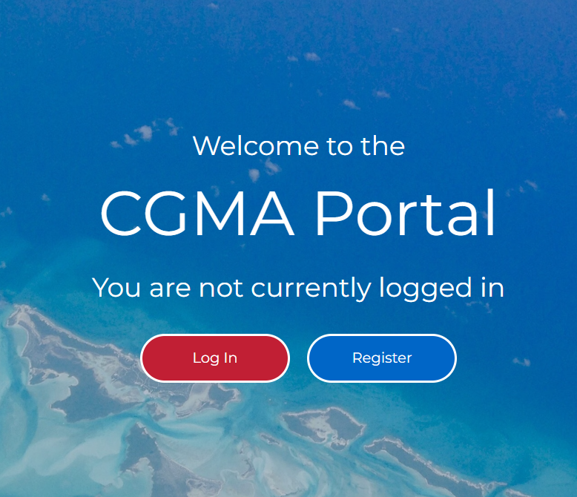
Notes:
You can get more information about CGMA's programs and how to apply for assistance by speaking with your CGMA Representative or by visiting the website at mycgma.org
If you’re not sure who your CGMA Rep is, you find that out on our website, as well via the "Find My Rep" button in the top right corner.
The online application portal is NEW (as of Dec 2024) and everyone eligible can start an application for assistance without a CGMA Rep's initial help.

Slide 14
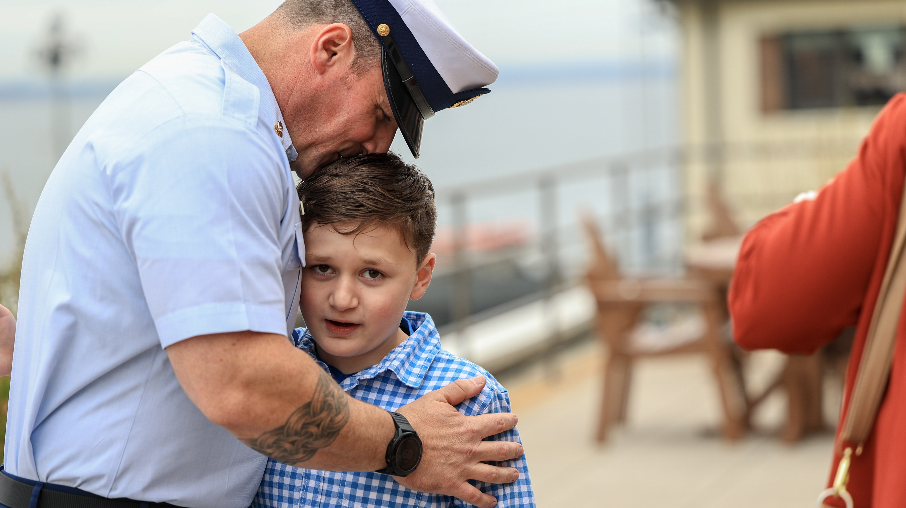
CGMA IS 100% FUNDED THROUGH DONATIONS
Notes:
In order to provide this support, CGMA relies on contributions from the Coast Guard community.
As I said, we are the Coast Guard’s only official aid organization. CGMA does NOT receive any government funding.
CGMA is 100% funded through donations, primarily from the Coast Guard community.

Slide 15
COAST GUARD DONATION TRENDS
As the need for support has increased, donations and allotments have decreased dramatically over time.
If this trend continues, we will not be able to sustain our current level of support.
We are losing an average of 877 allotments annually
Notes:
Over the last several slides, we've talked about the support that CGMA provides.
The funds you raise directly fund grants and loans that change lives—ensuring individuals receive critical services, and our Coast Guard community thrives.
Needs are increasing, but funding is shrinking. The demand for services is rising at an unprecedented rate. Without increased donations, CGMA won’t be able to sustain the current level of support they provide or keep up with the growing need.
Giving through an allotment provides steady, reliable funding that allows CGMA to sustain it's giving and support those in need. Allotments are automatic, recurring and are deducted directly from your paycheck.
Over the last few decades, allotments among Active Duty Coast Guard members – which is the most important method of donation – has steadily declined at a pace of 877 allotments each year. This translates to a loss of about $43,000 per year. Over the last decade, the cumulative impact of this has been a nearly 50% reduction in allotments.
At this rate of decline, we will not be able to continue to provide the assistance the community has come to rely on at level it’s come to expect.
This is why our Annual Fundraising Campaign is so important.
This is our opportunity to directly ask the Coast Guard community to help us fund the programs people need – and to remind them of the resources available.

Slide 16
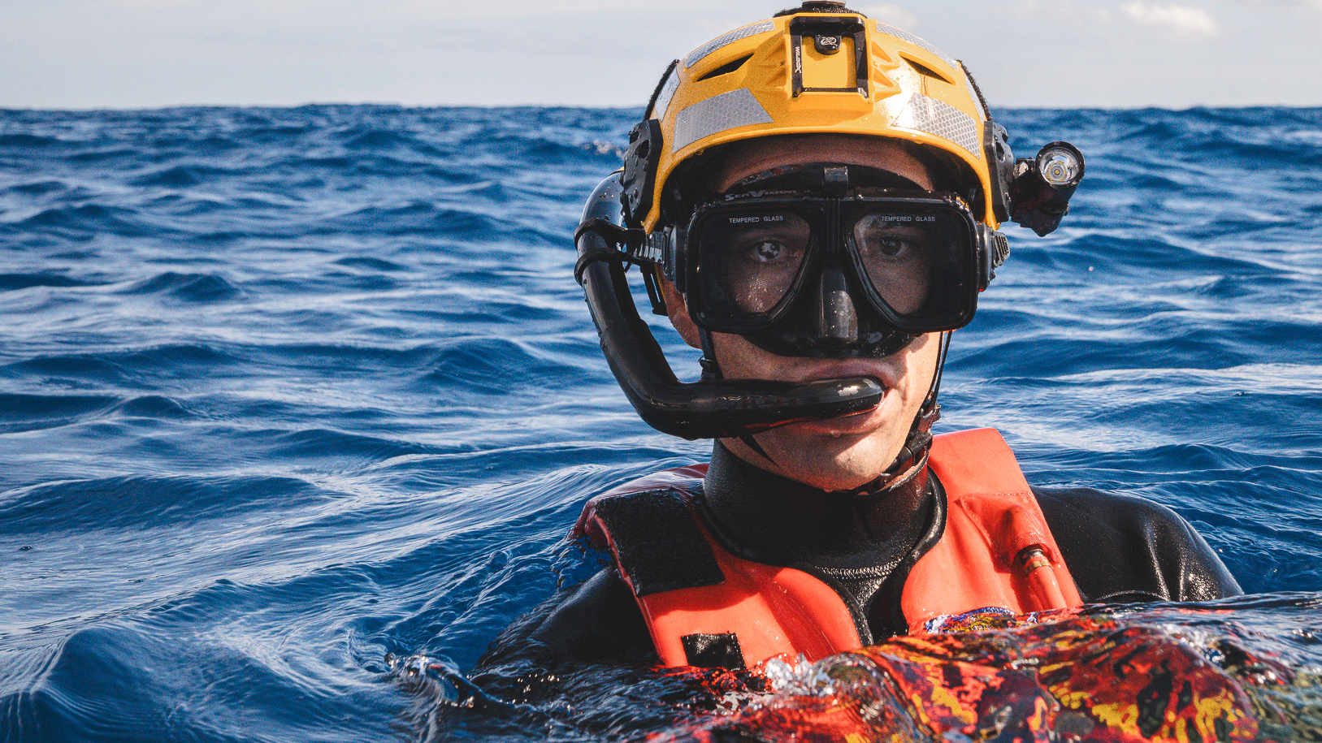
2025 ANNUAL FUNDRAISING CAMPAIGN
THE POWER OF US
APRIL 1 – MAY 31
Notes:
This year’s campaign will run from April 1 through May 31
Our campaign theme is The Power of Us
This truly embodies CGMA – we are Coasties Helping Coasties. We are able to provide Coast Guard community members the help they need when they need it thanks to the generosity of all its members.

Slide 17
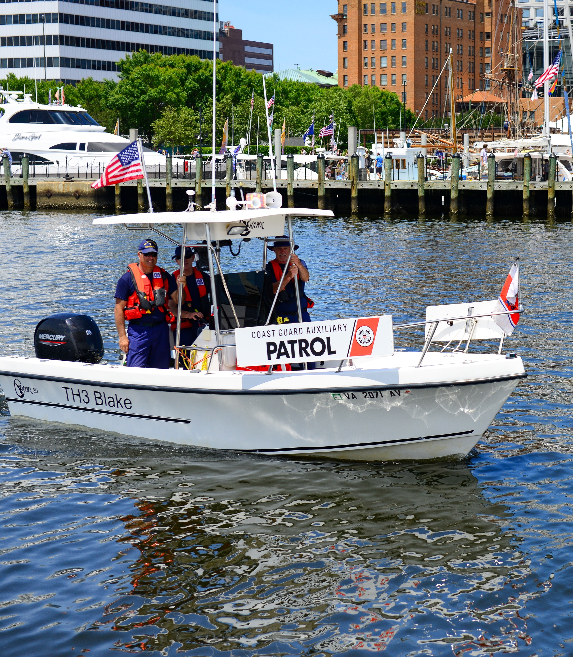
YOUR ROLE AS CAMPAIGN COORDINATOR
Serve as the primary contact about the campaign at your unit
Spread the word about the campaign and the importance of donating through:
Lead the campaign kickoff / All-Hands CGMA training
Connect with 100% of personnel at your unit
Hold 1:1 Conversations
Hold fundraising event
Display campaign materials
Help people make their donations
Report to CGMA on progress toward goals
Attend execution and wrap-up calls
AT LARGER UNITS, YOU CAN RECRUIT KEY WORKERS TO SUPPORT YOU.
Notes:
So, what does it mean to be a Campaign Coordinator?
You will be our local voice and primary contact throughout the campaign to help drive fundraising efforts and increase awareness of the support and programs available to our Coast Guard community
Using the materials we provide, you will spread the word about the importance of donating through presentations to your teams, fundraising events and one-on-one conversations.
Handing out Pledge Forms during your all-hands meeting kickoff is one of the most effective ways to encourage participation, ensuring that everyone receives the information and has an opportunity to give.
If necessary, you can help people complete their pledge forms –
You will collect all pledge forms along with checks and money orders and submit a Campaign Coordinator Summary Report to CGMA at the end of the campaign recapping your fundraising efforts.
At larger units, Campaign Coordinators can recruit Key Workers to support you during the campaign. It’s important to select individuals who are motivated, knowledgeable, and trustworthy. Whenever possible, they should be individuals who have volunteered to serve in that capacity and are familiar with CGMA.
If you are at a unit where your Key Workers will not be co-located with you - please contact CGMA-HQ to coordinate getting materials to your Key Workers and to discuss the process for submitting Key Worker Summary Reports, Pledge Forms, and donations.
You will also received invites to an execution call during the campaign and a wrap-up call at the end of the campaign. Please be on the lookout for these invitations.

Slide 18
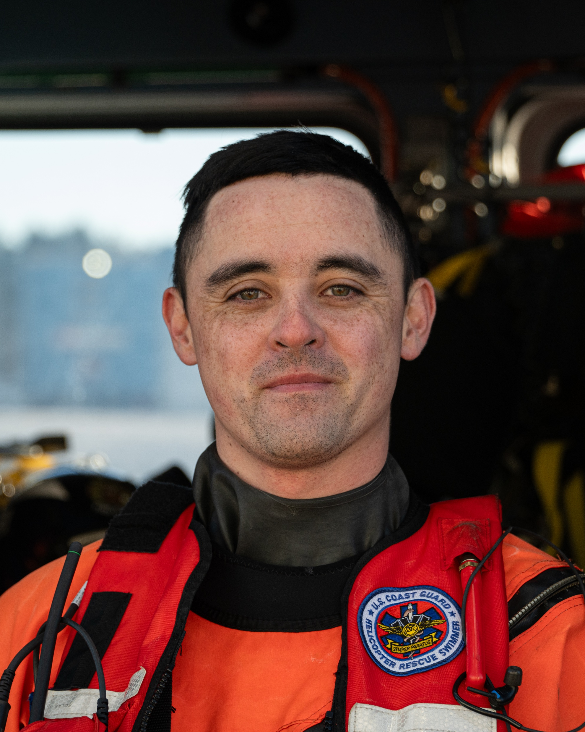
GOALS
Connect with 100% of the members of your unit
Double Active-Duty allotments and increase overall giving
Increase awareness of programs and resources
Notes:
You are the key connection between the campaign and your unit—your enthusiasm and leadership will set the tone.
This isn’t just about meeting goals; it’s about strengthening support for our Coast Guard family.
Every conversation is an opportunity to increase awareness, inspire giving, and make a lasting impact.
Connect with 100% of Your Unit – try to ensure you and/or your Key Workers connect with everyone in your unit
Personal outreach matters: having a direct conversation is more effective than posters or emails alone.
We want you to lead by example: your commitment influences others—consider making your own contribution first.
Know your audience: some will give out of a sense of duty, others when they see the direct impact—you know your unit best - tailor your approach
Double Active-Duty Allotments and Increasing Overall Giving
The more we raise, the more we can do for Coast Guard members and families facing financial hardships
Starting or increasing an allotment ensures consistent, reliable funding for emergency grants, zero-percent loans, and essential programs
Every contribution - large or small - strengthens the safety net community.
We also want to take this opportunity to increase awareness of the programs, support and resources that CGMA offers – you can do that in your All Hands presentation.
If you don't know the answer about a particular program, you can reach out to your rep or reach out to us at CGMA-HQ

Slide 19
KEY MESSAGES
Your Donations are Critical to CGMA Funding
CGMA is 100% funded through donations, mostly through the Coast Guard community
While the need for support continues to increase, donations have dramatically declined.
Without your donations, we cannot continue to provide the support you deserve and have come to rely on.
Emphasize Convenience
Payroll allotments allow you to “set it and forget it”
Already enrolled in payroll allotments? Consider increasing it this year.
It’s easy to start a new allotment or increase your current allotment
You can also donate online via credit card (includes a 4% transaction fee), check or money order. You can set up a recurring credit card donation to multiply your impact month after month.
Notes:
Achieving these goals starts with clear, compelling conversations. To help you engage and inspire your unit, here are the key messages to focus on:
CGMA is 100% funded through donations, mostly through the Coast Guard community
We do not receive any government funding
Emphasize Convenience – Donating is easy
Payroll allotments allow you to “set it and forget it”
Already enrolled in payroll allotments? Consider increasing it this year.
The easiest way to do this is on the website

Slide 20
Include current duty station and 5-digit OPFAC number when donating
When you present to All Hands, include your OPFAC in the presentation.
PAYROLL ALLOTMENT | CREDIT CARD | CHECK
Notes:
Let’s talk for a minute about how people can donate. There are a few ways.
You will receive pledge forms that people can complete and return to you - and then you submit them with your summary report at the end of the campaign.
They can use these pledge forms to set or increase a payroll allotment or to make a one-time donation using a credit card (for a fee), check. As I mentioned, handing out pledge forms is one of the most effective ways to encourage participation and giving. It's one way groups can come together to commit their support - especially if everyone decides to complete the form while in the meeting.
Members can also donate or start or increase an allotment online - so if someone can't make it to the meeting or doesn't want to fill out a pledge form then and there, they can go online.
Payroll allotments are the method we focus our efforts on because Coast Guard members can set it and forget it, and 100% of the funds go directly to CGMA.
Allotments are automatic deductions and make giving easy.
A small amount per paycheck adds up over time, providing sustainable support
Even an increase of $5 or $10 per month can make a significant difference
Many of the materials you receive will have a QR Code on them that takes them directly to the donate page on our website. There, people can they can start or increase their payroll allotment or make a one-time donation using a credit card, again, this includes a 4% admin fee
When donating, it’s important that they include the name of their current duty station and 5-digit OPFAC number.

Slide 21
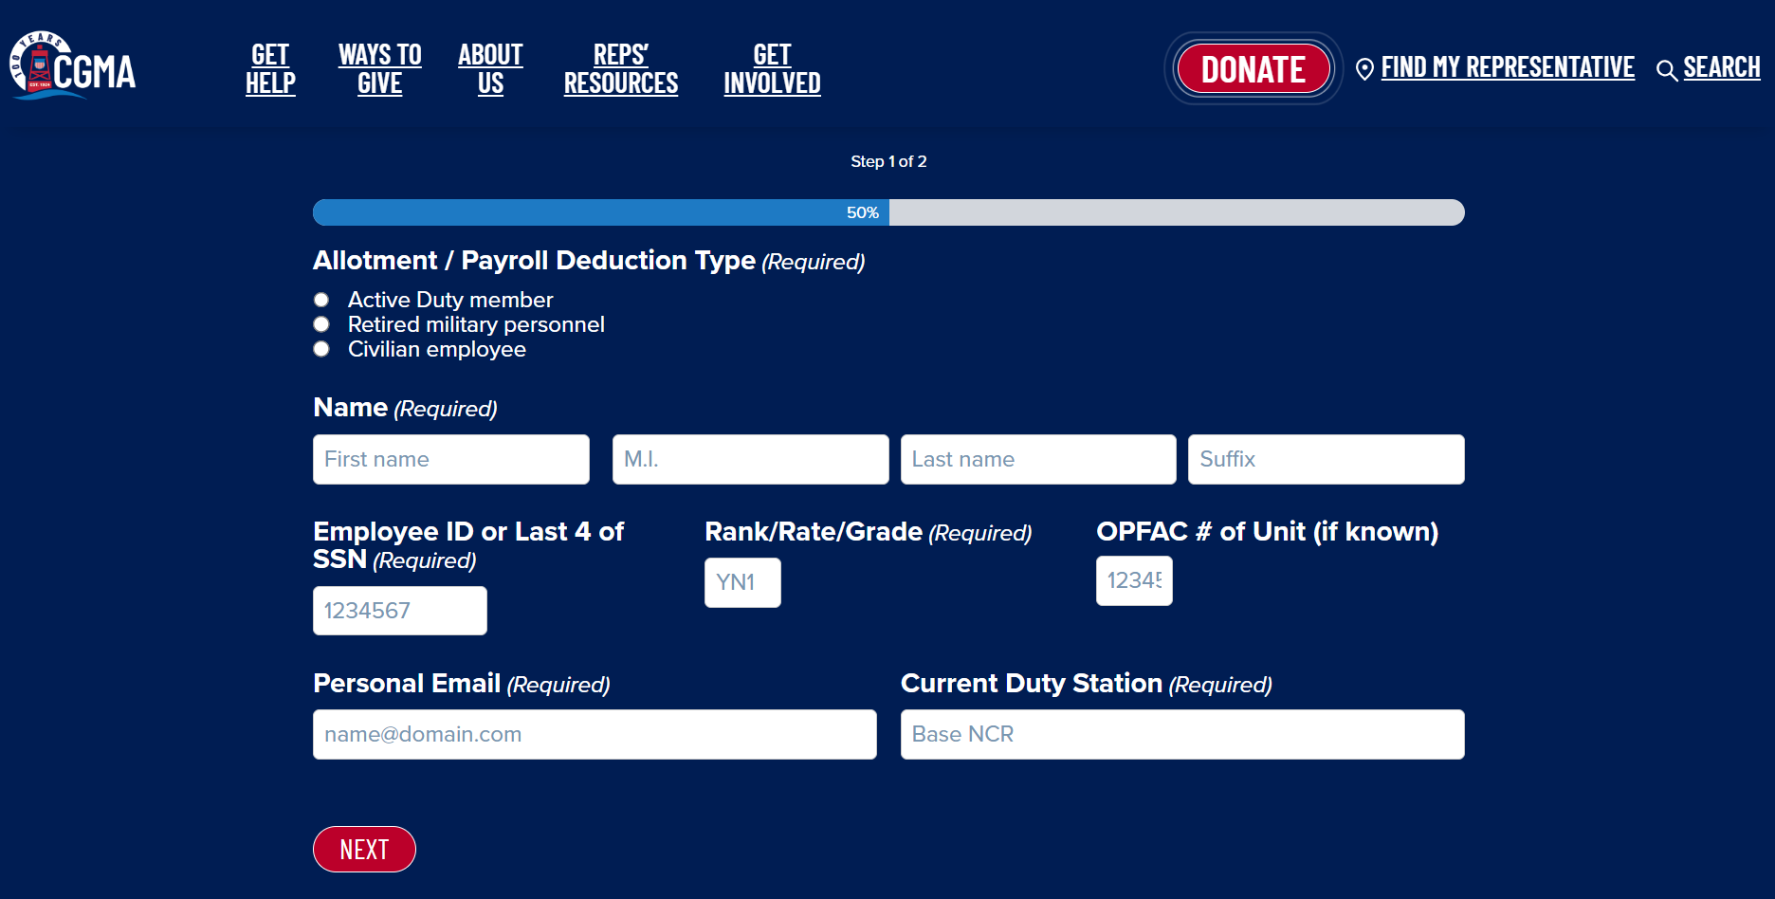
Notes:
Here's how people can sign up for or increase an allotment:
Step 1 is to fill out their personal information, including employee ID or SSN, Rank/Rate/Grade and OPFAC# of your unit.

Slide 22
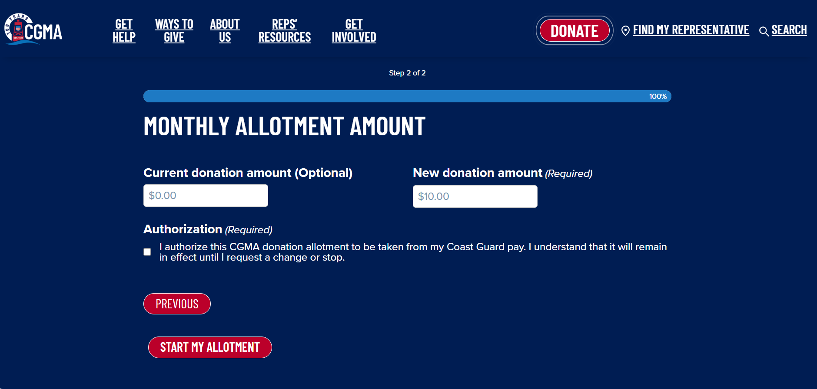
Notes:
Step 2: Need to add this

Slide 23
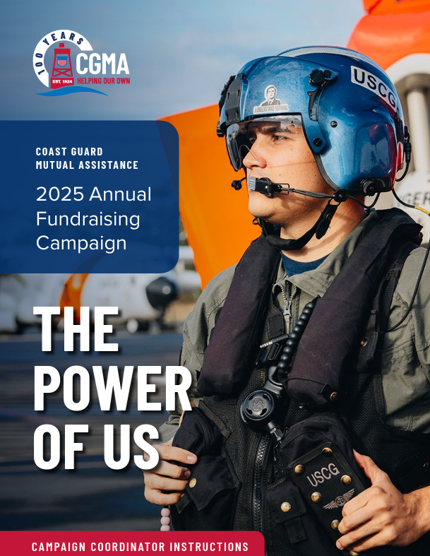
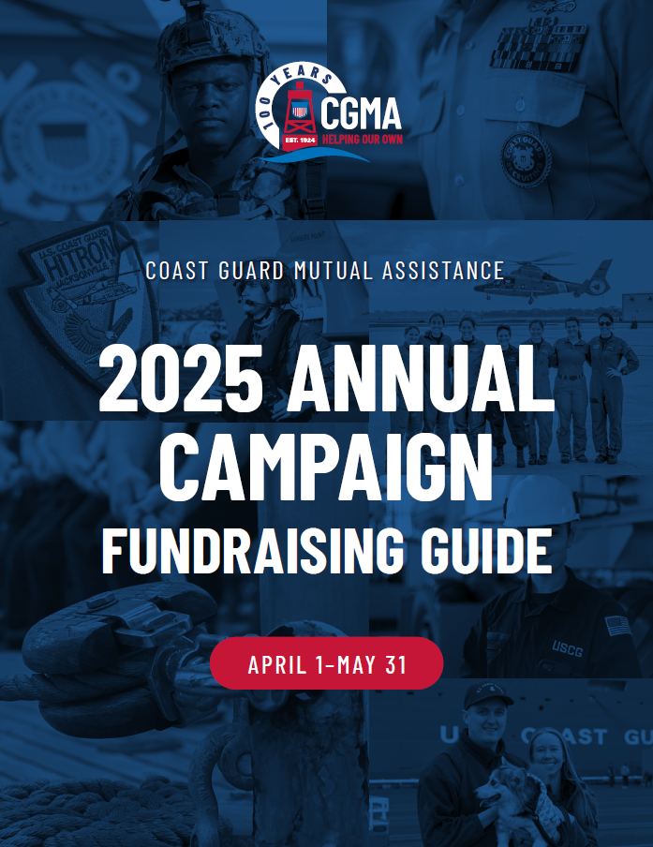
COORDINATOR RESOURCES
Coordinator Toolkit
All Hands Presentation
CGMA Video
Digital Media Kit
Coordinator Instructions
Key Worker Instructions
Fundraising Guide
Key Messages
Best Practices
FAQs
Unit Size/ Expected Attendance | Dollar Amount
25 or Under | $50
26-50 | $75
51-75 | $95
76-130 | $135
131-250 | $175
251-399 | $200
Over 400 | $250
Request Kickoff Event Funds with CGMA Form 32 on the Resource Site
MATERIALS AVAILABLE ON THE CAMPAIGN RESOURCE CENTER AT MYCGMA.ORG/ANNUAL-CAMPAIGN
Notes:
We’re providing several tools to help you run a successful campaign.
On the campaign resource center, you’ll find your Coordinator Toolkit.
The Toolkit includes:
The Campaign Kickoff Presentation for you to share with your team kicking off the campaign.
A social media kit you can raise awareness using your Intranet (if your base has one),
Your Coordinator Reference Guide will provide the process details for submitting completed pledge forms, ethics and standards around fundraising, and other key procedure items
A Fundraising Guide, which offers tips for your kickoff event, information about command support, and ideas for fundraising events.
The Fundraising Guide also includes key messages and best practices for a successful campaign
FAQs for you to use when speaking with your shipmates
A weekly social media kit to help keep messages fresh throughout the campaign

Slide 24
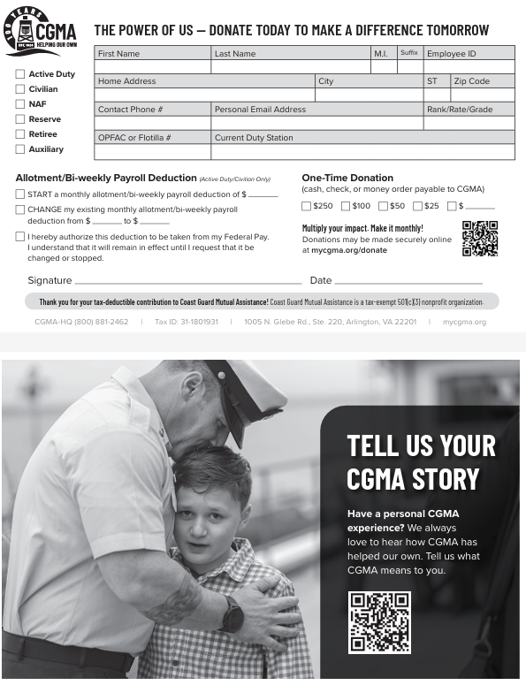
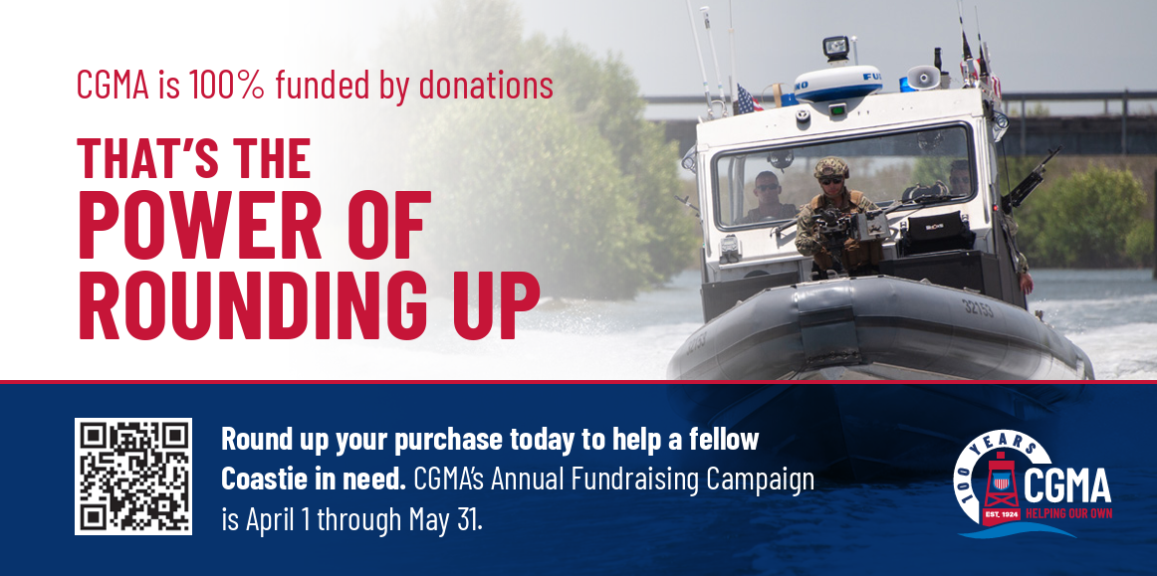
CAMPAIGN MATERIALS
Campaign Materials
Pledge Forms
Posters
Flyers
MATERIALS ARRIVE MID-MARCH
Notes:
If you haven’t already, you’ll also receive a box of campaign materials
The box will include including posters, flyers, and pledge forms.
These materials will ship in in mid-March
Please be sure to hang posters them in high traffic areas before the campaign launches to raise awareness, and hand out pledge forms and flyers in your kickoff meeting and other events.

Slide 25
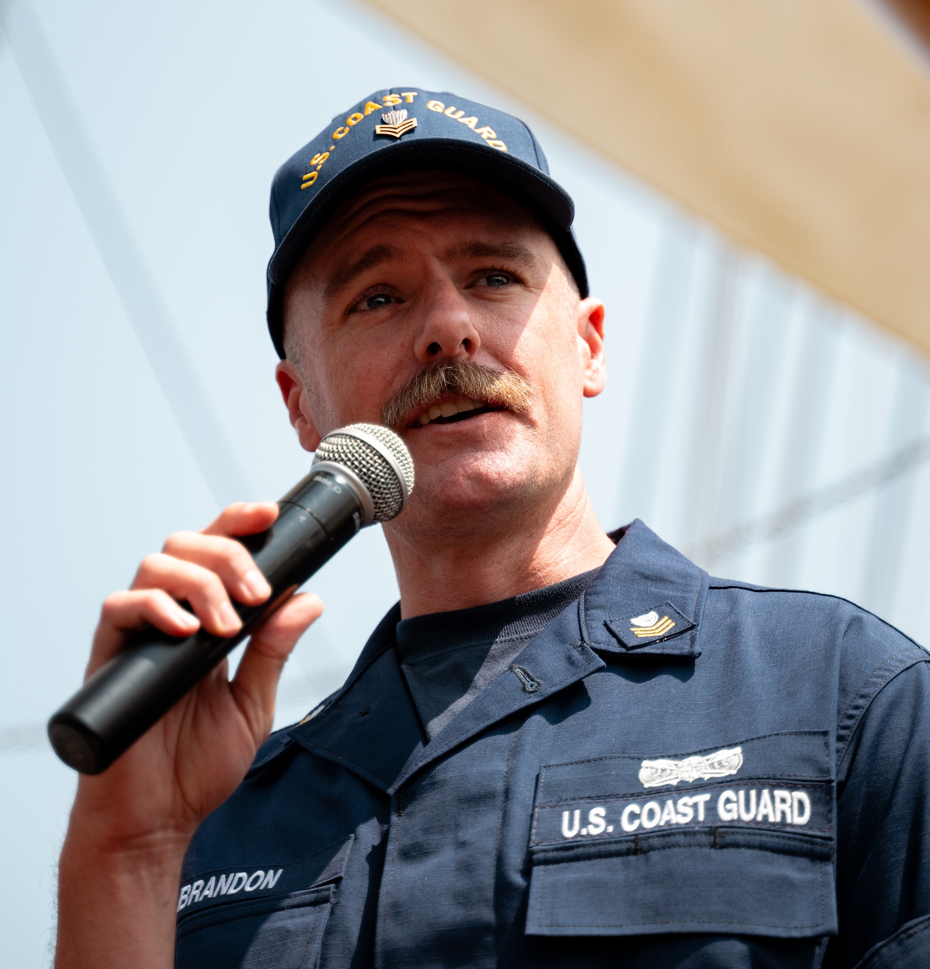
PLANNING YOUR CGMA CAMPAIGN ALL-HANDS
Hold your CGMA Campaign during April
Show CGMA 5 minute video;
Run through CGMA Campaigns All Hands Powerpoint
Arrange for location, refreshments and decorations
Ask your CO/OIC to kick off the meeting, or line up a keynote speaker
Announce the All Hands well ahead of time in the Plan of the Week, calendar invitation, or other local communication
Arrange for Public Affairs/media coverage, if appropriate
Have the FAQs on-hand so you can answer any questions
AGENDA
Opening Remarks
About CGMA
Why Give?
Keynote Speaker
2025 Campaign Goals
Ways to Participate
Q&A
Call to Action
Notes:
Your kickoff meeting is the launch of your campaign and the best time you have to tell the CGMA story, so you want to be as prepared as possible.
Arrange for location, refreshments, decorations, etc. CGMA can provide funds to cover the cost of refreshments, banners, balloons, and other items. Refer to the Campaign Coordinator’s Reference Guide for instructions on how to request these funds.
Ask your CO/OIC to kick off the meeting or line up a keynote speaker. It’s also powerful to hear from someone who has received help from CGMA.
Announce the kickoff well ahead of time in the Plan of the Week, email calendar invitation, and other local communication medium.
Arrange for Public Affairs/media coverage, if appropriate
Develop a program for the event. For example:
Welcome and Opening Remarks. It would be a great idea to have your CGMA Rep attend and open the meeting with you and your CO/XO
About CGMA – Who We Are and What We Do. Again, your CGMA Rep would be a perfect person to deliver this with you and answer any questions
Why Give – Reiterate that the Coast Guard community is the sole recipient of assistance as well as the primary funder of CGMA
Keynote Speaker/Testimonial If you know of anyone who would be open to sharing how they have used CGMA assistance, ask them to share their story.
Campaign Goals – Fundraising Target for 2025 – each unit has a goal this year. Your CO is aware and can share this with you.
Ways to Participate
Q&A
Closing and Call to Action

Slide 26
CAMPAIGN BEST PRACTICES
Establish Connections
Share personal impact stories or share stories of how CGMA has helped others (do not use client names unless you have permission to do so)
Build one-on-one connections through conversations and direct appeals
Tailor your message to your unit
Reference emails and endorsements by leadership and leverage leadership support
Build Awareness and Create Opportunities to Donate
Host small fundraising events (e.g., Chik-fil-a or Krispy Kreme sales, Plank Challenge, Pie-in-the-Face Challenge)
Display Visual Reminders (e.g., put posters up in highly trafficked areas)
Leverage Local Social Media Groups (e.g., Facebook) to spread the word and encourage participation
Celebrate participation and milestones – publicly thank individuals who have signed up or increased their allotments (with their permission).
Share progress updates with your team to build momentum and foster a sense of accomplishment.
Notes:
As I said, the Fundraising Guide includes Best Practices for a successful campaign.
These includes recommendations for establishing connections with the people you’re presenting to and speaking with one-on-one.
One of these is tailoring the message to your unit. You know your unit best.
When you receive the kickoff presentation, you’ll be able to adjust your message to make it as impactful as possible.
The Guide also includes recommendations for building awareness and creating opportunities to donate.
Again, you can tailor these to what will work best for you and your location.

Slide 27
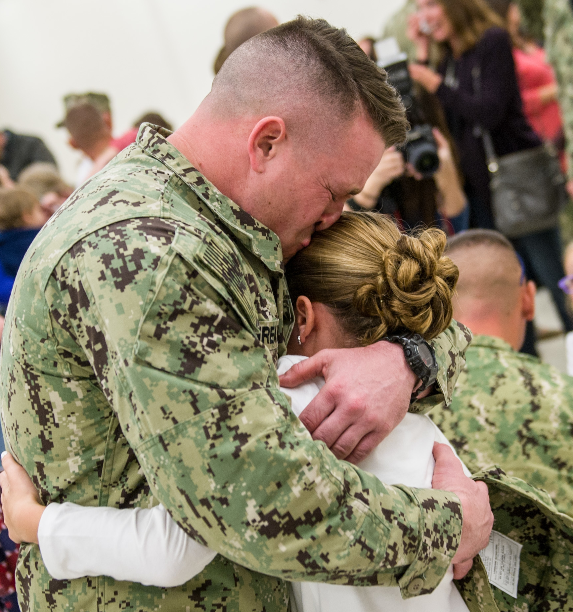
TIMELINE
Mid-March
Campaign materials ship
April 1
Annual Fundraising Campaign launches
April 1-30
Hold CGMA Campaign All Hands
Throughout the Campaign
Weekly emails
May 31
Annual Fundraising Campaign ends
Notes:
Lastly, we’ll just review the timeline.
You should receive your materials in Mid-March
The campaign launches April 1
Your CO/XO should be scheduling your kickoff meeting, so connect with them to coordinate the meeting
Throughout the campaign, you’ll be sharing updates with us on your progress
May 31 the campaign ends

Slide 28
Q&A

